Slide 1
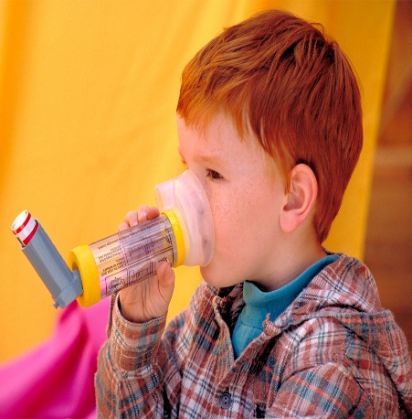
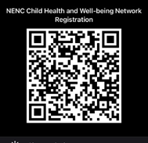

Beat Asthma Friendly Schools Accreditation.
Carol Barwick
Clare Caygill
Nichola Jackson
Community Asthma Advisors
North East and North Cumbria’s Child Health and Wellbeing Network
Feel free to Tweet throughout @EveryChildNENC and join our Network here via the QR code

Slide 2
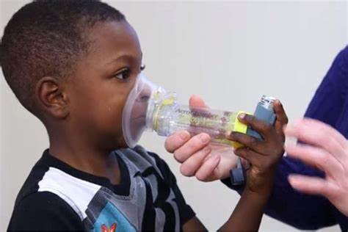
Asthma
Asthma is the most common long term medical condition in children and young people.
Around 1 in 11 children live with asthma.
Outcomes for children and young people living in deprived areas are worse.
The UK has one of the highest emergency admission rates for asthma in Europe.
There are over 25,000 emergency hospital admissions for asthma amongst children a year in the UK.
Asthma is a main contributor to school days lost.
(National bundle of care for children and young people with asthma September 2021. )
Notes:
Read information from slide
Also discuss that in every school class 2-3 children young people will have asthma

Slide 3

Effects of Asthma on Education
Children with persistent, uncontrolled or severe asthma are more likely to miss school, compared to children with mild asthma.
Children who have been in hospital for asthma had more time off school and this is the likely cause of their poorer educational attainment particularly KS1
Research shows having a diagnosis of asthma is a risk factor in dropping a grade between mock and final exams.
Uncontrolled asthma can lead to decrease academic performance
Every September, more children are rushed to hospital due to their asthma than at any other time of the year.
Research studies suggest that asthma is responsible for up to 18% of school absences, with evidence improved asthma control improves school attendance and performance.
A Survey found that 86% of children with asthma have at some time been without an inhaler at school.
Notes:
Read the slide information

Slide 4
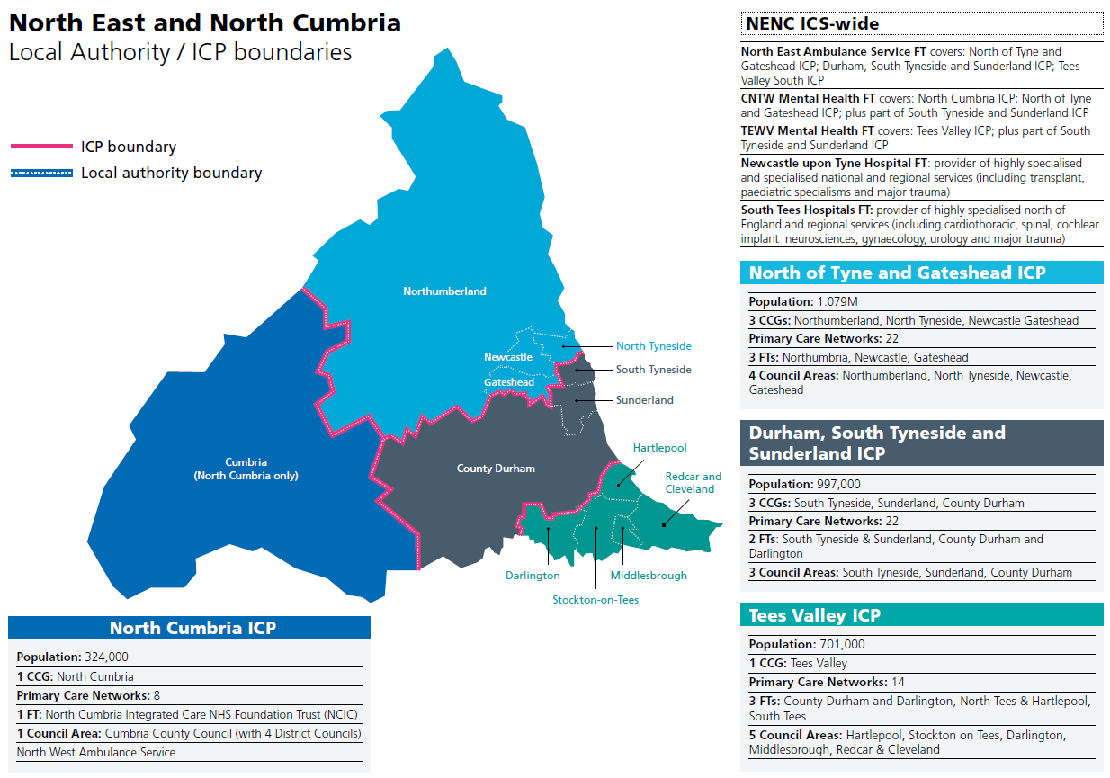
North East and North Cumbria Integrated Care System
Notes:
Reflect that this is outdated in relation to the terminology but still effectively demonstrates the vast geography and contextualise this in relation to Health Inequalities and factors of deprivation
Explain this is the new ICS area map and the aim is to promote uniformity of asthma care for children and young people across the area. Each area has specific needs depending upon the different cultures, level of deprivation and geographical position.
NENC created by the ICS in 2018, made up of individual organisations working together in partnership to improve health and care.
Northern England Clinical Networks brings together clinicians and healthcare and other professionals staff from different services, organisations, sectors and geographies. Drive to improvement in the quality and equality of healthcare for the NENC 3.1 million population.

Slide 5
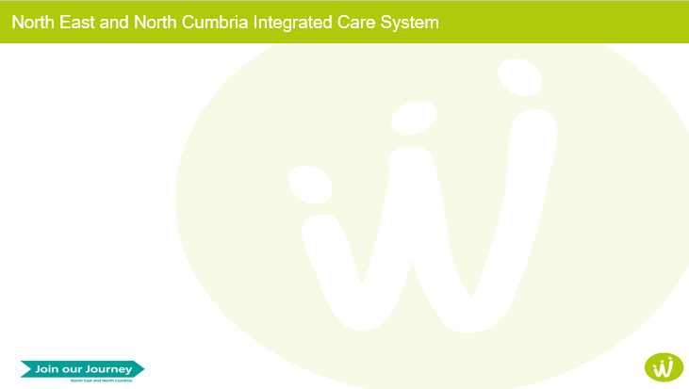
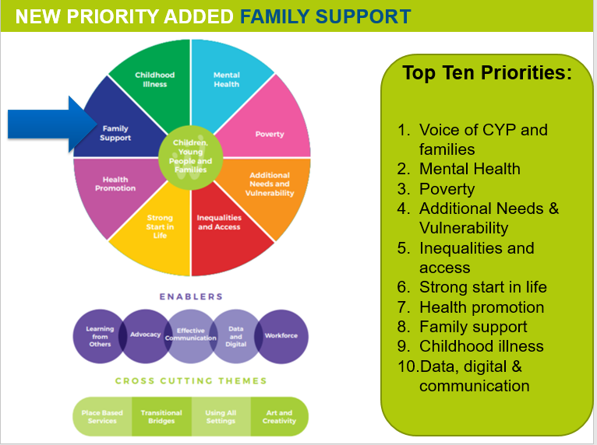
NHS England and NHS Improvement ambition is to reduce avoidable harm to children and young people from Asthma and improve the quality of life.
Taking a whole system approach to asthma management.
Addressing environmental tiggers
Education programme
Personalised care ( individual asthma plan/known as PAAP)
Effective preventable medicine
Improved accuracy of diagnosis
(National bundle of care for children and young people with asthma September 2021. )
Notes:
Read through the slide and NHS England and NHS Improvement aims.
Whole system approach the aim is to try and ensure everyone who has contact with a CYP with asthma has an positive influence on their care.
Strongly supports the Child Health and Well Being priorities.
Also the Vision of the CHWN
“ In the North East and North Cumbria we believe that all children and young people should be given the opportunity to flourish and reach their potential, and be advantaged by organisations working together”

Slide 6
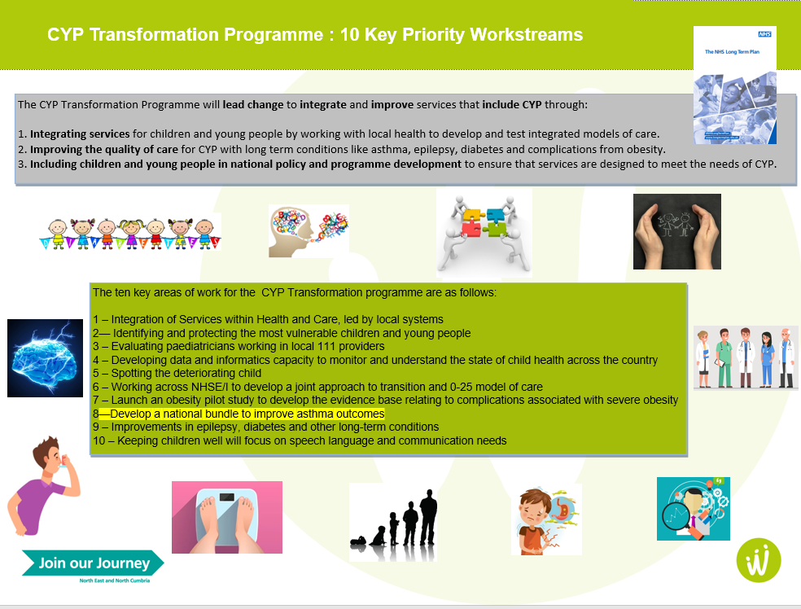
Notes:
The Vision for the CHWN NENC
Whole system approach the aim is to try and ensure everyone who has contact with a CYP with asthma has an positive influence on their care.
Strongly supports the Child Health and Well Being priorities.
Priority 8 and 9 are about improving asthma care.

Slide 7
Notes:
Discuss the asthma pathway each section.
Environmental parental smoking needs to be discussed by all professionals at all levels. Assessment and education provided and support services available discussed. Dangers to the child and young person. Smoke free zone outside schools PHSE session in school to educate CYP dangers of smoking and vaping.
Housing Home conditions damp/ mould in homes Consider the cleaning products/ chemicals used within the home. Air fresheners/ candles /diffusers and deodorant sprays.
Air pollution Traffic/ industry/ high pollen count/ traffic near schools. Discuss example and Living streets report/moving to inside of pavement reduces pollution. Reducing traffic nears schools/ stopping cars engine running and waiting at the school drop off and pick ups away from schools if possible.
Early diagnosis need clear and accurate diagnosis and documentation. Universal clear pathways and guidance for CYP . Newcastle is the regions Tertiary centre.
Improving awareness of asthma is key, linking with education , sports clubs etc . Promoting Beat asthma and Healthier together websites and resources. School to discuss with parents any concerns regarding a CYP asthma and liaise with GP/ practice nurse or Respiratory nurse specialist. Being able to recognise signs and symptoms of asthma for those may not have a diagnosis.
Effective preventable medicine ensuring the correct training / awareness sessions. Schools to ensure PAAP are in place for all CYP and all staff members are aware. Regular assessment of inhaler technique and training. Discuss triggers and stresses. All CYP who have more than 3 reliever inhalers in 12 months need to be reviewed more frequently.
Management of exacerbation. The aim is to manage asthma effectively in Primary care .Standards for Emergency/ Urgent care for assessment/ treatment / referrals and discharge. School can play a key part in monitoring CYP attendance and liaising with parents/ carers and professionals involved.
PAAP in school for every CYP with asthma, asthma reviews and inhaler techniques to be checked.
Assessed for risk of Severe asthma attack. All school staff to be aware of any CYP with a diagnosis of severe asthma
Improve electronic care communication between Secondary and Primary care.
48 hours asthma review post discharge.
Severe asthma referral criteria and pathway. Service model for severe asthma. Transition from CYP to adult services. Expected outcomes for Severe asthmatics. Developing standardising and updating educational resources. New therapies research and development is ongoing.
CYP having the right inhaler in school is really important and emergency contact numbers are up to date.
Exacerbation all staff had training/ awareness session to ensure they can provide the CYP with the best care and support.

Slide 8
Asthma & Allergy/ Anaphylaxis Education Survey results January 2022
198 responses (from approximately 1440 schools) all ICS area contributed.
The survey was completed by various school team members.
Half the results were from Primary Schools.
Over 70 schools said they did not have an asthma policy .
69 Schools did not have a asthma lead.
111 schools would like further training.
125 schools would like to explore the possibility of being a asthma friendly school.
Notes:
Discuss the survey information slide.
Over 70 schools had an asthma policy schools may have had an asthma statement rather than a policy .
111 said they would like further training but had the other schools already had training or had an annual training programme /updates in place.
125 schools said the would like to explore the possibility of being asthma friendly schools but school may have been unsure of the commitment or expectations required.

Slide 9
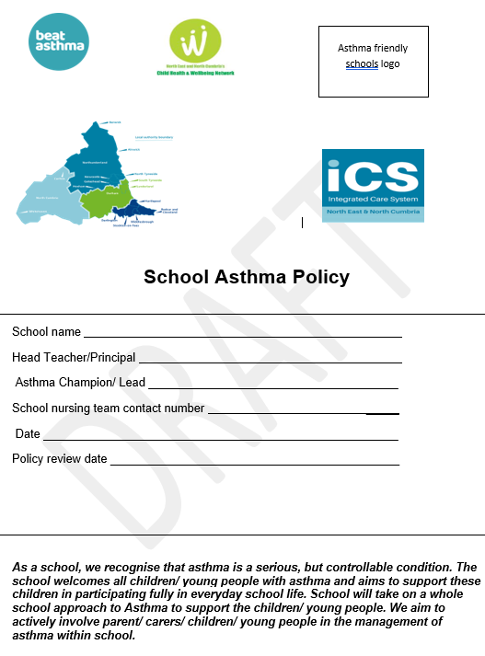
Beat Asthma Friendly Schools Criteria
Notes:
Example showing the Beat asthma friendly school policy and accreditation package.

Slide 10
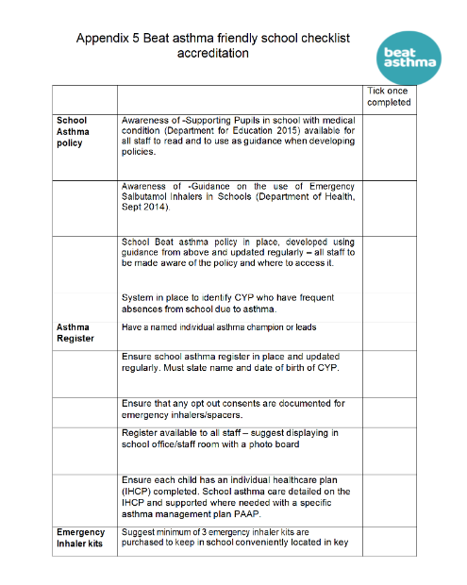
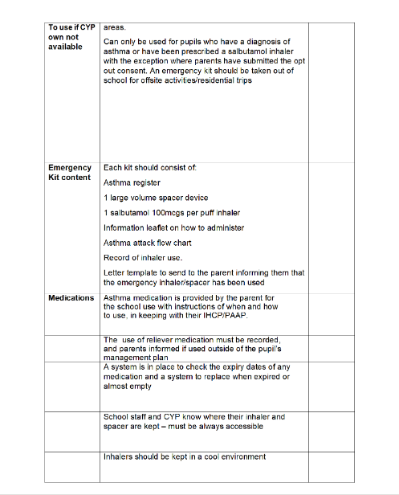
Beat Asthma Friendly Schools Accreditation
Notes:
Discuss and enlarge the beat asthma friendly school framework criteria.
Makes your school a happy safer place for CYP with asthma .
Accreditation includes aims to build on the good practice already being undertaken in schools to support CYP and improve their asthma care.

Slide 11
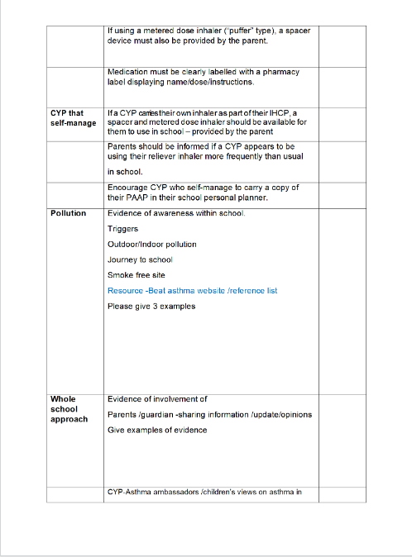
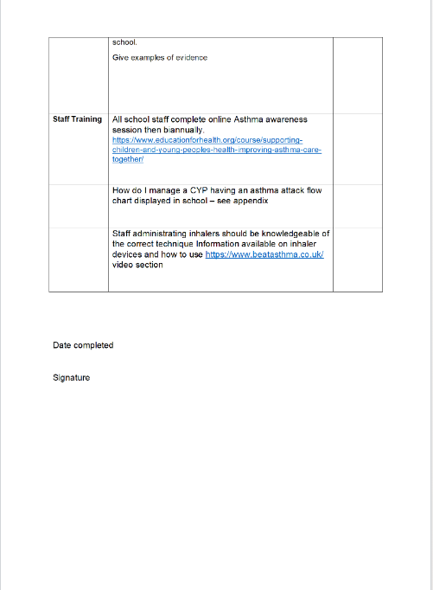
Beat Asthma Friendly Schools Accreditation (contd)
Notes:
Discuss and enlarge the beat asthma friendly school framework criteria.

Slide 12
Who will be Involved
Parent/ Care
CYP
Children and Young people
Education (asthma friendly schools)
Social care
Health School nurses/ Health visitors / community nurses
Gps /practice nurses
Asthma nurse specialist/ Paediatricians Hospital
Notes:
Examples of who can be involved to support CYP and the whole school community approach to improve asthma care for CYP.

Slide 13
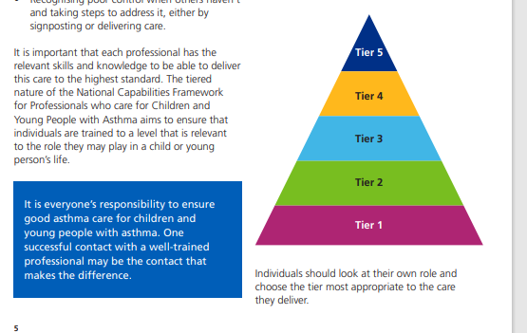

Asthma Awareness Sessions
Individuals and professionals will be divided into to different Tiers for awareness sessions.
Tier 1 session includes a 45 minutes online session with multiple choice question to check the individuals knowledge and understanding. This training is free to complete.
Tier 1 Social care, housing support officers, teaching staff and leaders of children’s clubs (cubs, sports, after school clubs, children’s centre staff)
Different tiers will have different requirements for the training/ awareness required.
Education awareness session link Tier 1
https://www.educationforhealth.org/course/supporting-children-and-young-peoples-health-improving-asthma-care-together/
Notes:
Discuss slide information Tiers 1-5 awareness training . The aim is to complete the training awareness session most appropriate to your role and knowledge.

Slide 14


Next Steps for Beat Asthma Friendly Schools
Task and Finish group meeting19/07/22
Regional Beat asthma friendly schools policy uniformity across the whole ICS area
Beat asthma friendly schools pilot Primary whole ICS, Secondary Gateshead area from September 2022
Review pilot and adapt as needed.
Develop timeline following Beat asthma friendly school
pilot to roll out to all ICS areas.
Notes:
Discuss slides

Slide 15
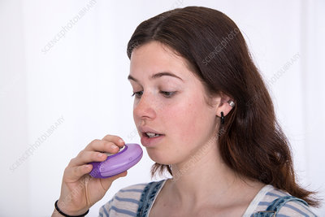
Any Questions ?
Thank You
Please help us to improve asthma care for children and young people.
Asthma friendly schools logo
Notes:
Thank you for your time. Please feel free to ask any questions ?

Slide 16
Resources/ References
https://www.england.nhs.uk/publication/national-bundle-of-care-for...
National bundle of care for children and young people with asthma
National bundle of care for children and young people with asthma: resource pack
Beat Asthma https://www.beatasthma.co.uk
NICE guidance (2017)
https://wwwAsthma + Lung UK (blf.org.uk).evidence.nhs.uk/search?q=ASTHma+guidelines+in+children
BTS Sign (2019)
https://www.brit-thoracic.org.uk/document-library/guidelines/asthma/...
National-Capabilities-Framework.pdf (e-lfh.org.uk)
Healthier together
Home :: Healthier Together (what0-18.nhs.uk)
Asthma and Lung UK
Asthma + Lung UK (blf.org.uk)

Slide 17
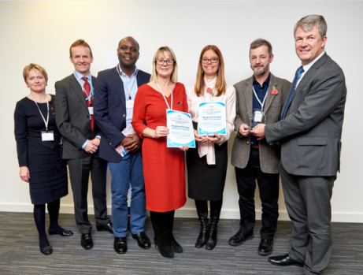
Thank you and stay in touch
Please follow, share and retweet relevant work so that we can continue to share good practice across the region at the child health and wellbeing network handle @EveryChildNENC
Visit our website - https://nhsjoinourjourney.org.uk/what-we-are-doing/priorities/optimising-health-services/child-health-and-wellbeing-network/
Please encourage colleagues from all areas of the child health and Wellbeing Network to register with england.northernchildnetwork@nhs.net so they are included in our communications and feed into the workplan projects that they are interested in.
Notes:
Please follow, share and retweet relevant work so that we can continue to share good practice across the region at the child health and wellbeing network handle @EveryChildNENC

