Slide 1
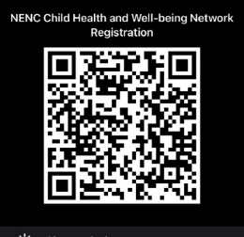

North East and North Cumbria’s Child Health and Wellbeing Network
Feel free to Tweet throughout @EveryChildNENC
and join our Network here via the QR code

Slide 2
Child Health and Well Being Network NENC
Asthma Leadership Group ( NENC ICS)
Dr Samantha Moss (Clinical Lead)
Mrs Louise Dauncey (Delivery Manager)
Dr Neelmanee Ramphul (Consultant Paediatrician )
Dr Ahmed Hegab (Consultant Paediatrician)
Carol Barwick (Lead Community Asthma Advisor)
Dr Andrew Bright ( Anaphylaxis)

Slide 3
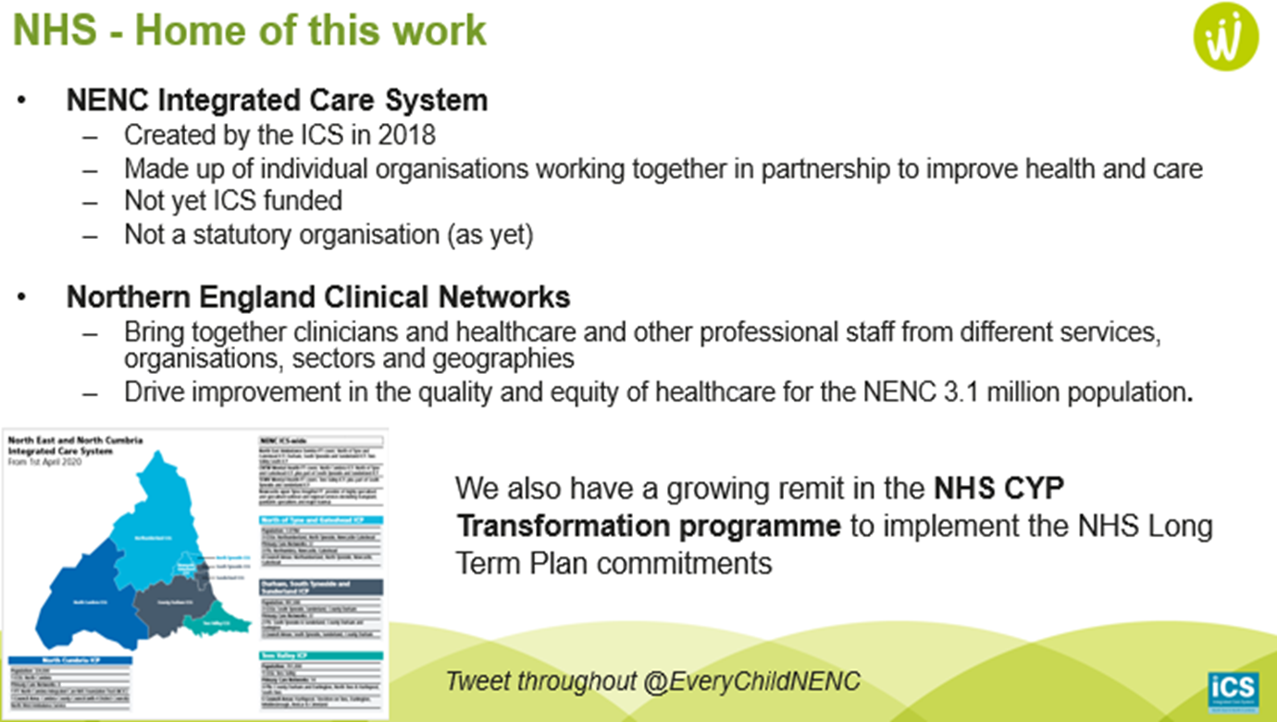
Child Health and Well Being Network NENC
Notes:
The NENC ICS is a partnership of organisations including local councils, voluntary and community services that provide health and care across our region.
Clinical networks focus on priority service areas to bring about improvement in the quality and equity of care and outcomes of the population, both now and in the future.

Slide 4
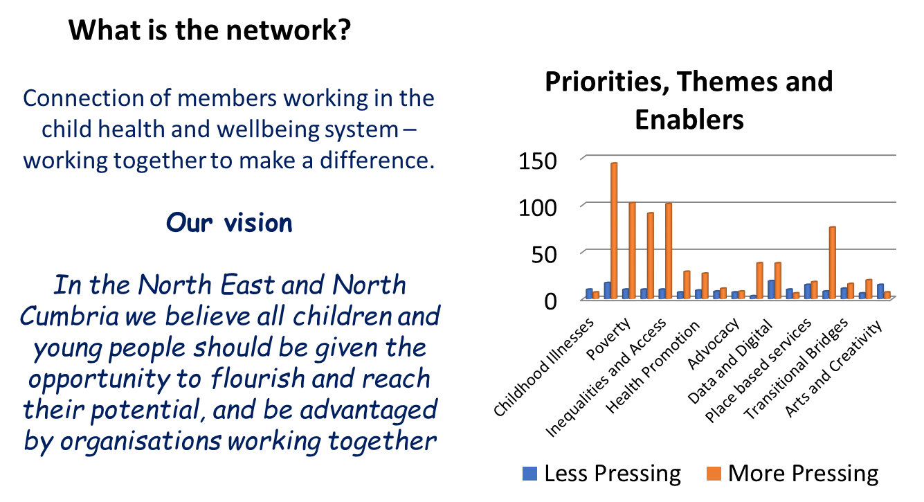
Child Health and Well Being Network NENC
Notes:
Read slide

Slide 5
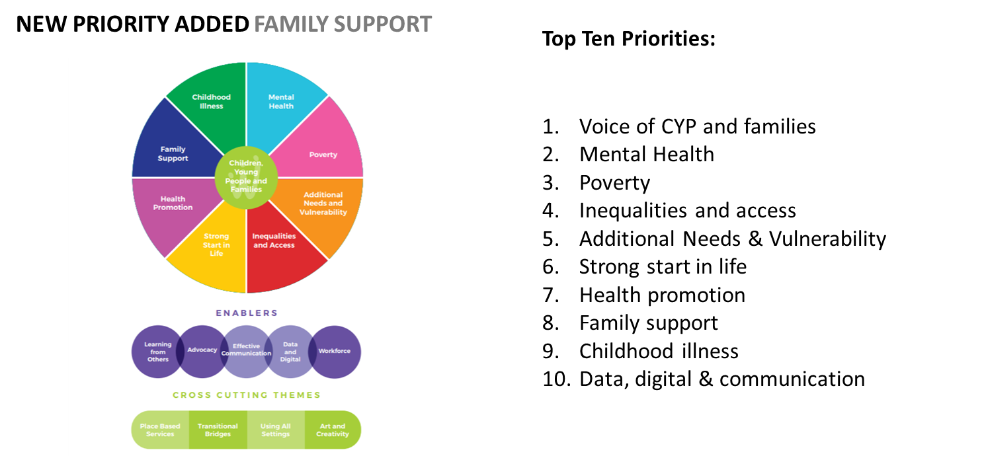
Child Health and Well Being Network NENC

Slide 6
Asthma
5.4 million people who suffer from Asthma in the UK
1.1 million children
Common chronic disease in children
Outcomes for children in the UK amongst the worst in the West
Outcomes even worse in the North East
Notes:
Most classes have between 2 and 3 children with asthma diagnosis.

Slide 7
What do we know already?
National Review of Asthma Deaths (NRAD) report (2013)
  28 deaths in young people < 19 years old
20 to 30 children continue to die per year
State of Child Health Report, Royal College of Paediatrics and Child Health (RCPCH): UK Asthma deaths (2017)
  17 deaths (0-14 years old)
  22 deaths (5-24 years old)
Healthcare Safety Investigation Branch (HSIB) Report :May 2021
Ongoing National Asthma and COPD Audit Programme (NACAP) Audit looking at care in hospital
Notes:
NRAD 2014 Asthma Kills – Review looking at 195 deaths, 28 were under 19 years old (recorded between Feb 2012-Feb 2013) 90% of deaths in the children under 19yrs considered avoidable.
Inappropriate treatment, no reviews, no asthma action plans and failure to recognise worsening asthma are major factors. It has been 10 years since these figures and despite their findings children continue to die.
There has been a small reduction in the total amount of deaths among children and young people as a result of asthma. In 2017, 17 0-14 year olds and 22 5-24 year olds died in the UK.
HSIB - investigation looked at the risks involved in the management of children aged 16 years and under diagnosed with asthma. Diagnosis and the management of asthma, particularly in children and young people, can be complex. It is important to get it right, as otherwise significant harm or death can result.
NACAP – clinical audit recommendations from children admitted to hospital. This is on going.

Slide 8
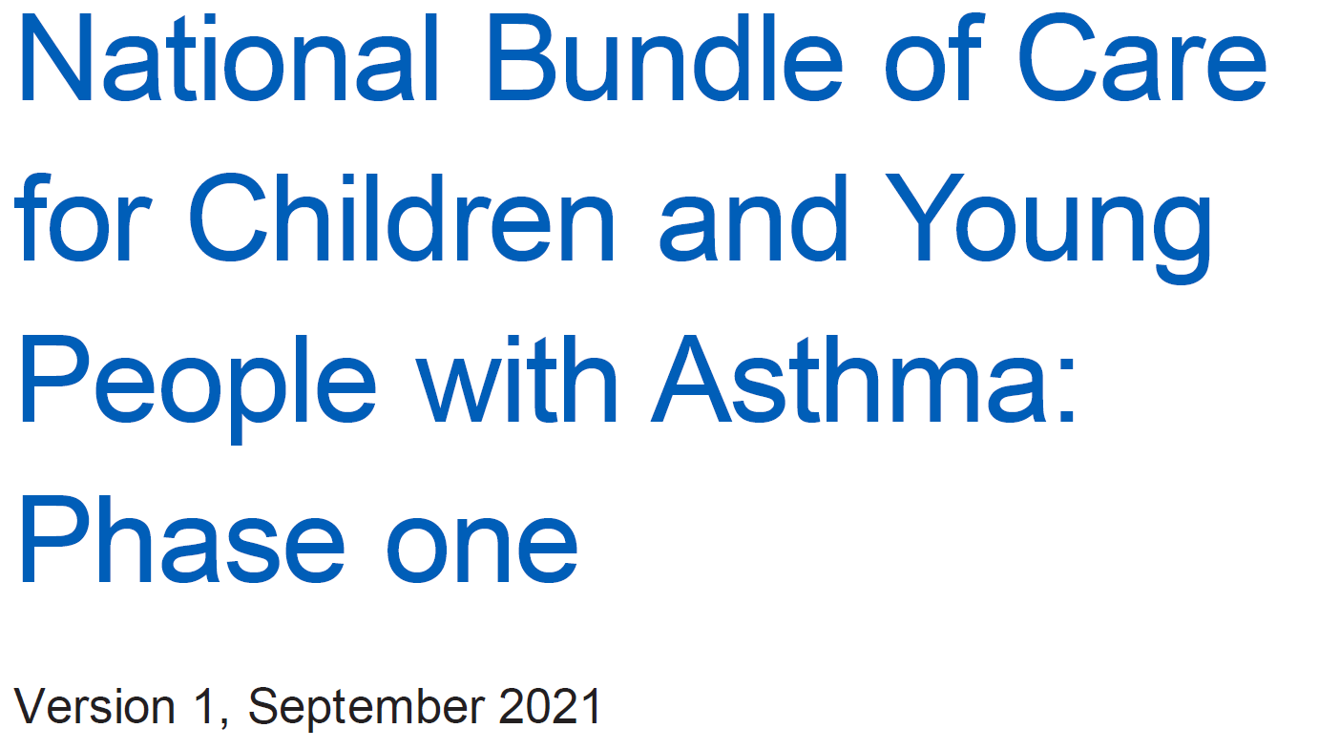
Notes:
The National Bundle of care for children with asthma is phase one of a plan to support integrated care systems to deliver high quality asthma care. A final and complete version was due in spring 2022 however this is not yet published. We are expecting this to be soon.

Slide 9
Focus of National Asthma Bundle
Whole system approach
Organisation of care and leadership
Environmental Impacts
Accurate and Early Diagnosis
Effective Preventative Medicine
Managing Exacerbations
Severe Asthma
Competencies/Training and Education Needs
Data and Digital
Notes:
NHS England and NHS improvements ambition is to reduce avoidable harm to children and young people from asthma and improve their quality of life. This will be achieved by taking a whole system approach to asthma management.
The focus of the bundle is divided in to different strands:
Organisation of care and leadership
Integrated care systems should have a named lead with asthma expertise who is responsible and accountable for the dissemination and implementation of asthma standards and good asthma practice.
Environmental impacts
All professionals should understand the dangers of air pollution, indoor air quality and parental smoking and ensure they discuss these risks.
Early and accurate diagnosis
Should be based on clinical features of a comprehensive history, diagnosis should be recorded in the notes and coded accordingly.
Effective Preventative Medicine
ALL children should have a PAAP. Prescription of inhaler should be appropriate and education given. Regular reviews should be undertaken.
Managing exacerbations
National standards will be published re. assessment/treatment/referral/discharge planning and f/up.
Severe Asthma
Each ICS should ensure that CYP with severe asthma should have access to a difficult to treat asthma service.
Training and Education
All people involved in the care of CYP should be trained to the appropriate level. Several Tiers.
Data and Digital
NHS data should be shared and used more efficiently. This can help identify variations in care, Prescribing and monitoring any changes that are implemented. This includes better use of remote consultations and asthma apps, making it easy for people to attend appointments and self manage effectively.

Slide 10
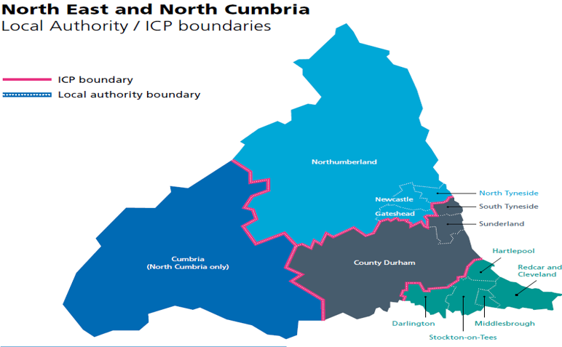
Primary Care Survey
104 responses from across the region
Online ( MS Forms)
20th December 2021 to 13th February 2022
Average completion time 10.5 minutes
Return rate of about 18%(around 570 GP Practices in NENC)
All areas represented
Notes:
The Asthma Leadership Group wanted to gain an insight in to what was already available in Primary care in the North East and North Cumbria. A questionnaire was devised and sent out in December 2021. Thank you for those who responded as we understand that this was sent during a difficult time. We do not underestimate the pressures of primary care.

Slide 11
Demographics of Respondents

Slide 12
Organisation and Leadership
13% of respondents had a lead role within the CCG or Primary Care Network
39% had a designated lead for Children and Young People
67% had a lead for respiratory conditions in general
39% have a link pharmacist
Notes:
Link pharmacists – hold sessions in practice for advice or questions.

Slide 13
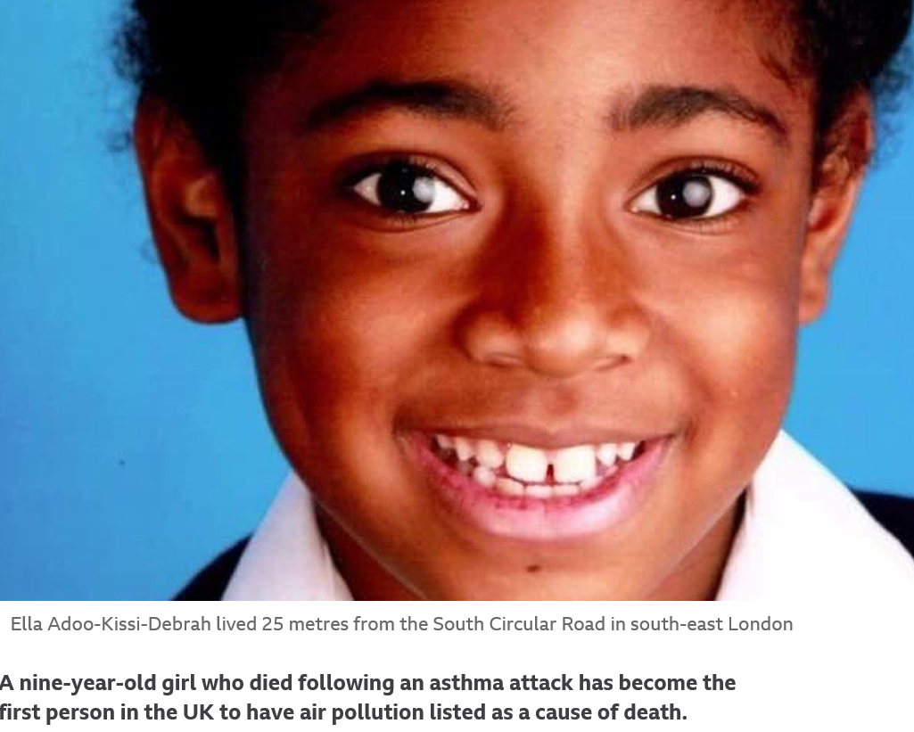
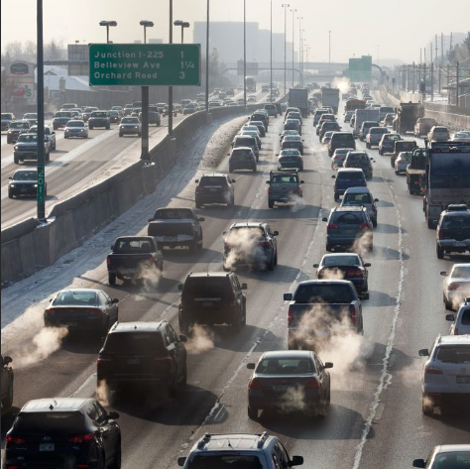
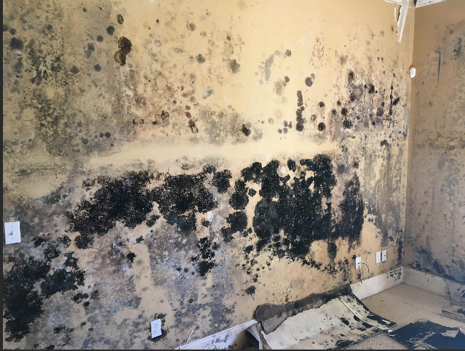

Environmental Impacts
Notes:
This young girl is the first asthma death where air pollution was recorded as a cause of death. Air pollution was a significant contributory fact to both the induction and exacerbations of her asthma. During the course of her illness between 2010 and 2013 she was exposed to levels of nitrogen dioxide and particulate matter in excess of WHO guidelines. The principal source of her exposure was traffic emissions.
Air pollution can be both indoor and outdoor such as - smoking, moulds, wood burning stoves, perfumes, plug ins, cleaning products, paints etc. and is associated with:
Higher incidence and prevalence of asthma
Asthma symptoms
Asthma attacks and hospitalisations

Slide 14

Environmental Impacts
76% of respondents recorded a smoking history in the household routinely
Notes:
Only 76% of respondents said that they recorded a history of smoking within the household however we should discuss smoking and the effects it has on asthma at any encounter.
Smoking and passive smoking increases:
Risk of poor asthma control
Hospitalisations for asthma
Risk of asthma death

Slide 15
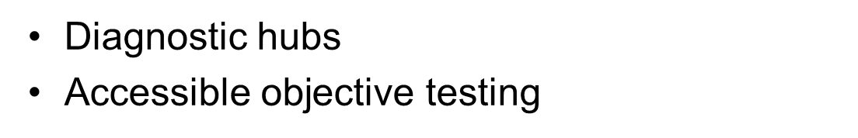
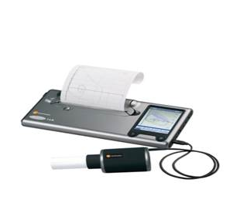

Accurate and Early Diagnosis
Notes:
Early and accurate diagnosis is the goal. We must get better at objective testing.
NICE recommend from 5yrs old however in reality this is 7-8yrs. However we would like to make objective testing more accessible for all, such as diagnostic hubs.
Objective testing is not just helpful for diagnosing but for monitoring also. Sometimes having a figure/number e.g. Peak Flow hits people harder rather than saying or explaining what poor control can look like.

Slide 16
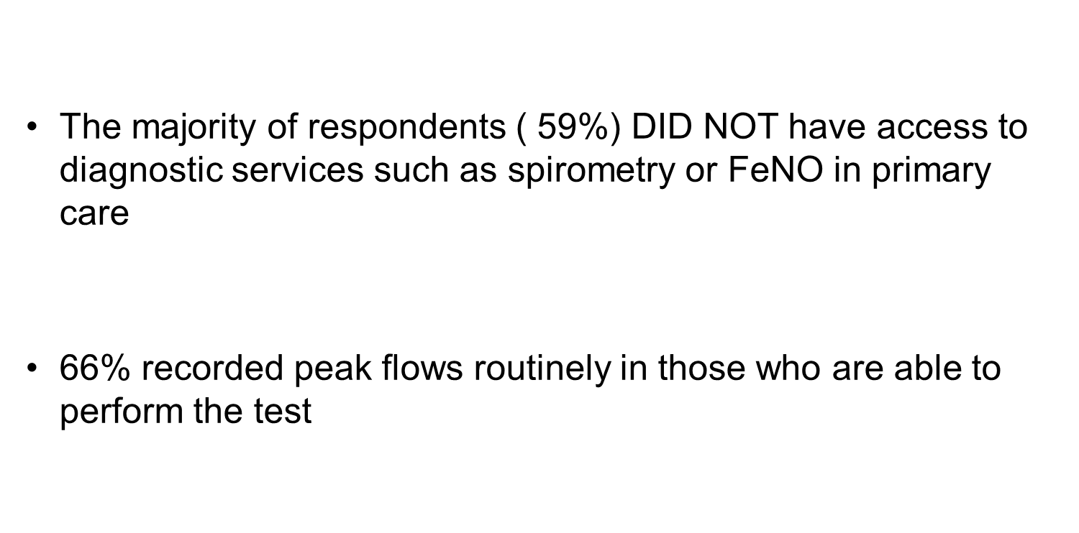
Accurate and Early Diagnosis
Notes:
Peak flow is good although not a substitute for spirometry or FeNO. Peak flow is good for monitoring.

Slide 17
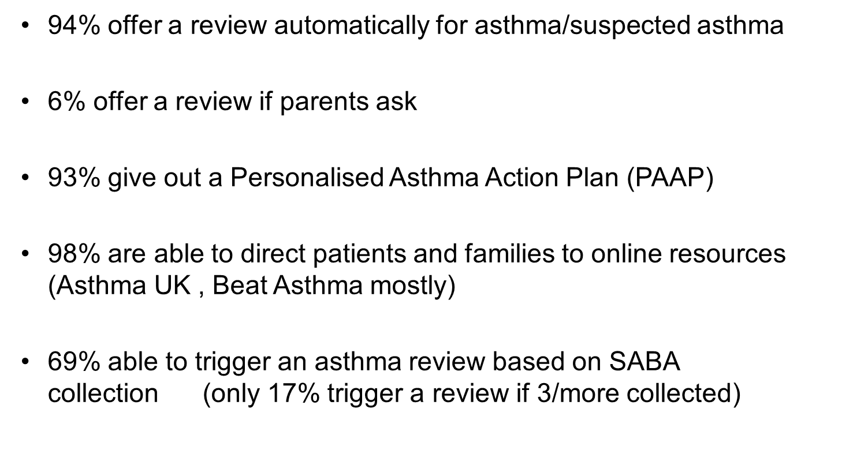
Prevention
Notes:
SABA – As recommended by BTS/SIGN guidelines we are hoping to encourage review if three or more are collected.
NACAP does not record if CYP have a PAAP on admission. This would be helpful to know – Dr Ramphul is auditing this at Gateshead.
Although a review is offered we are aware that CYP and parent/Guardians do not always take this offer up.

Slide 18
Managing Exacerbations
Majority ( 85%) aware that a 48 hours review is recommended post discharge after hospital attendance
Only 63% able to offer it
Main reasons:
    CAPACITY
    Sometimes communication raised as an issue (especially if seen on a Friday evening)
Notes:
If a Friday they will not receive a review within 48hrs. Electronic systems do not all link together.
We may need to look at models where this follow up is shared between primary and secondary care. We are aware this is a problem however there are important reasons for 48hr reviews – we need to ensure that CYP is improving . Trajectories should be that once a CYP has received steroids they should improve however this does not always happen.

Slide 19


Severe Asthma
Of those who identified themselves as leads, 67% were aware that they can refer directly into a severe asthma service in tertiary care if needed
Notes:
Our local tertiary centre is the Great North Childrens Hospital. Not all CYP need to be seen in secondary care for a referral to be made to tertiary care. GP’s can do this if the child meets the severe asthma checklist.

Slide 20
Training and Education
Most respondents ( 66%) were not aware that the National Asthma Bundle had been published
18% had access to paediatric asthma training ( 7% able to access yearly or more frequently than yearly)
The majority of respondents referred to BTS /SIGN and NICE guidance when needed
Notes:
As part of the Asthma bundle of care there are recommendations for training. There are 5 tiers.
The training will be aimed at what care you give not merely what profession you are.
BTS/SIGN and NICE guidance however GINA can also be referred to.

Slide 21
Data and Digital
61% had a guideline/policy of when to refer into secondary care
50% audit how many annual reviews are conducted
39% audit the number of patients who have a PAAP
28% audit the number of courses of oral steroids prescribed per patient per year and the number o unscheduled hospital attendances per patient per year
11% audit the number of 48 hours review conducted
39% have a link pharmacist who can monitor SABA collection
Notes:
There is a working group currently looking at referral pathways for primary/secondary and tertiary care.

Slide 22
Positive Findings in Primary Care
Good use of PAAP
Annual review offered to the majority
Families are being directed to web based resources
Awareness of the importance of the 48 hours review
Notes:
Awareness of need for 48hr review even if not in place.

Slide 23
Areas for Improvement
Better access to Paediatric Asthma Training
Better access to diagnostic service
An URGENT need to address SABA overuse both to improve disease control and for sustainability
Better concordance check
A strategy to facilitate 48 hours review
Utilise every opportunity to deter smoking and exposure to smoking
Notes:
Smoking – we would hope to get closer to 90% in addressing smoking.

Slide 24

So, what next?

Slide 25
Training and Education
Working closer together to run education sessions/ training days across the North East and Cumbria
Understanding barriers
Exploring motivation to engage in further training across the board
Embed National Training Initiatives
Notes:
Training will not be based on occupation but rather how involved you are with asthma. For example a practice nurse seeing children in the surgery rather than GP may be working at Level 3 tier.

Slide 26
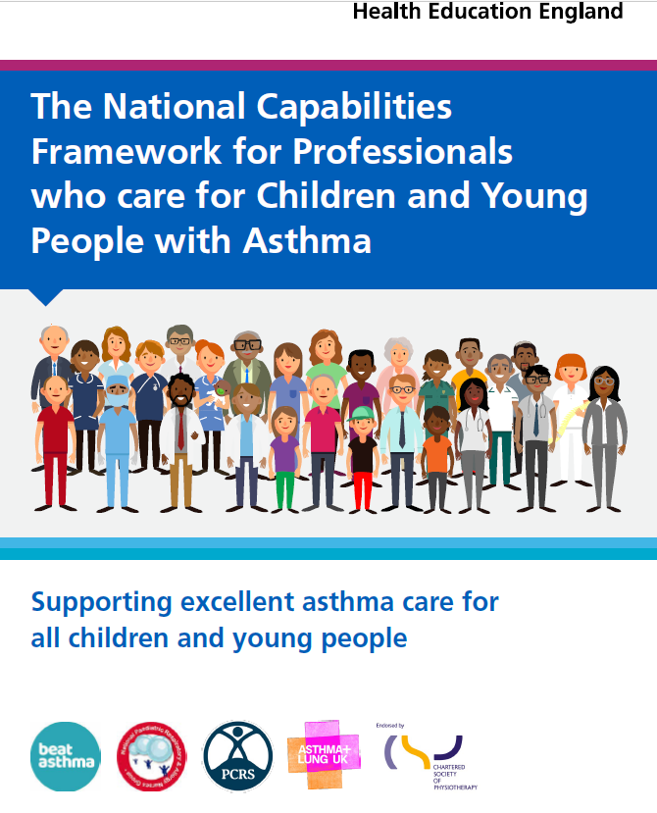
Training and Education
Notes:
Document outlining the different Tiers from 1 to 5. Up to date Asthma training may become part of a CQC inspection and may become mandatory.

Slide 27

Training and Education
Notes:
Discuss Tiers 1,2 and 3

Slide 28
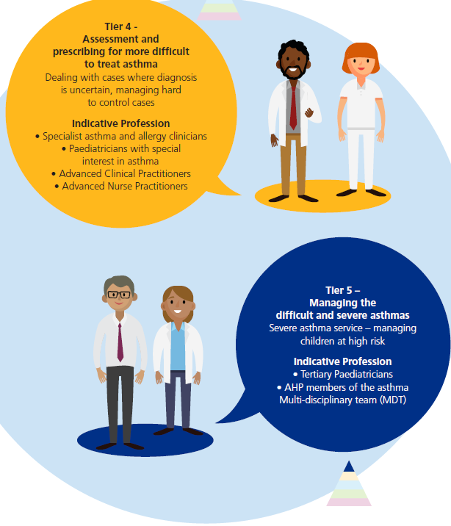
Training and Education
Notes:
Discuss Tier 4 and 5.

Slide 29
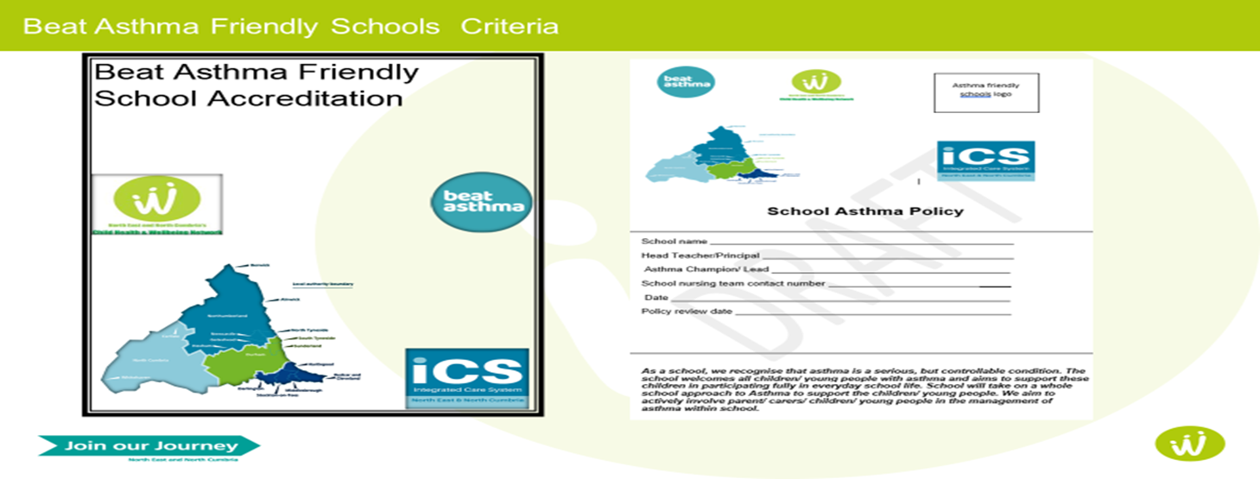
Beat Asthma Friendly Schools Criteria
Notes:
The Community Asthma Advisors are now launching the Beat Asthma Friendly Schools Pilot across the whole of the ICS area – one primary school in each area have been chosen to pilot the scheme. Training/awareness will be part of the accreditation. We are also working in partnership with the Gateshead asthma project who may pilot this in the secondary schools in Gateshead only. If this pilot is successful it will be rolled out to all schools across the ICS.
From this there may be an increase in children attending for asthma reviews and education linking with primary care if they have any concerns regarding children in their schools.

Slide 30



Maximise use of Regional Resources
Notes:
We want to maximize the use of regional resources we have available locally. Beat anaphylaxis – most asthmatics will also have allergies.

Slide 31





Recommended Resources For Asthma
https://www.beatasthma.co.uk/
https://www.nenc-healthiertogether.nhs.uk/
https://www.asthma.org.uk/
https://www.itchysneezywheezy.co.uk/
Notes:
Itchy sneezy wheezy – hay fever generally doesn’t exist on it’s own – close link to asthma.

Slide 32

Conclusion
Our role is to promote and work together to help embed the National Bundle Of Care for CYP with Asthma

Slide 33
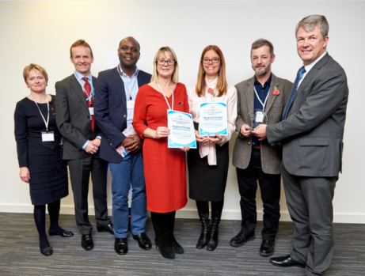
Thank you and stay in touch
Please follow, share and retweet relevant work so that we can continue to share good practice across the region at the child health and wellbeing network handle @NorthNetChild
Visit our website - https://nhsjoinourjourney.org.uk/what-we-are-doing/priorities/optimising-health-services/child-health-and-wellbeing-network/
Please encourage colleagues from all areas of the child health and Wellbeing Network to register with england.northernchildnetwork@nhs.net so they are included in our communications and feed into the workplan projects that they are interested in.

