Slide 1
NECPAAC
6th June 2023

Slide 2
Workshop 4 – Recognising Uncontrolled Asthma
-Dr Neelmanee Ramphul
Consultant Paediatrician, Gateshead Health NHS Foundation Trust
-Dr Arshid Murad
Consultant Paediatrician, South Tees Hospitals NHS Foundation Trust
-Dr Elizabeth Mclellan
Consultant Paediatrician, Great North Children’s Hospital, Newcastle

Slide 3
Aims and Objectives
Recognising uncontrolled asthma
Escalation
Management according to BTS guidelines
Referral pathways

Slide 4
Recognising uncontrolled asthma

Slide 5
BTS definition: Uncontrolled asthma
describes asthma that has an impact on a person's lifestyle or restricts their normal activities.
Symptoms such as coughing, wheezing, shortness of breath and chest tightness associated with uncontrolled asthma can significantly decrease a person's quality of life and may lead to a medical emergency.
Questionnaires are available that can be quantify this.

Slide 6
BTS guideline: Uncontrolled asthma
Uses pragmatic thresholds to define uncontrolled asthma:
3 or more days a week with symptoms
or
3 or more days a week with required use of a SABA for symptomatic relief
or
1 or more nights a week with awakening due to asthma.

Slide 7
Asthma clinic
11y male
Referral from secondary services
6 hospital admissions
8 boosts of steroids
Infant eczema
Significant pectus excavatum
Skin prick testing positive:
dog, cats, house dust mite
Bottom bunk

Slide 8
Early days
Paediatrics clinic:
Clenil modulite 50mcg 2 puffs BD
Salbutamol infrequent
No admissions
6 yr of age Re-referred paediatrics:
Multiple admissions
Frequent Salbutamol use
Clenil modulate 100mcg 2 puffs BD
What would you do?
What would you do?

Slide 9
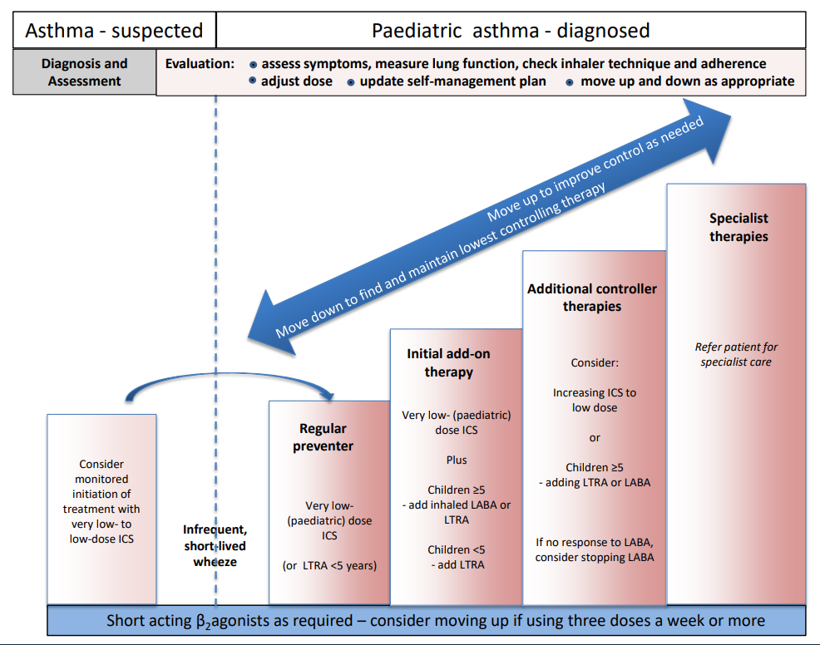
LTRA (Montelukast)
Review response in 4-8 weeks
LABA & ICS combined
Seretide (Fluticasone & Salmetorol)
Symbicort (Budesonide & Formoterol)

Slide 10
Stepwise approach
Continue on Clenil modulite 100mcg 2 puffs BD
Add in Montelukast
4mg ON
Review in 6 weeks
Has required 1 boost of steroids
No real difference in symptoms
What would you do?

Slide 11
LABA & ICS combined
Seretide (Fluticasone & Salmetorol)
Symbicort (Budesonide & Formoterol)

Slide 12
Stepwise approach
Continue Montelukast 5mg ON
Switch to Seretide 100 accuhaler
1 inhalation BD
Review in 8 weeks:
No change in symptoms
Using salbutamol several times per week
What would you do?

Slide 13
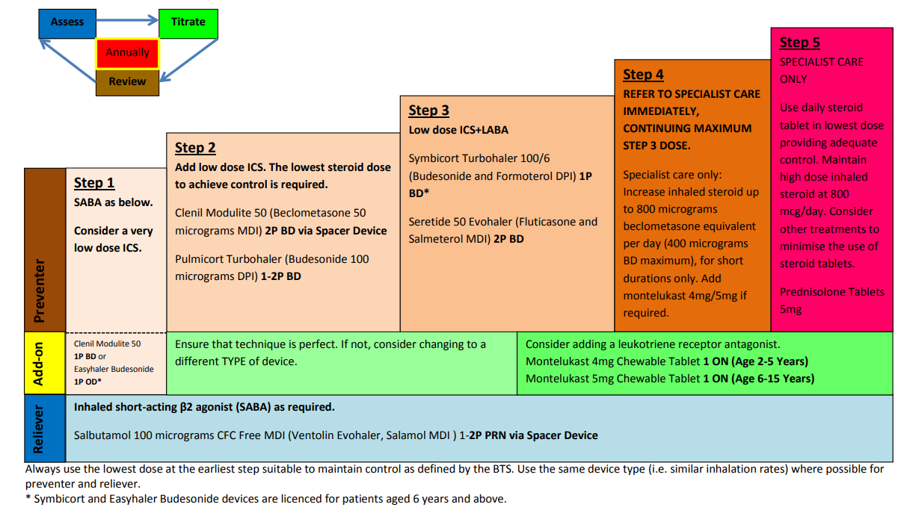

Slide 14
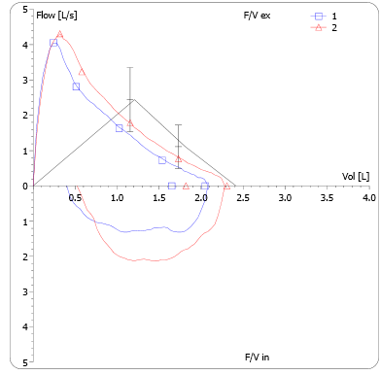
First clinic
FeNo 31ppb

Slide 15
First clinic
PLAN:
Switch to Slo-Phyllin
Asthma nurse specialist
Adherence
Inhaler technique
PAMP

Slide 16
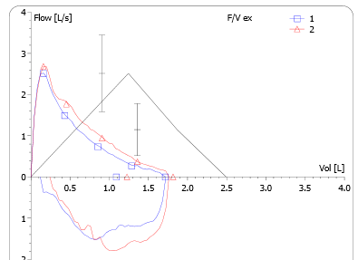
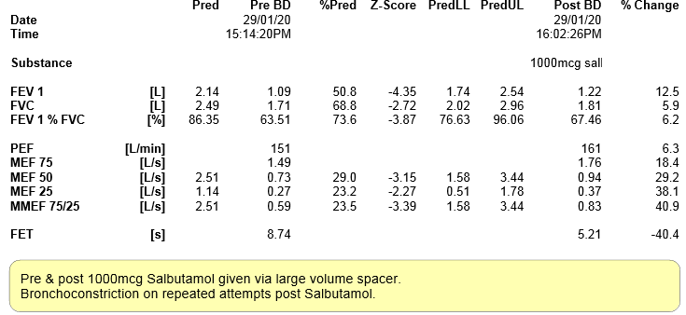
Second clinic
10 puffs salbutamol multiple times/day
Boost of Pred for 2 weeks

Slide 17
-> Emergency Admission
Further 4 weeks Pred
Fostair 100/6 2 puffs TDS
Further investigations​
Bronchoscopy: normal larynx & lower airway anatomy (mucosa inflamed)​
Bronchial mucosal biopsies: eosinophilic inflammation and basement membrane thickening ​
CT: small airways disease ​
IgE 3066 ​
Eosinophils: 0.99

Slide 18
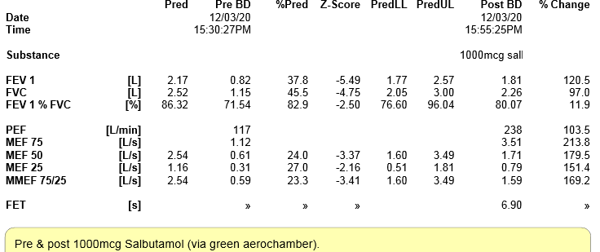
Clinic (4w later)
Boost of steroids: 21 days, then long-term low dose
PLAN to start Mepolizumab

Slide 19
BTS guidelines asthma
1.10.3 For children and young people aged 5 to 16 with a diagnosis of asthma, include advice in their self-management programme on contacting a healthcare professional for a review if their asthma control deteriorates. [2020]
1.10.4 For children and young people aged 5 to 16 with deteriorating asthma who have not been taking their ICS consistently, explain that restarting regular use may help them to regain control of their asthma. The evidence for increasing ICS doses to self-manage deteriorating asthma control is limited. [2020]

Slide 20
How could we monitor control?

Slide 21
BTS – 1.13 Monitoring asthma control
1.13.1 - If control is suboptimal:
confirm the person's adherence to prescribed treatment
review the person's inhaler technique
review if treatment needs to be changed
ask about occupational asthma (see recommendation on checking for possible occupational asthma) and/or other triggers, if relevant. [2017]

Slide 22
BTS – 1.13 Monitoring asthma control
1.13.2 - Consider using a validated questionnaire to monitor asthma control in adults. [2017]
1.13.3 - Monitor asthma control at each review using either spirometry or peak flow variability testing. [2017]

Slide 23
BTS – 1.13 Monitoring asthma control
1.13.4 - Do not routinely use FeNO to monitor asthma control. [2017]
1.13.5 - Consider FeNO measurement as an option to support asthma management in people who are symptomatic despite using inhaled corticosteroids. (This recommendation is from NICE's diagnostics guidance on measuring fractional exhaled nitric oxide concentration in asthma.) [2017]
1.13.6 - Do not use challenge testing to monitor asthma control. [2017]

Slide 24
BTS – 1.13 Monitoring asthma control
1.13.7 - Observe and give advice on the person's inhaler technique:
at every consultation relating to an asthma attack, in all care settings
when there is deterioration in asthma control
when the inhaler device is changed
at every annual review
if the person asks for it to be checked. [2017]

Slide 25
Any questions?

Slide 26
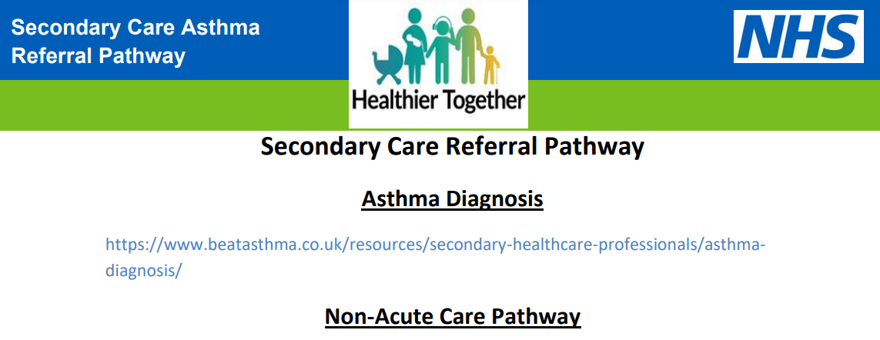
When to refer to secondary care?
Healthier together NENC/ professionals/ Paediatric pathways
https://www.nenc-healthiertogether.nhs.uk/application/files/6216/7276/1360/Referral_criteria_to_secondary_care_Final.pdf

Slide 27
Referral to secondary care
persistent chronic symptoms (most days for >3 months) or worsening symptoms
2 or more courses of oral steroids per year
>1 hospital admission or ED attendance per year
The use of >6 SABA inhalers per year ( >3SABA/year however indicates poor control)
Asthma Control Test (ACT) / Childhood Asthma Control Test (c – ACT) score of <20
Psychosocial/ safeguarding/ neglect: threshold for referral may need to be lower
Diagnosis unclear

Slide 28
When to refer to tertiary care?

Slide 29
When to refer to tertiary care?

Slide 30
Tiers 1 to 5 Training
Access the training: Asthma (Children and young people) - elearning for healthcare (e-lfh.org.uk)

Slide 31
Any Questions

