Slide 1

Healthier Together Champions Session

Slide 2
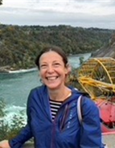
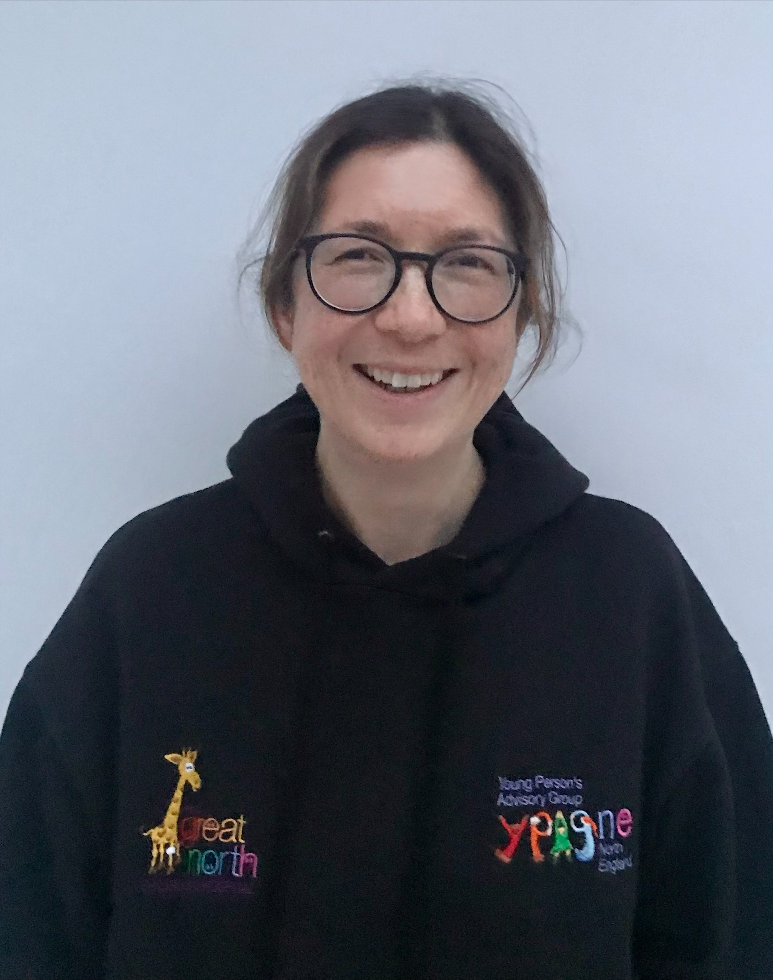
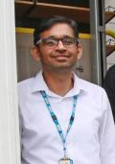
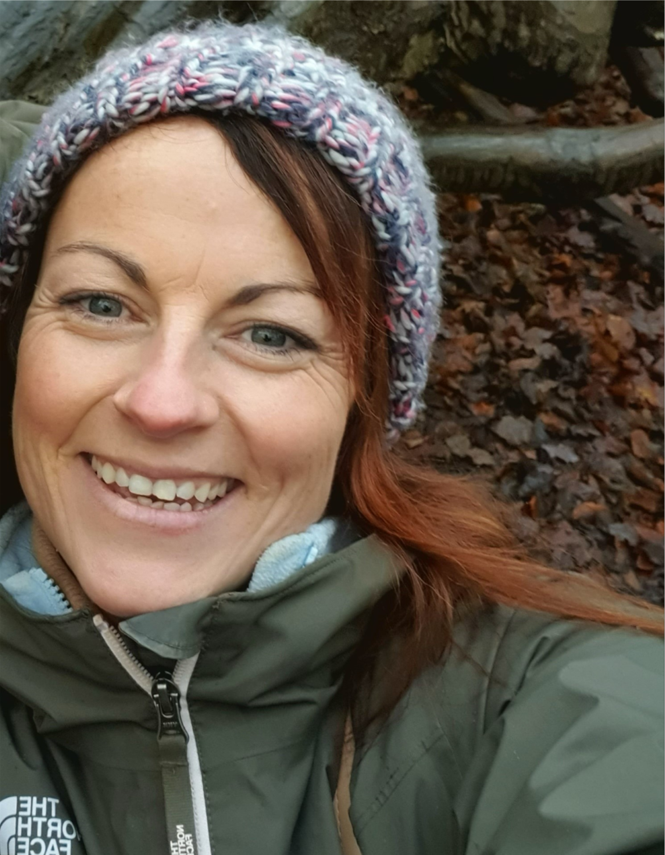
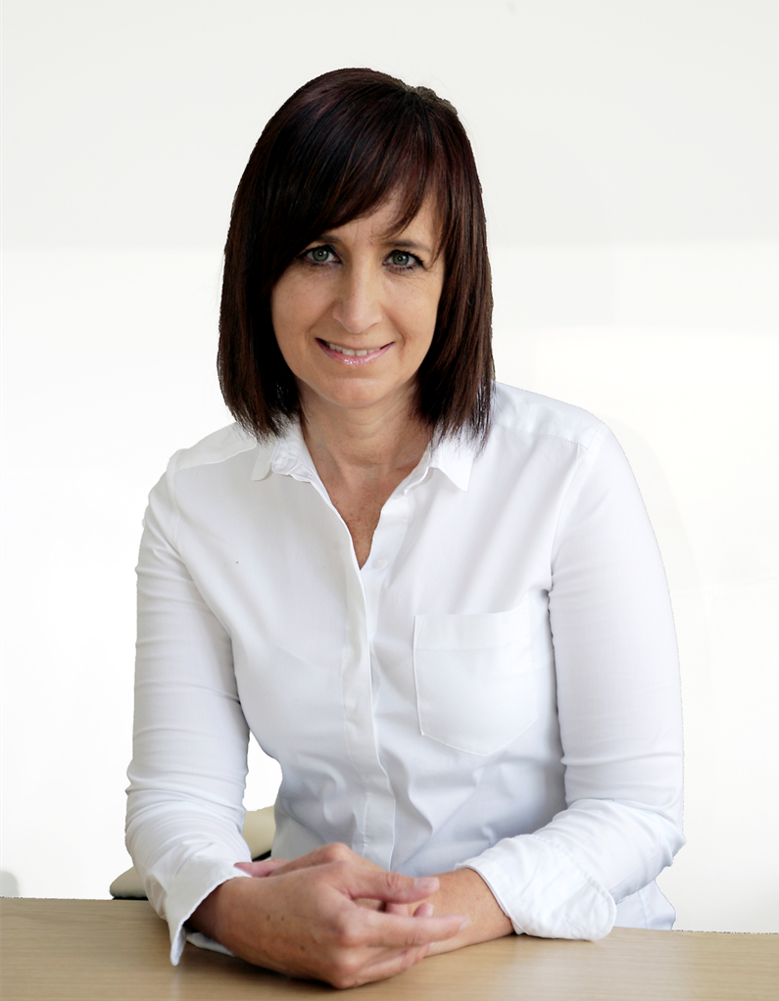
Meet the Healthier Together Team
Dr Alex Battersby
Clinical Lead
Dr Emma Lim
Clinical Lead
Sunil Kumar
Pharmacy Advisor
Laura Cassidy Network Deliver Manager
Anne Jones Data and Digital Lead

Slide 3



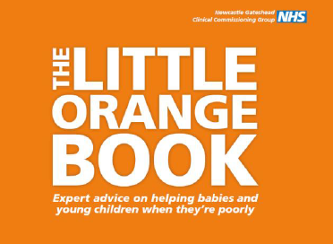

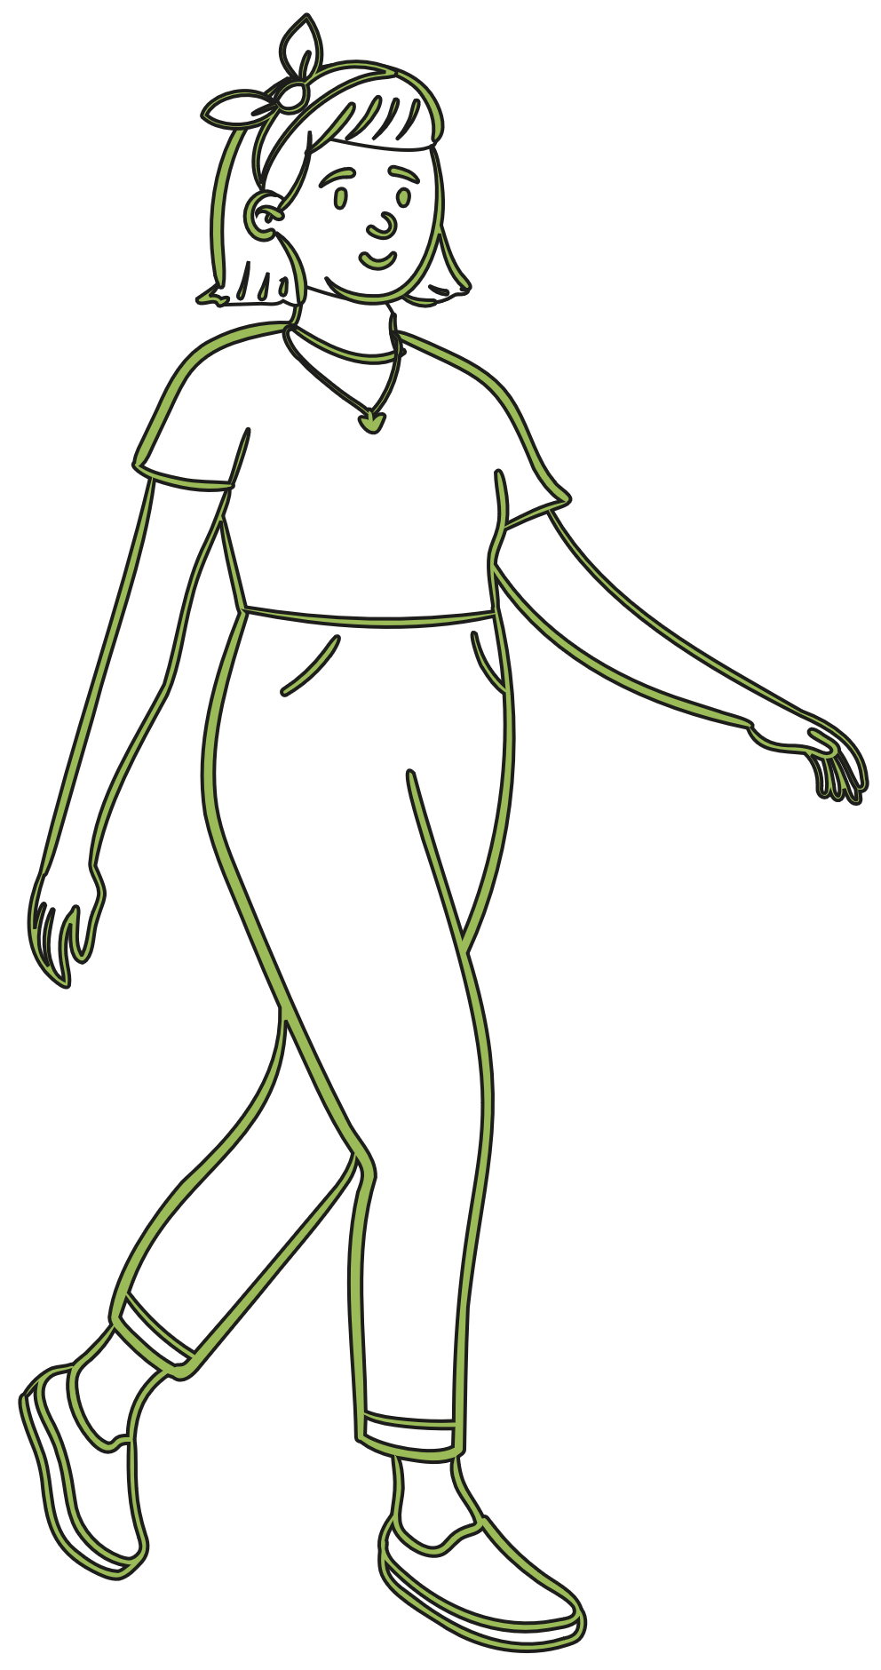
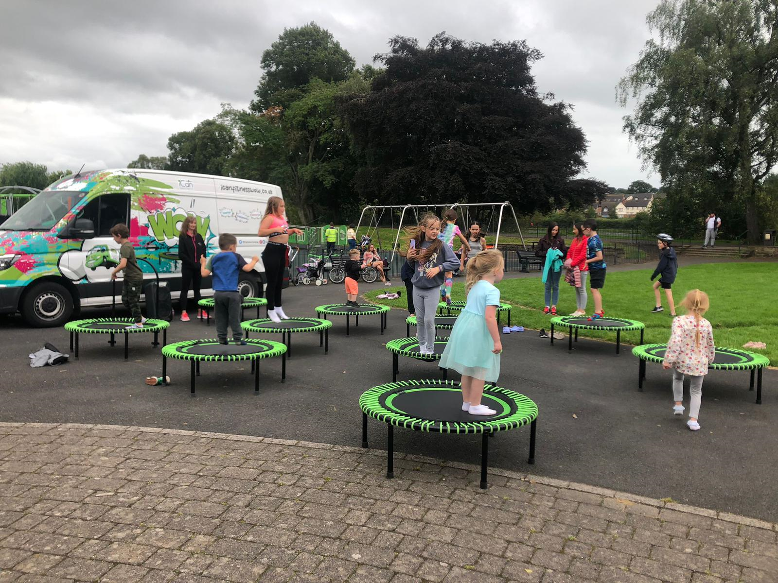
What today’s session will cover
Healthier Together Mobile app
  Who’s it for?
  More stats!!!
Healthier Together hosts
  An introduction to the North-East and North Cumbria Child Health and Wellbeing Network
  Why Healthier Together?
    How did it get started?
    Who’s it for?
    Stats!!!
Our partners
  Little Orange Book
Healthier Together Website
  A walkthrough the site
Healthier Together Champions
  The role of the Champions
  Challenges facing Champions
  Examples from existing Champions

Slide 4

The Child Health and Wellbeing Network
The network brings together people from all sectors across the North-East and North Cumbria region, to work with children, young people and their families to support them and have a positive impact.
The Network’s Vision
“In the North East and North Cumbria we believe all children and young people should be given the opportunity to flourish and reach their potential, and be advantaged by organisations working together “

Slide 5
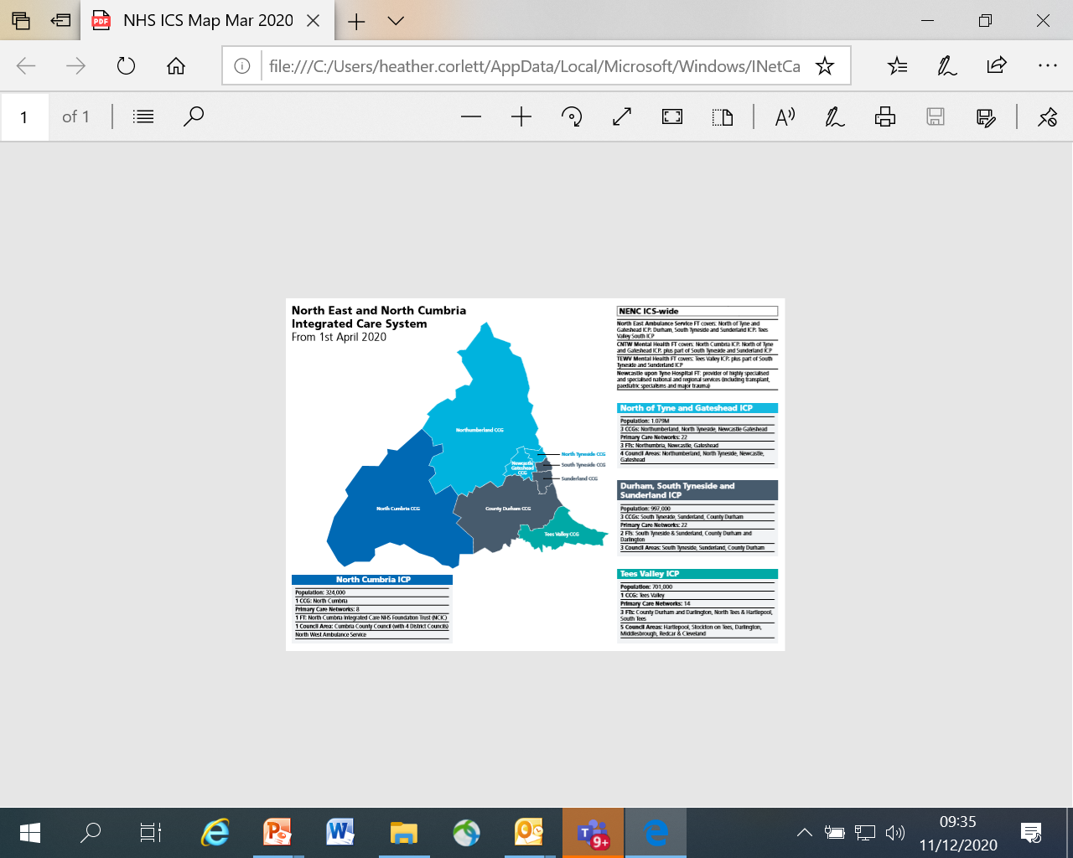
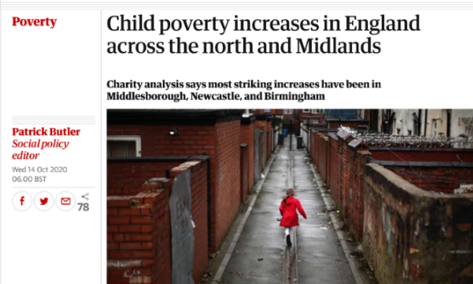
NHS Home of this work
NENC Integrated Care System
  Created by the ICS in 2018
  Not yet ICS funded
Growing remit in the NHS CYP Transformation
programme
Eight of the 10 UK local authorities suffering the sharpest child poverty increases over this period, which covered the peak years of austerity, were in the north-east, headed by Middlesbrough, where 41.1% of children where in poverty in 2018-19, up from 28.6% five years earlier.

Slide 6
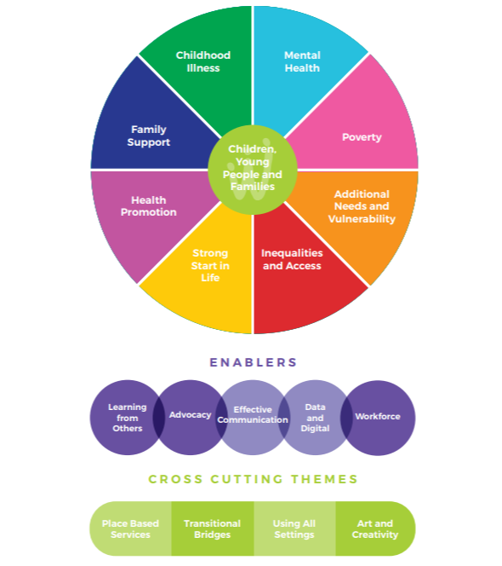
New priority added during pandemic FAMILY SUPPORT
Top Ten Priorities:
Voice of CYP and families
Mental Health
Poverty
Additional Needs & Vulnerability
Inequalities and access
Strong start in life
Health promotion
Family support
Childhood illness
Data, digital & communication

Slide 7
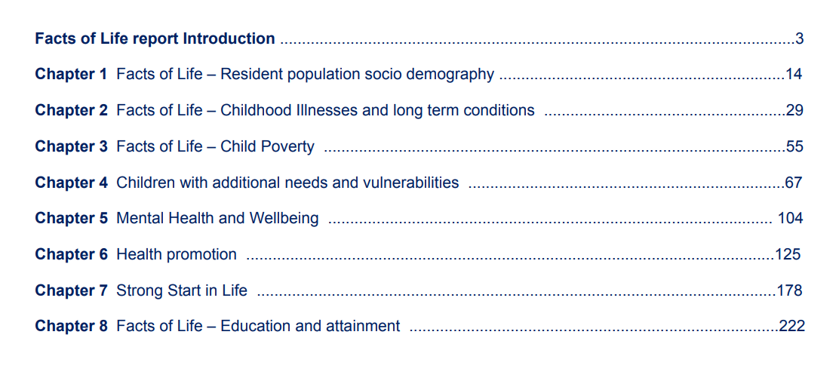

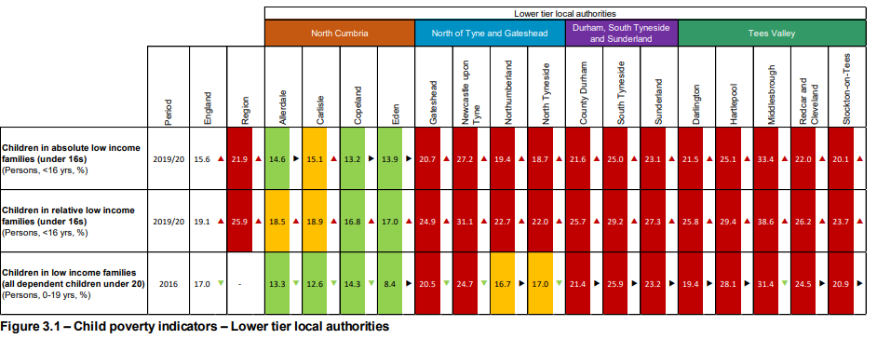
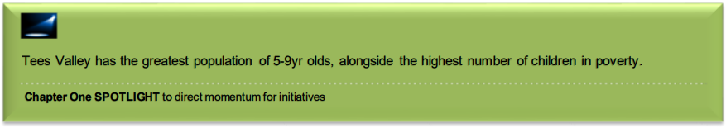
Facts of Life in the North East and North Cumbria
facts-of-life-report-final.pdf (northeastandnorthcumbriaics.nhs.uk)

Slide 8
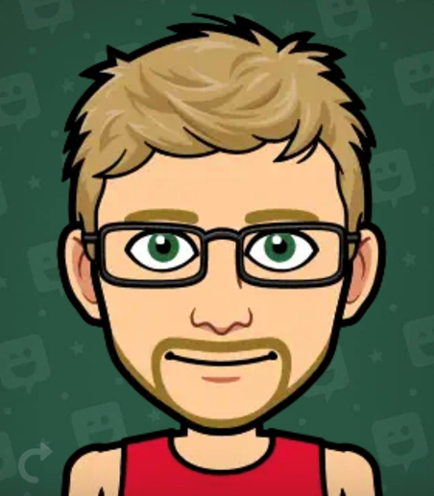
Network Membership
Total Membership – 2000+
Increase in all areas
'Other' category includes
  Police
  sports coaches
  arts and culture organisations
Team, Advisors and Apprentices too!
Our Apprentice Adam, based within Middlesbrough Council, has an interest in Looked after Children and Care Leavers, and attends both the professional and Youth Boards.

Slide 9


Some initiatives in partnership….

Slide 10

What have we done?
Youth Board and Network of Network to promote youth voice
2 young apprentices worked within our team
Deliver the CYP Transformation programme
13 schools accredited as Beat Asthma Friendly
Healthier Together - over 5,000 children registered
VCSE partnership model to embed initiatives into our most underserved communities – over 25 organisations involved
Over 500 trained in Youth MH First Aid
Asthma - Primary Care to Secondary Care and Secondary Care to Tertiary Care pathway downloaded 2918 times & L1 and L2 Elearning for Health Asthma Training accessed by 1261 people
Network of advisors to support breadth of system
Over 1000 children been part of STAR initiative
12 huddles to share good practice
Attracted new funding into NENC – ARC, ACE,NHSCT
Membership of over 1900
Twitter followers of over 2000 and Facebook more than 400 followers
Twitter reach of over 100,000 impressions in 2023
NENC specific CYP Core20 Toolkit developed and launched
New innovations from new partnerships – poverty proofing in health settings, Sustainable Healthcare Resources, Iterative development to promote sustainability:
- 4th iteration of poverty proofing
- 3rd iteration of STAR initiative
- 2nd iteration of YMHFA

Slide 11
Why Healthier Together?

Slide 12
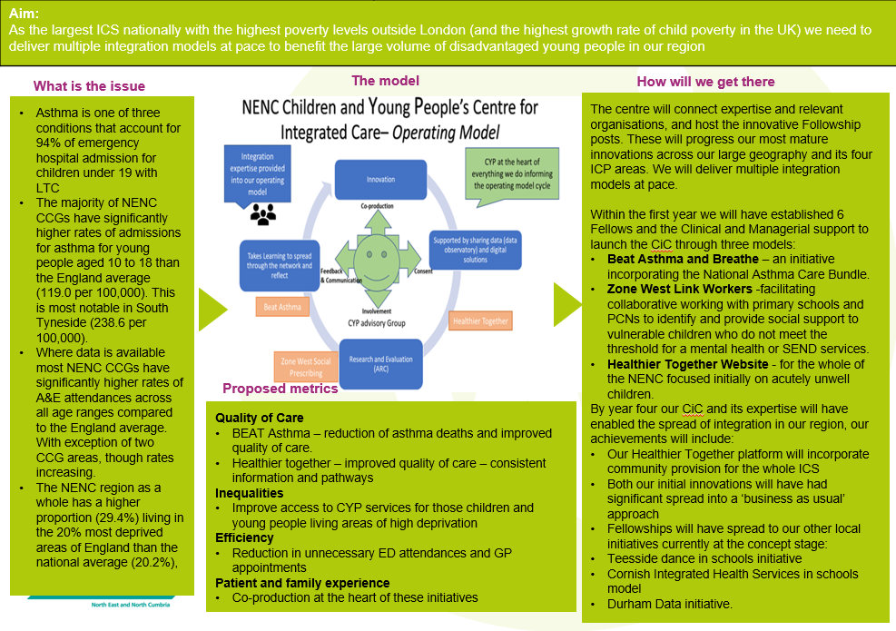
Integration Centre Background – NHSE Test Site – Funded Bid
Notes:
Integration test site NHSE funded Integration Centre

Slide 13
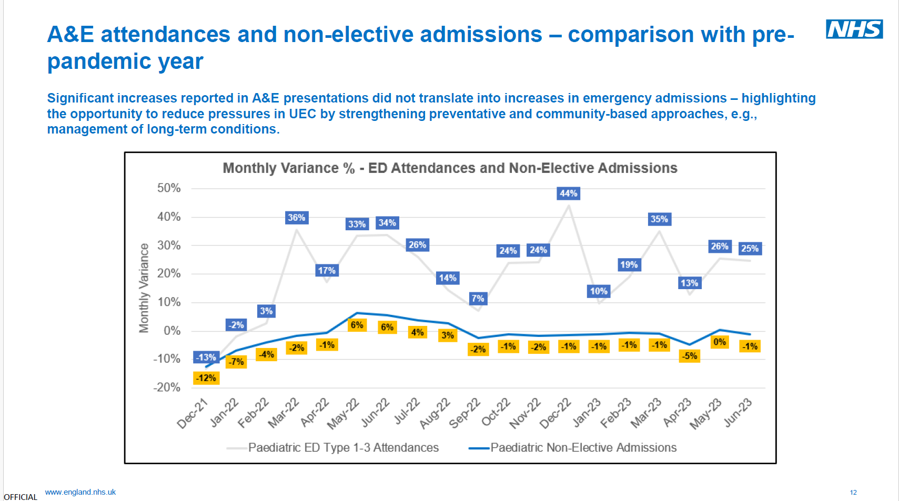
Children and young people account for 25% of A&E attendances.
Notes:
Most NENC CCGs have significantly higher rates of A&E attendances across all age ranges compared to the England average. With exception of two CCG areas, though rates are increasing.

Slide 14
Community Nursing Team
Primary Care
OOH Primary Care Services
Pharmacy
Patient/Parent at home
NHS 111/ Ambulance
Paediatric Admissions Unit
Emergency Department
Notes:
The Challenge: Multitude of providers/organisations to negotiate with/include in discussions
The arrows can go everywhere reflecting the multiple different pathways

Slide 15
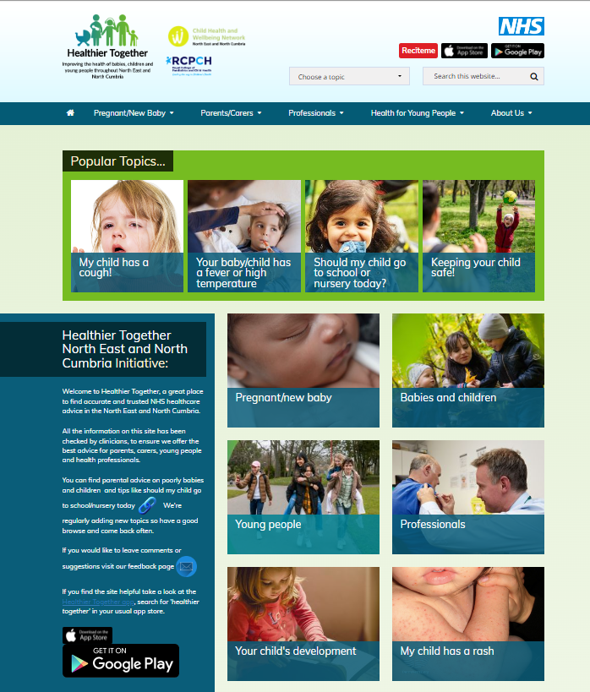
Why Healthier Together?
Adopted by the ICS NENC CHWN as model of good practice from Southampton (by Dr Sanjay Patel, Consultant Paediatrician) and it has been spread successfully to further sites nationally with more areas coming on board.
Activity data from Wessex strongly suggest a significant reduction in urgent care activity for children and young people associated with implementation of the Healthier Together programme.
Valued by both staff and families alike as a platform to share information consistently across the whole healthcare system.

Slide 16
Co-Design: Feedback from Parents (2014)
Opinions
Those living in poverty more vulnerable
Perceive a lack of communication between professionals
Simple information – difficult to find online
  NHS Choices so much information, difficult to navigate
NHS 111 – variable opinions – “really helpful service”, “not good for children” & “directed to A&E when not always necessary”
Facebook a good source of reassurance from other parents
Requests
Education on common illnesses
Website / App for parents
Consistent information from healthcare professionals

Slide 18
Has it made any difference - measuring success
Qualitative
  Parent interviews conducted
Quantitative
  Website hits
  Impact on behaviour
    Parent health seeking behaviour
    Clinician behaviour

Slide 19
Who is Healthier Together for?

Slide 20
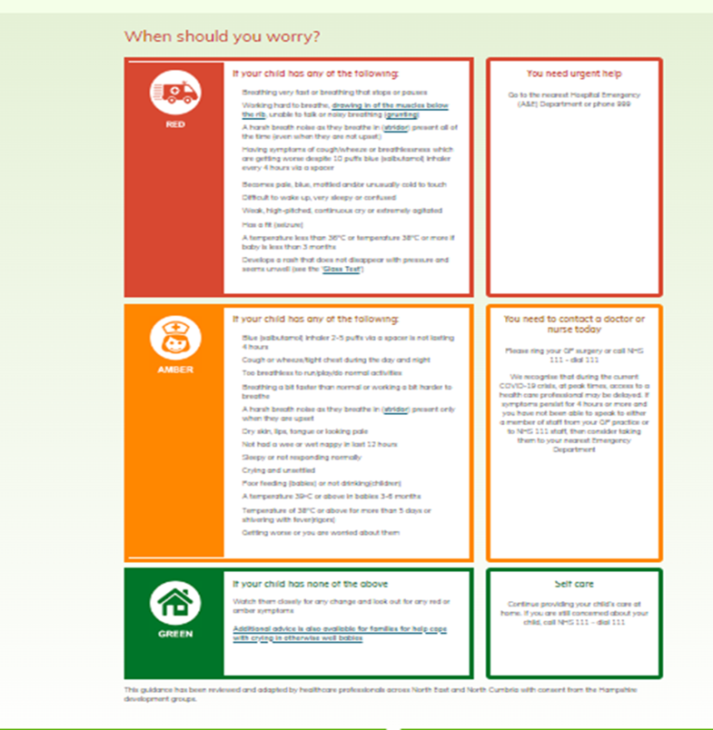

Target Audience
Easy to use traffic light system
Healthcare professionals (via standardised local clinical guidelines, educational resources & referral pathways).
The site provides useful resources for pregnant women, parents, carers and young people (via information leaflets, self-care advice, & guidance on when and how to access appropriate local healthcare services).
Promotes consistent advice aligned with information available on parent pages and facilitates shared decision making.
SAFETY NETTING!

Slide 21
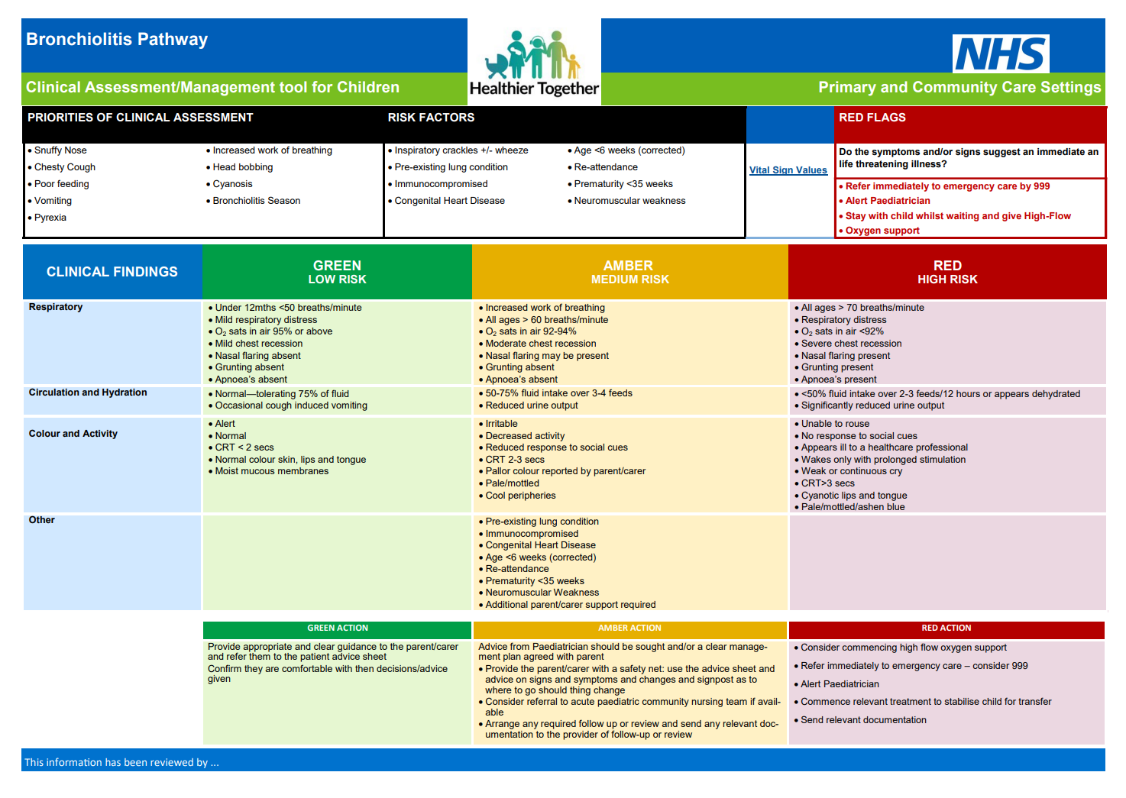

Slide 22
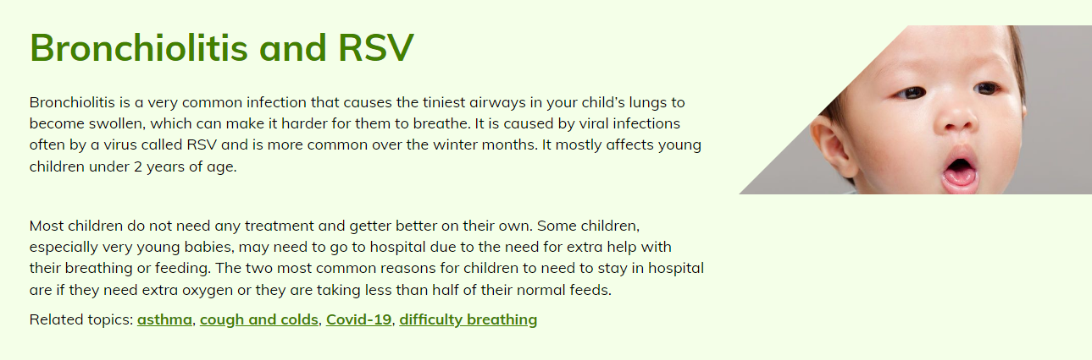
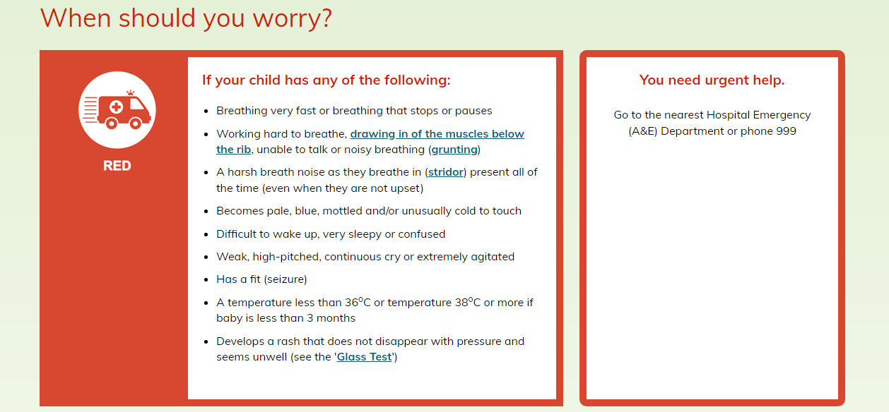
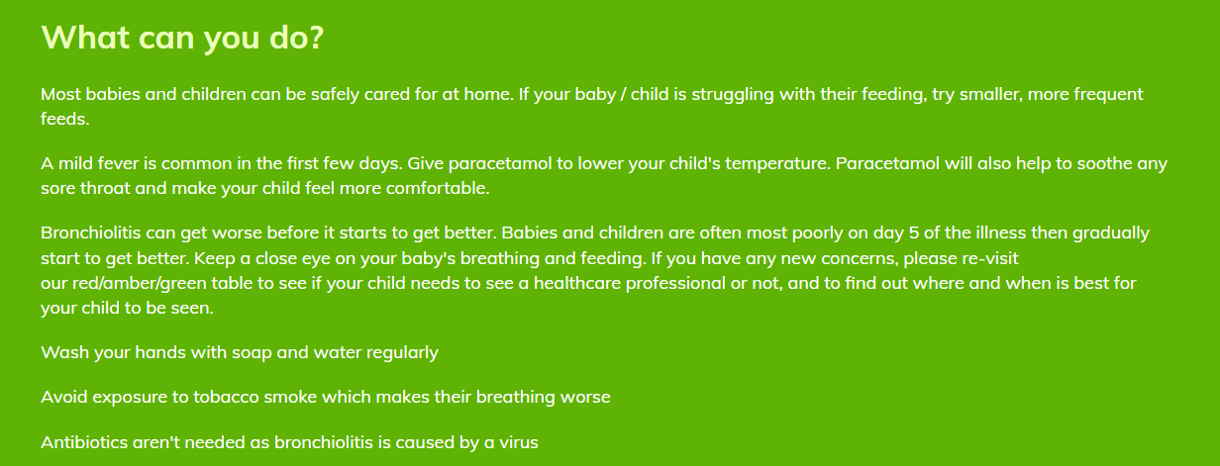
Healthier Together | NHS | Bronchiolitis (nenc-healthiertogether.nhs.uk)

Slide 23
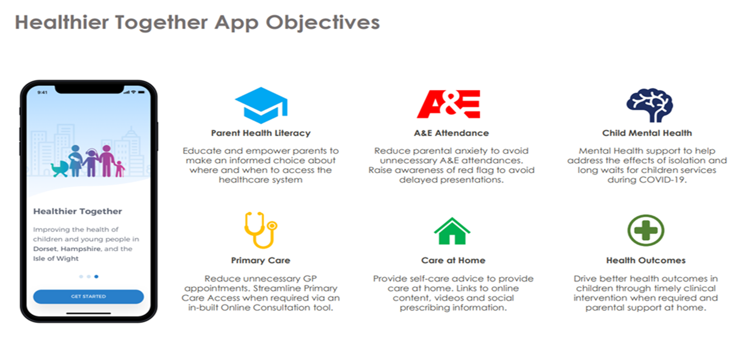

Slide 24
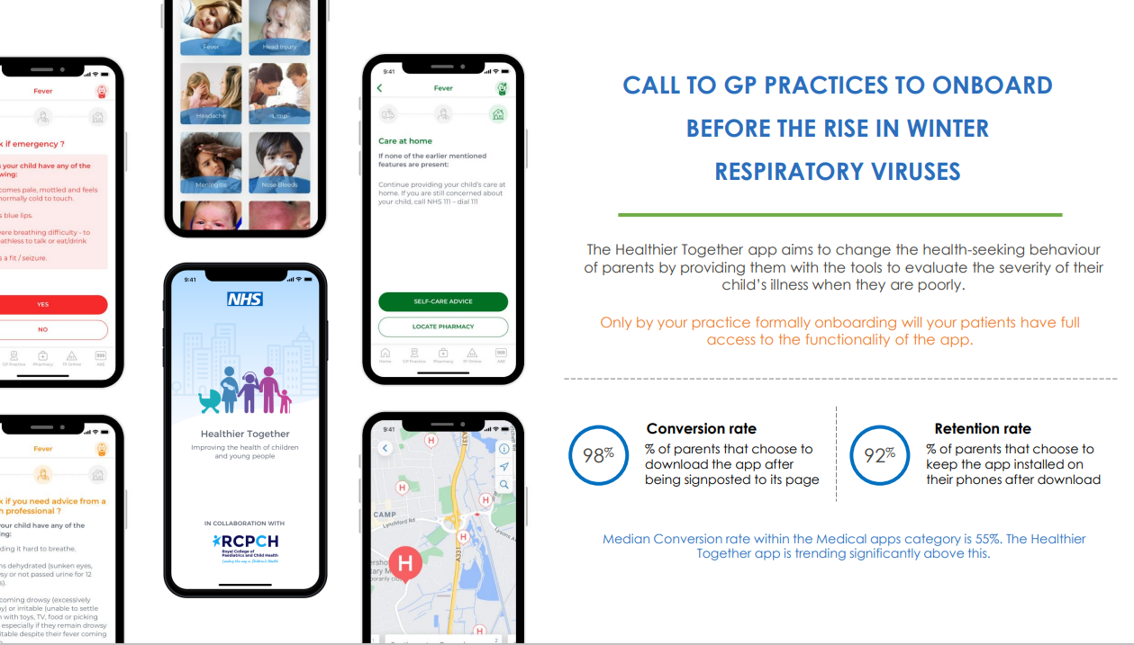

Slide 25
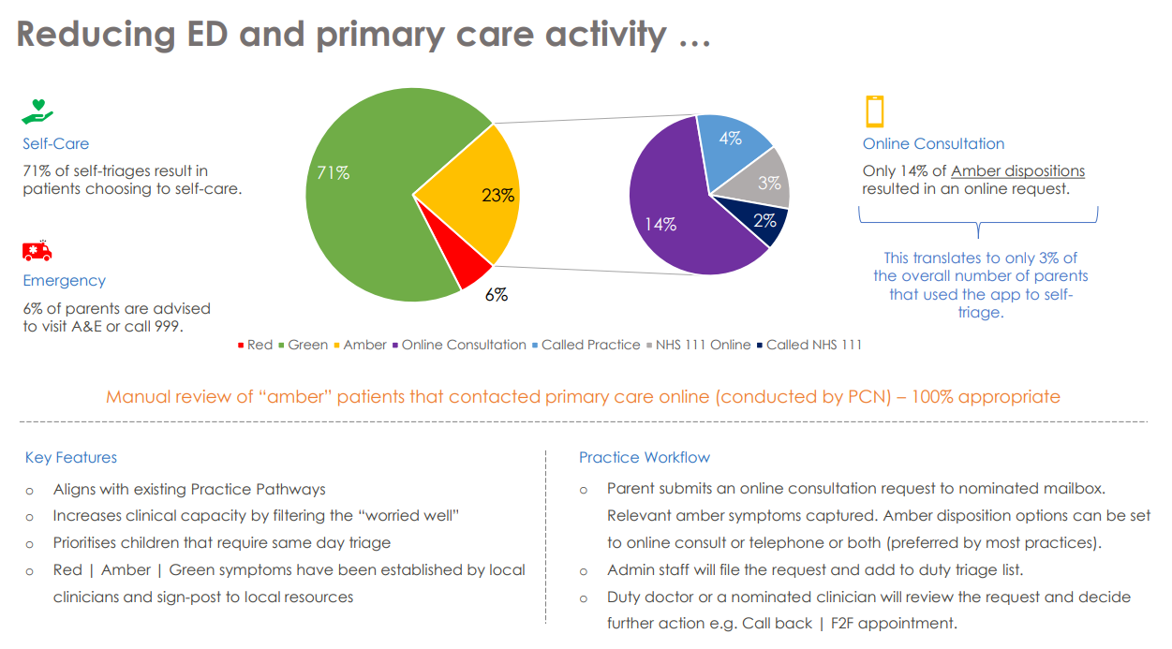

Slide 26
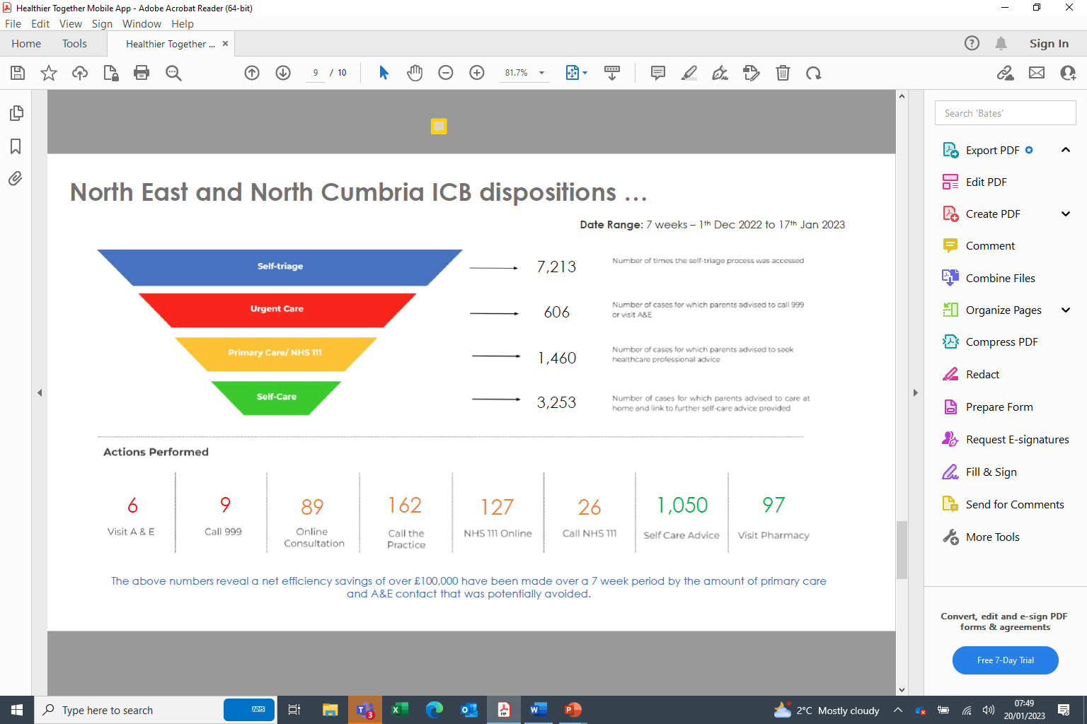

Slide 27
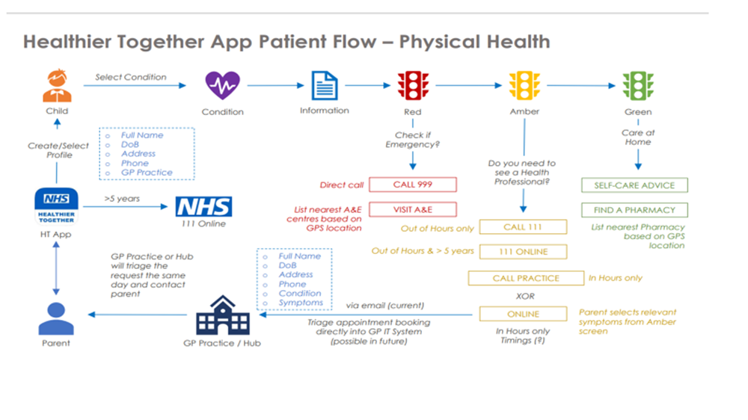

Slide 28
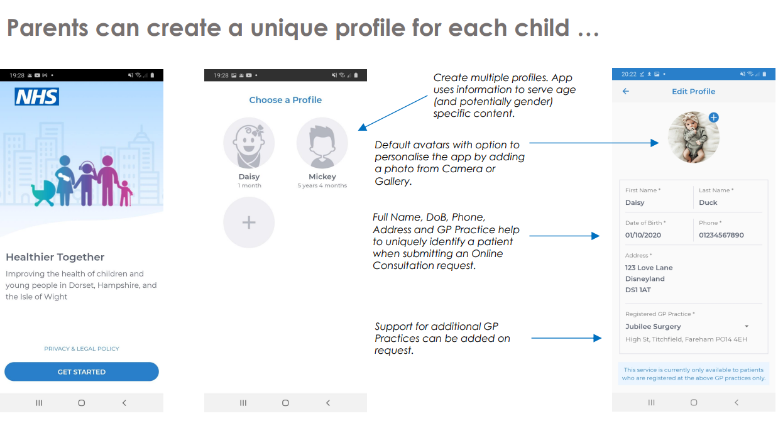

Slide 29
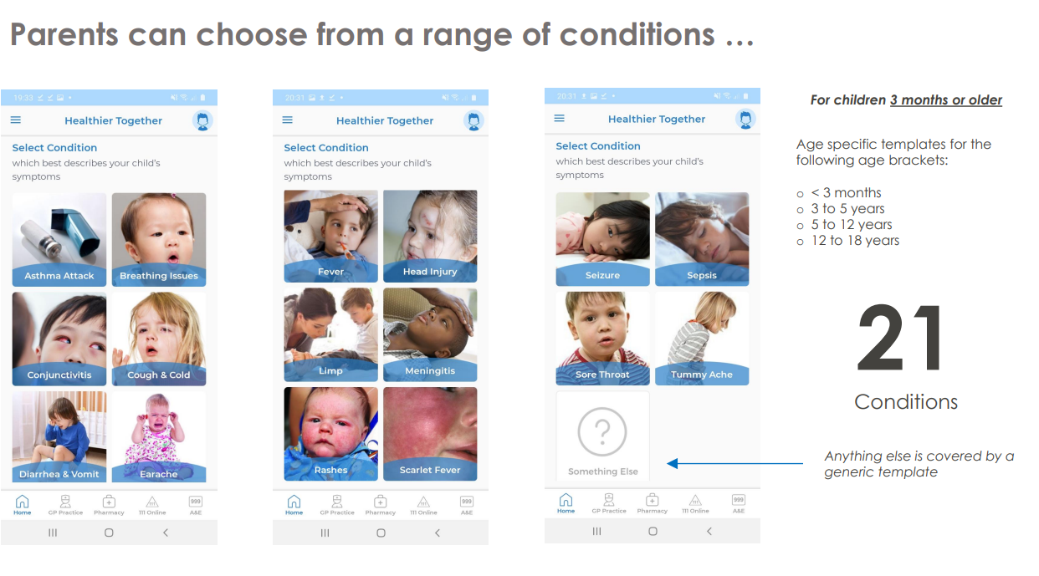

Slide 30
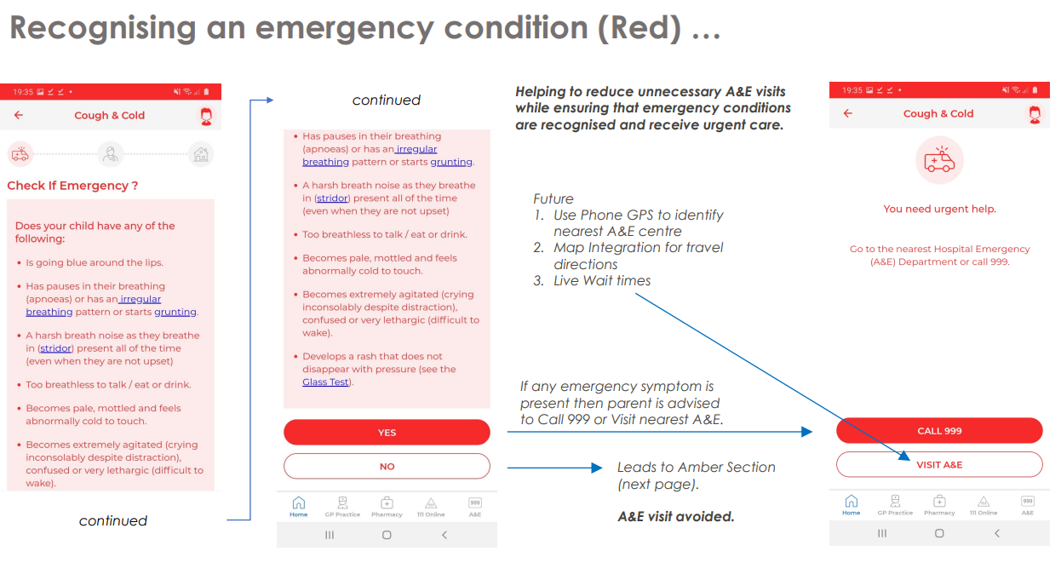

Slide 31
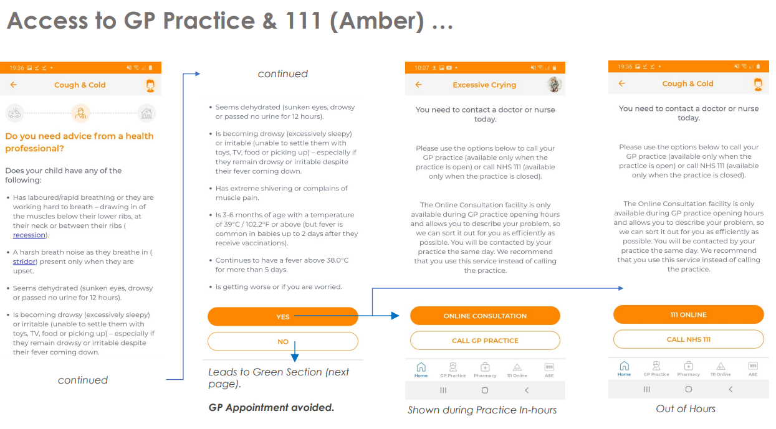

Slide 32
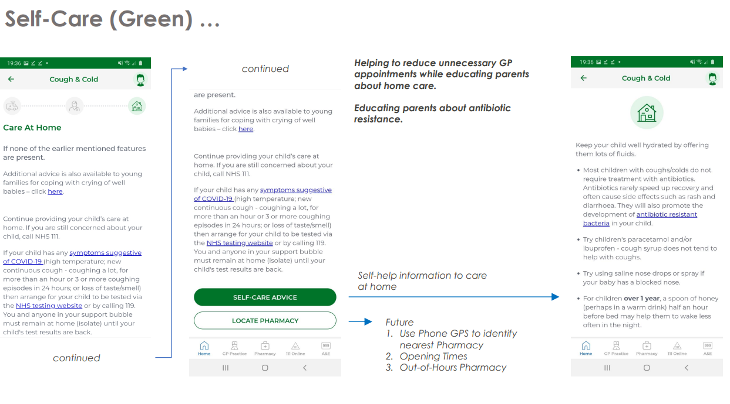

Slide 33
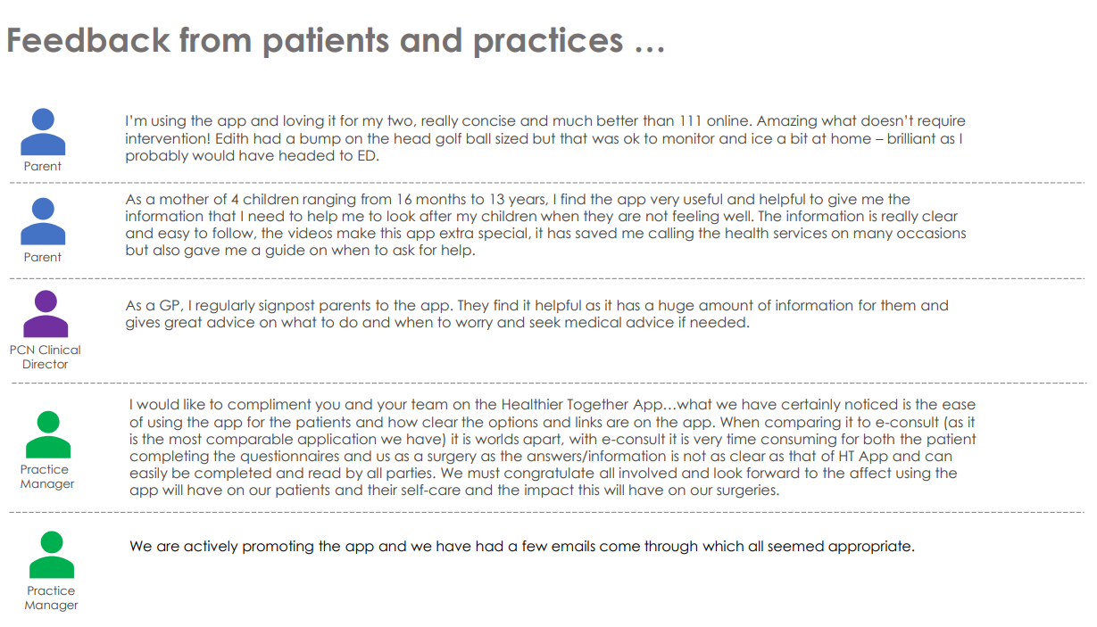

Slide 34
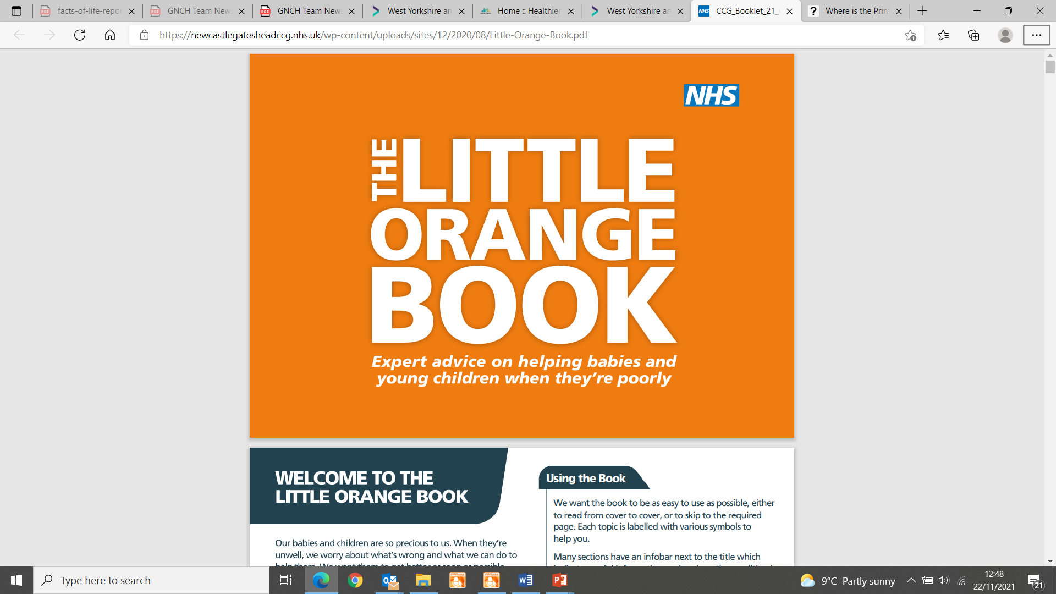
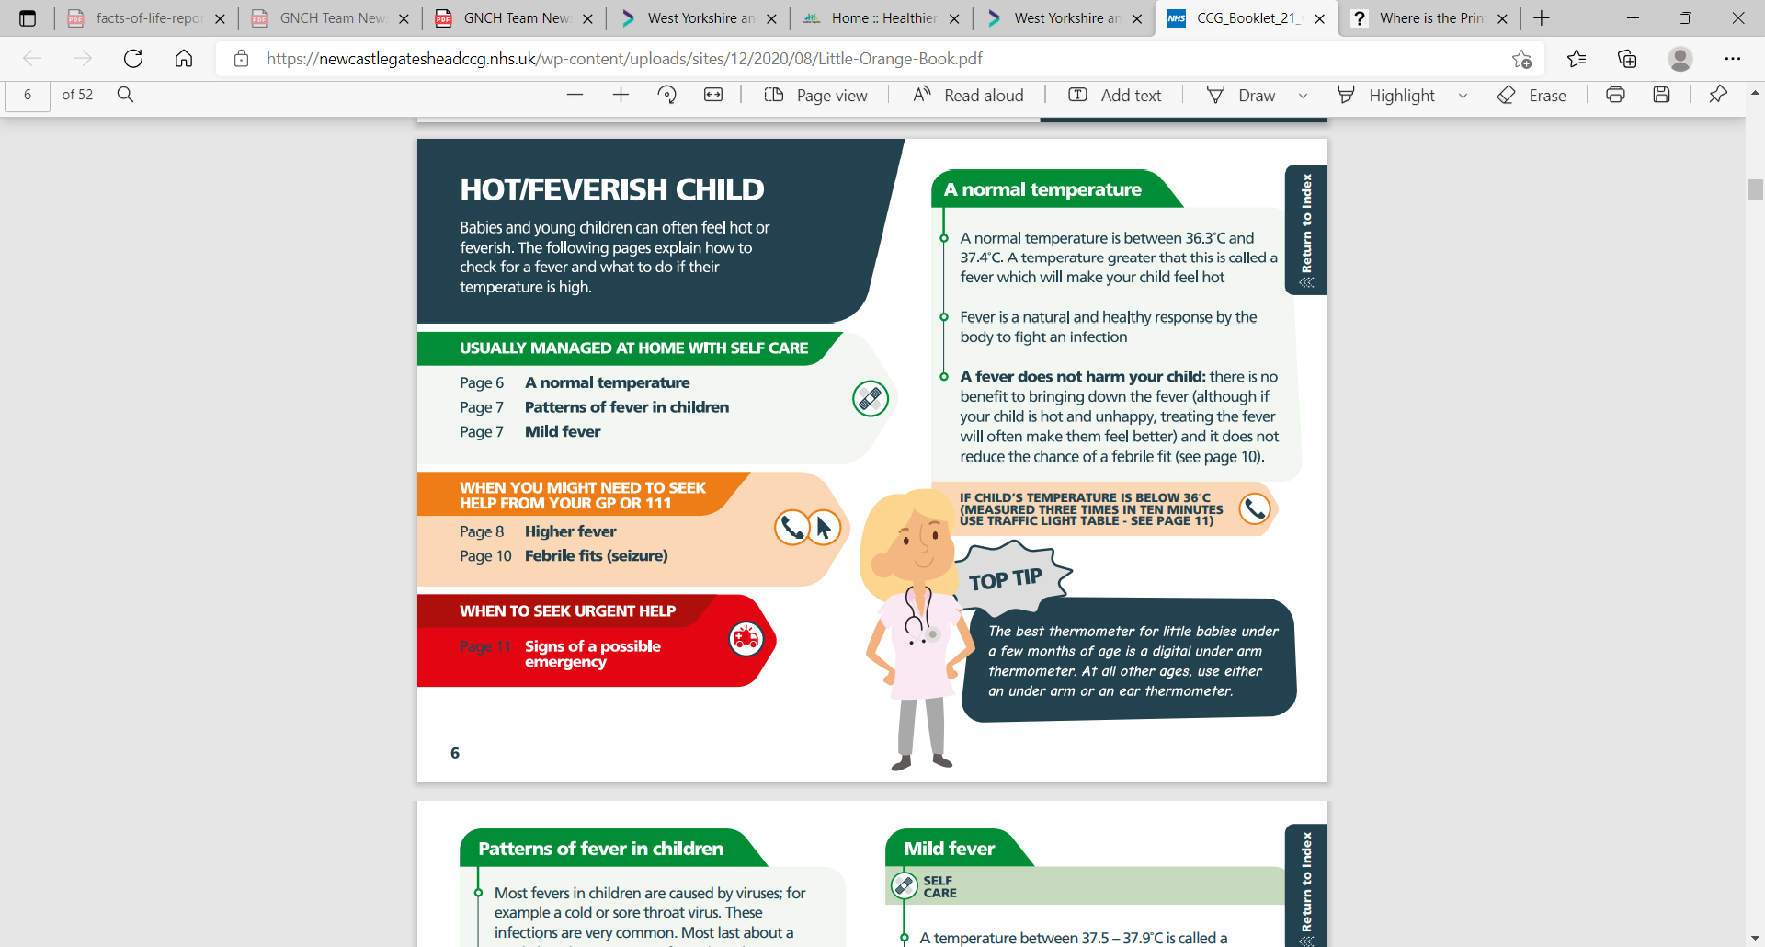
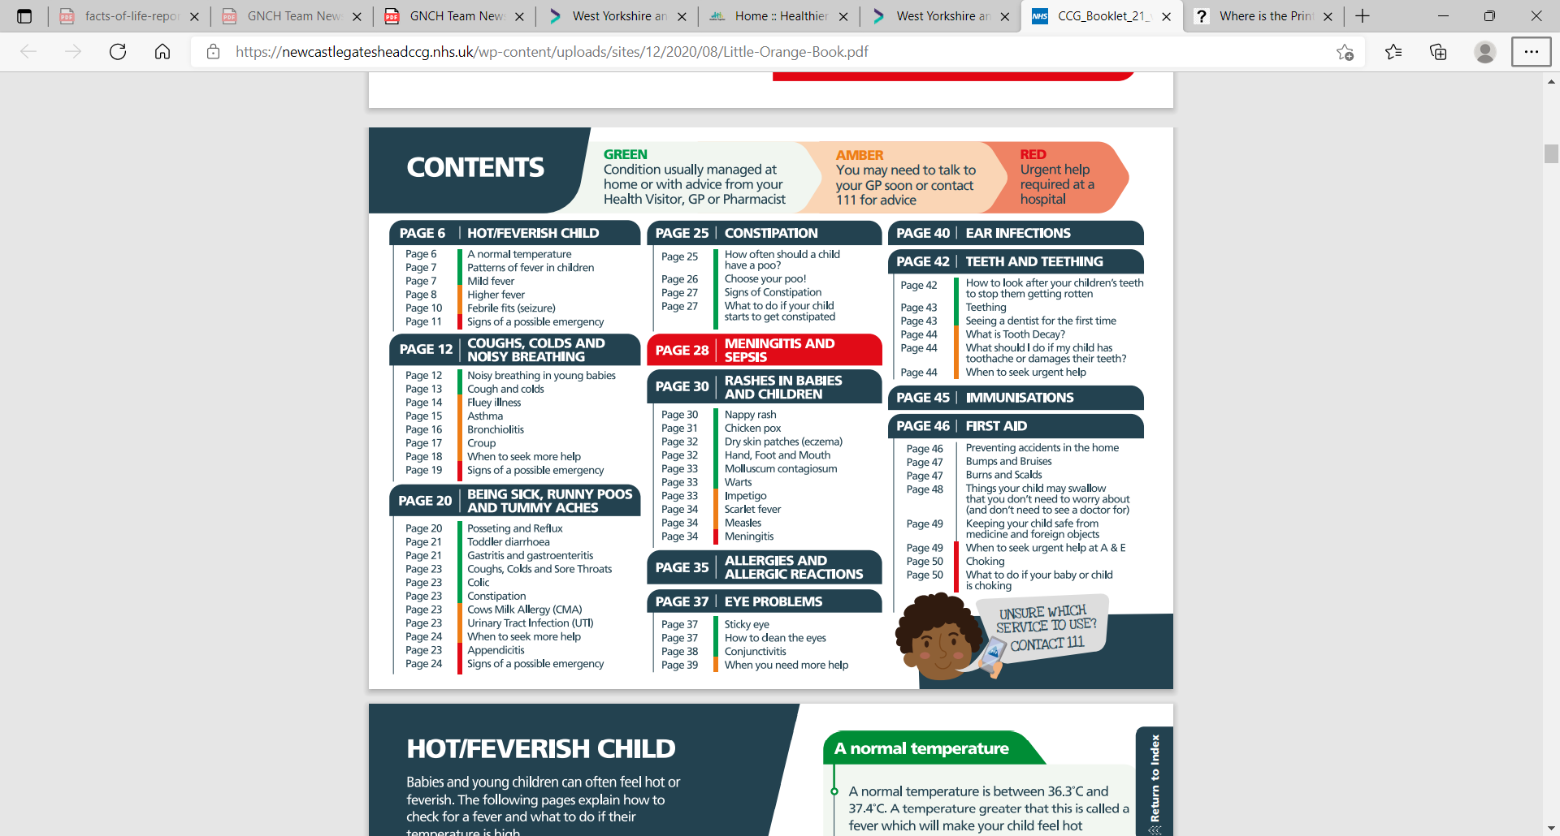
Little Orange Book…Dr David Jones & Kate Cushing Gateshead-Newcastle CCG
  CCG_Booklet_21_v1.1_g (nenc-healthiertogether.nhs.uk)

Slide 35
Little Orange Book
Aimed at parents with children aged 0-5 years
Available in hard copy or digital
Hosted on Healthier Together

Slide 36
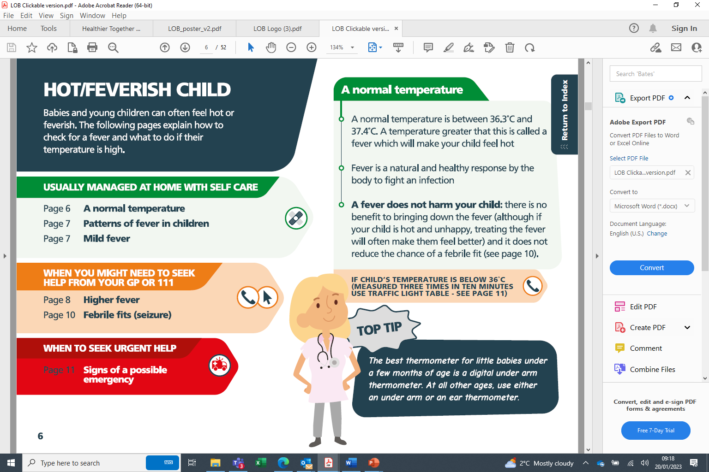

Slide 37
5 Minute Comfort Break

Slide 38
A walk around
Healthier Together website

Slide 39
Not all about acute illness other useful pages
Should my child go to school today?
Healthier Together | Should my child go to school today (nenc-healthiertogether.nhs.uk)
Milk Allergies
Healthier Together | Is it cow's milk allergy? (nenc-healthiertogether.nhs.uk)
Worried about daily life
Healthier Together | Worried about daily life? (nenc-healthiertogether.nhs.uk)
Young peoples section
Health for Young People :: North East and North Cumbria Healthier Together (nenc-healthiertogether.nhs.uk)

Slide 40
But how do you get people to use the resources?
Parents
  Role-modelling by healthcare professionals
  Parent minor illness sessions (health literacy)
Community based staff
  Local authority public health teams
  Mental health education in schools
  VCSE organisations working with families
Healthcare professionals
  Education based on clinical pathways/safety netting sheets

Slide 41
Role as a Healthier Together Champion
To promote the Healthier Together website, mobile app and Little Orange Book with the communities you work
To support with accessing the Healthier Together website and mobile app by:
  Sharing with them that Healthier Together is an NHS trusted resource
  Informing them of what they can use Healthier Together for.
  Showing them around the website
  Supporting them to download the app on their phone
Gaining feedback from communities around Healthier Together to support ongoing development
Supporting case studies when service users have used the website or the app

Slide 42
Examples work of HT Champions Organisations

Slide 43
Work with young women up to the age of 25 to give them a brighter future by helping them to tackle some of life’s biggest challenges including substance misuse, domestic abuse, unemployment, poor health and wellbeing, sexual abuse and exploitation.

Slide 44

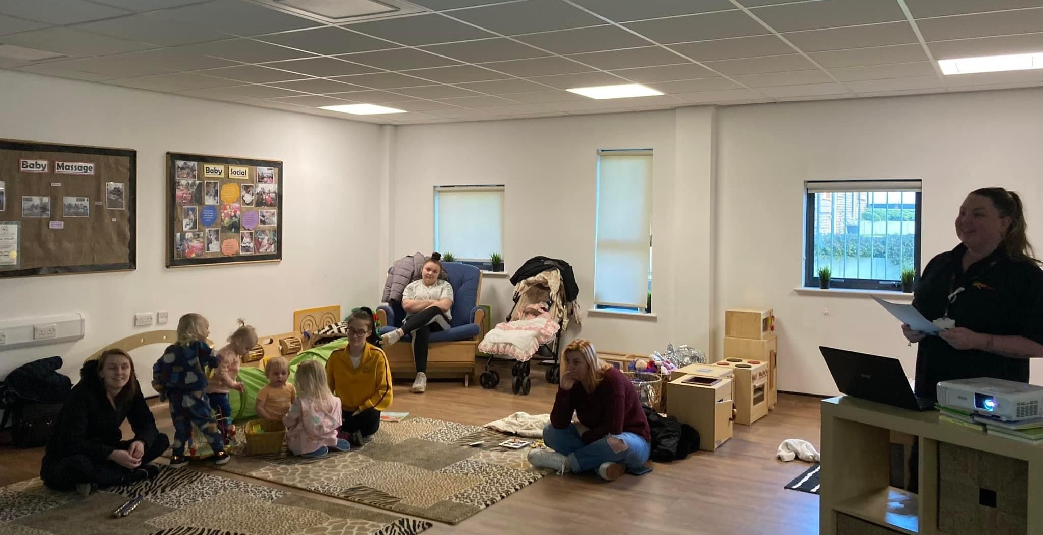
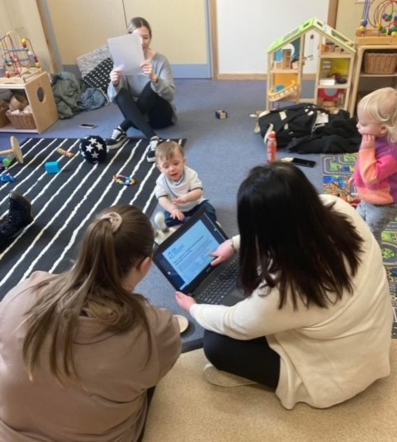
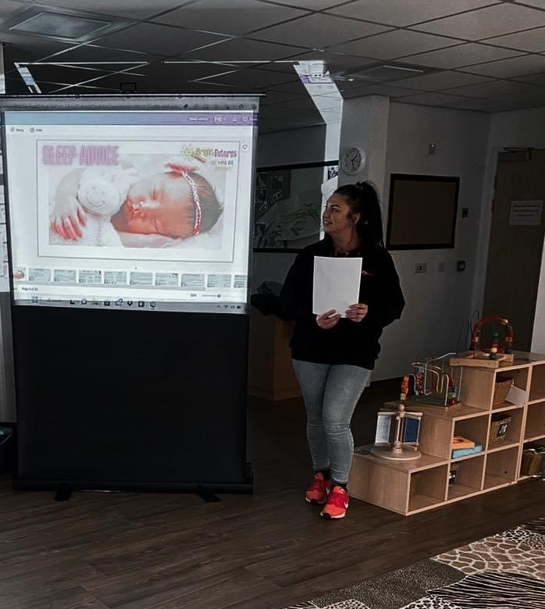
Bright Futures have been actively promoting the innovative Healthier Together NHS resource to clients and through our social media channels which have over 5,000 members.
Bright Futures Champions provided in-house training to all staff and volunteers, 18 in total, which encouraged them to share their learning and disseminate the resources amongst all groups we engage with on a daily basis.
To increase the reach promotion business-style cards and flyers have been distributed as part of staff outreach and detached youth work, in school lunchtime drop-ins, and in local children's centres, including Riverside and Jarrow, where Bright Futures young mums’ sessions are facilitated on a weekly basis.
Furthermore, two members of staff attended the Healthier Together lunch and learn session in January 2023, learning the importance of positive sleeping habits and good sleep hygiene. The staff were able to share their knowledge and further developed an interactive presentation with key information to help the young women maintain good health and well-being.
This presentation was shared in two young mums groups to over 30 young mums and via social media, capturing positive feedback from the mums who recognised the importance and benefits of the new resource

Slide 45
Bright Futures Case Study
Mum started attending the Bright Futures Young Mums and Mums To Be Groups in 2021 with her daughter.
Mum has always struggled with her mental health and at her lowest she contemplated taking her own life. Mums mental health severely declined during her pregnancy and she began to see a Counsellor to help her express herself better and process her thoughts and feelings. in her pregnancy and she was seeing a councillor regularly to help her express/process her thoughts and feelings. Additionality, Mum has a history of drug abuse.
Mum had explained that she finds bedtime very challenging with her daughter and that this can have a detrimental effect on her mental health.
Bright Futures Project Workers, Lindsey completed online training with Healthier Together Champions and following this produced a Sleep Advice Presentation which covered topics including safe sleep, sleep hygiene, screen time, and relaxing techniques for children aged 0-5 years.
Mum attended the Presentation which was delivered as part of the weekly group from a local Childrens Centres. Mum provided feedback: “I am so grateful for the advice I received today, I am going to try these calming techniques out with my daughter tonight. I feel excited to try a new routine with the all the information provided today, it has given me that little bit hope and encouragement I needed”.

Slide 46
Feedback from young parents
“Since I was told about the Healthier Together App at the Sleep Presentation it has eased a lot of worrying about my child if they become ill, the App has saved me rushing to A&E and panicking”.
“The Healthier Together presentation delivered by Bright Futures helped me learn the importance of having a good sleep routine for both me and my child.”
“The Healthier Together app and website is easy to use, provides good advice and stops me over-worrying about illnesses which could be treated at home instead of attending A&E.”
I used Healthier Together when my son had a rash. I found it easy to get more information using links on the page and felt more confident when I was speaking with his GP”

Slide 47

Promoting Healthier Together in Education
The West End Schools' Trust (WEST) is a charitable company of eight primary schools and partner organisations located in the inner west of the city of Newcastle upon Tyne.
8 Primary Schools within the Trust
Promoted Healthier Together to 3000 families

Slide 48

Supporting families through Healthier Together
Family A was supported to use the Healthier Together for her daughter about very sensitive female issue that she said she was too embarrassed to initially talk to doctor about. The advice was very useful and clear guidance on what to do next. Resulted parent in accessing pharmacy support only.
Family B – Child is a persistent absentee and is kept off school regularly for minor illnesses. Since parents were introduced to the app we have seen a small improvement in attendance.
Family C - One family has very poor attendance. Parents are always very wary of sending them in even with minor illness. Website shared with them, and they are encouraged to use. Staff know to ask the parents if they have accessed the website to get advice and it seems to be working. Parents seem reassured that they can send their children to school with different illnesses.

Slide 49

Work with a wide range of partners to highlight how physical activity and movement can be introduced to help them achieve their aims and the common goal of tackling inequalities across our region.
We know that being active and moving more has a positive impact for individuals and communities. It brings people together, raises aspirations, improves educational attainment, improves health and supports greener travel.
We know that being active and moving more has a positive impact for individuals and communities. It brings people together, raises aspirations, improves educational attainment, improves health and supports greener travel.

Slide 50

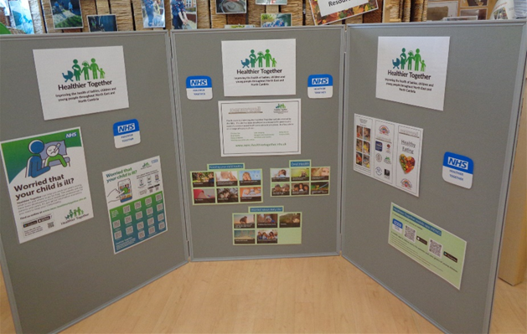
Promoting Healthier Together
Rise promoted the Healthier Together information to a diverse number of contacts within the children and young people sectors working across some of our most deprived communities.
General Rise newsletter (3 x months) – 1,600 people
Early Years newsletter (3 x months) - 425 early years practitioners
Early Years Conference –100 early years practitioners
Internal Rise staff intranet - 26 professionals
Early Years Active Start train the trainer programme 20 early years settings
Early Years Families Campaign – 833 families
Opening Schools Facilities Programme – x50+ schools
Bite Back Youth Food Champion Programme – x6 youth and community centres
Website – dedicated website page Healthier Together — Rise | Physical Activity Partners for Local, Regional and National Partners (wearerise.co.uk)
Staff have been promoting Healthier Together through wider contacts through further word of mouth / meetings etc
Together fund VCSE organisations – 100+

Slide 51
Rise use of social media
Rise direct reach for our social media channels:
831 Twitter followers
775 Facebook followers
Linkedin – 629 followers
As above, our social media strategy is very much focused to business-to-business
Through our support, almost all of the early years settings who took part in our Early Years Healthier Together families campaign utilised Social media to compliment their work. The reach of these posts was (approx. totals)
Facebook 1963
Twitter 1677
Instagram 179

Slide 52
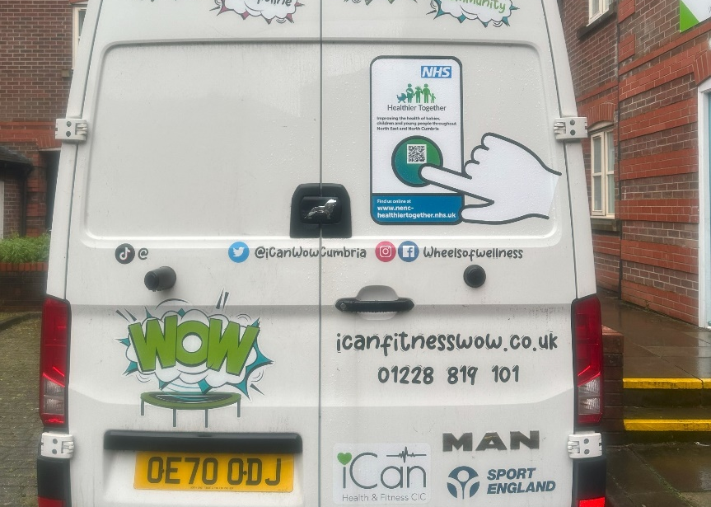
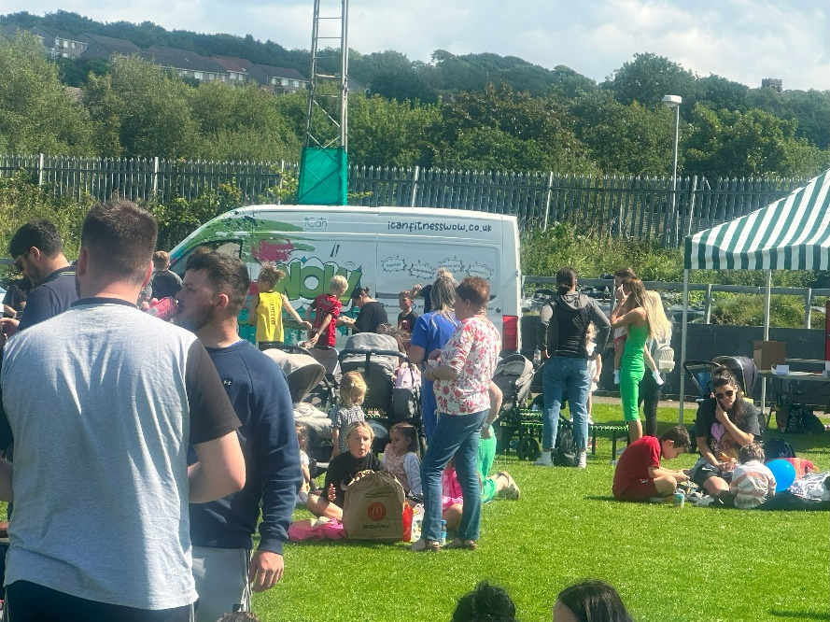
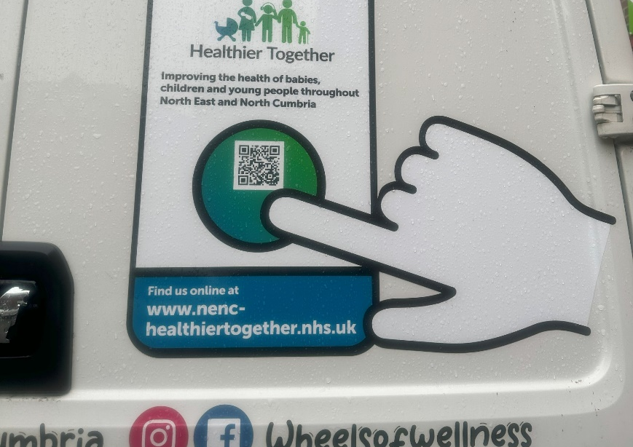
I-Can Health and Fitness CIC
Promoting Healthier Together as part of their Holiday, Activity and Food programme

Slide 53
How do you feel that Healthier Together will benefit communities?

Slide 54
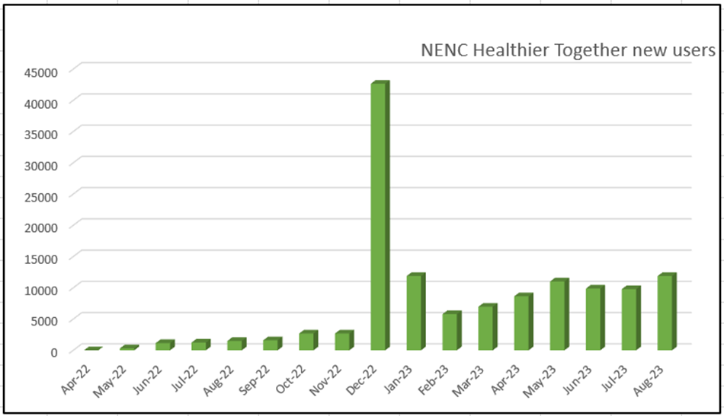

Healthier Together provides a go to platform that can be responsive to need

Slide 55
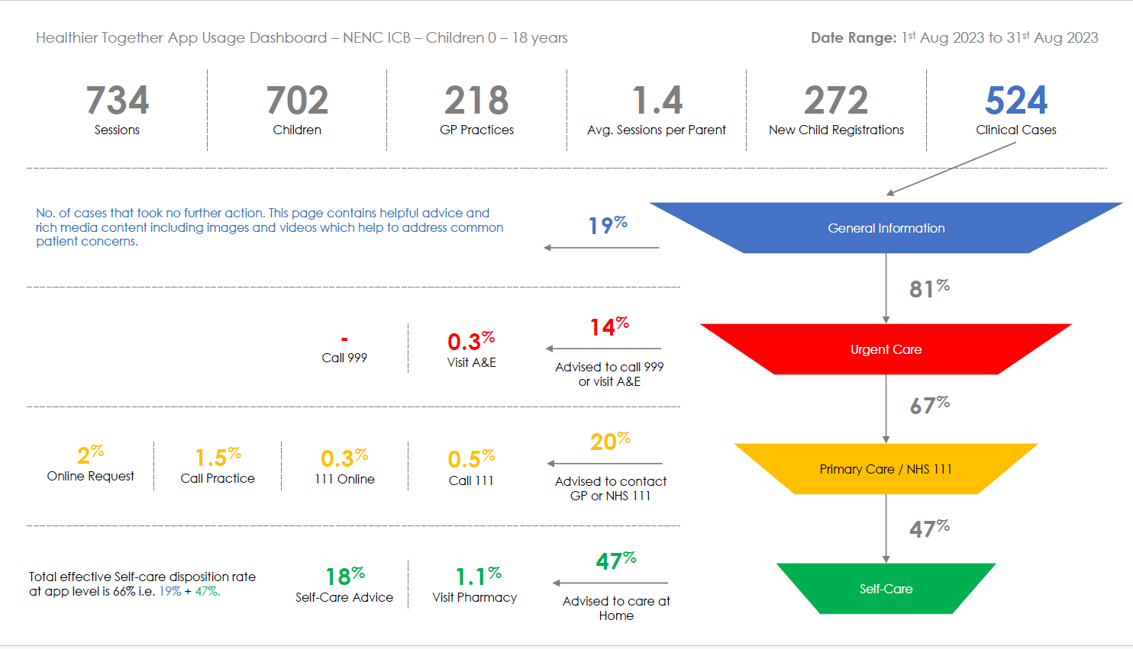
HT app usage
Over 5000 children registered on the app across 300 GP practices
28 practices now live with HT app
66% of App users directed to selfcare

Slide 56
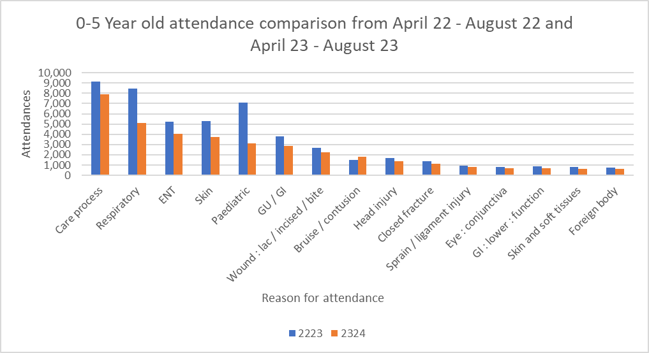
NENC A&E attendances

Slide 57
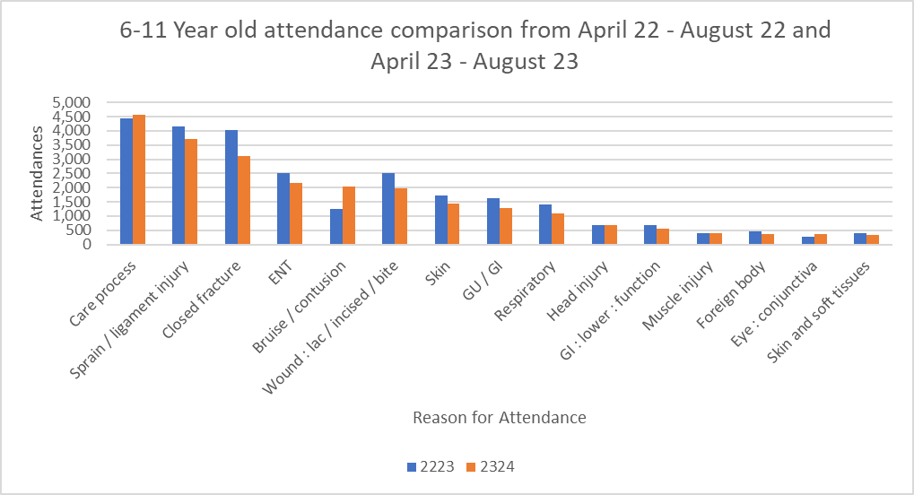

Slide 58
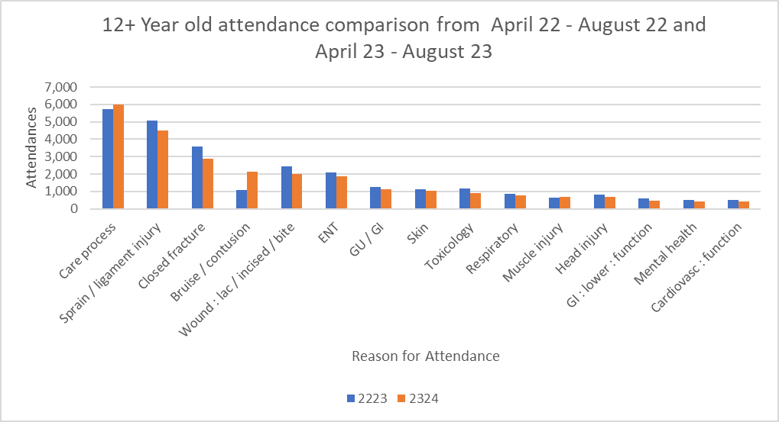

Slide 59
Healthier Together Champions Summary
Over 150 Healthier Together Champions trained from across 18 VSCE organisations.
Created a network of champions to promote Healthier Together in our underserved communities.
Reaching around 10,000 families.
Gained positive and negative feedback that allows us to adapt and shape the Healthier Together resource to ensure it meets the need of our families.

Slide 60
Healthier Together Resources
https://www.nenc-healthiertogether.nhs.uk/resources/promotional-material

Slide 61
What other resources do you feel we need?

Slide 62
Supporting feedback, case studies and evaluation

Slide 63
Question and Answer Session

Slide 64
Website link and social media !!
Healthier Together | Home (nenc-healthiertogether.nhs.uk)
Follow the project on social media
@HT_NENC on Twitter
HealthierTogetherNENC on Facebook.

Slide 65




Healthier Together
Our ask is for you to:
Download the Healthier Together app from your app store and familiarise yourself with it
Ask friends, family members, colleagues to download it too
Actively promote and signpost to the app and website with, organisations, individuals and communities you work with where it is appropriate.
If you would like any promotional materials to use within your organisation please email laura.cassidy8@nhs.net and we will arrange for them to be posted out to you.

Slide 66

Please follow, share and retweet relevant work so that we can continue to share good practice across the region at the Child Health and Wellbeing Network handle @EveryChildNENC
Visit our website - nhsjoinourjourney.org.uk/what-we-are-doing/priorities/optimising-health-services/child-health-and-wellbeing-network/
Please encourage colleagues from all areas of Child Health and Wellbeing to register via forms.gle/gG11zhr2Z8VLU2db9 so they are included in our communications and feed into the workplan projects that they are interested in.
Thank you
Stay in contact!
Contact us: england.northernchildnetwork@nhs.net

