Slide 1



Evaluation of the LEAP (Little Explorers And Parents & families) Pilot Project

Slide 2
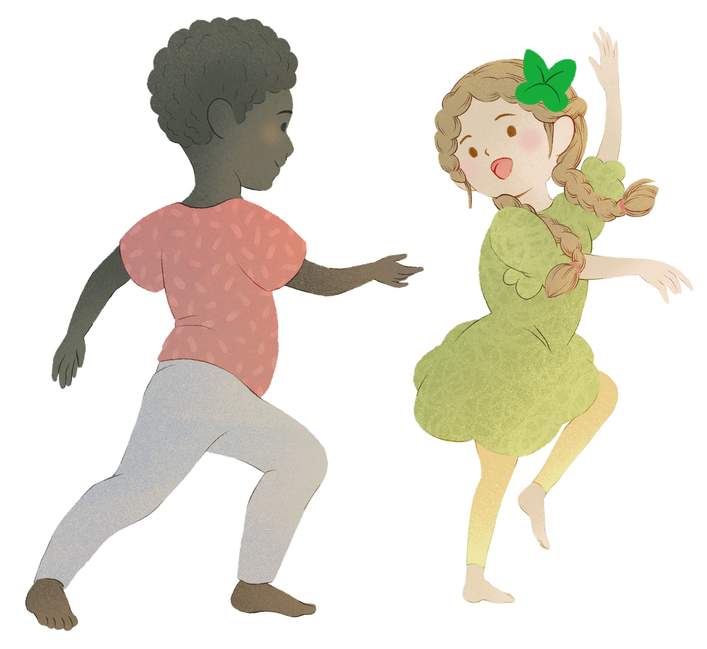
Background
Movement- and arts-based approaches provide important opportunities for child development
Research is needed to build the evidence base on use of these approaches in early years (EY) settings
Northern Ballet has delivered EY projects to introduce young children to dance since 2010

Slide 3

The LEAP pilot project
The LEAP (Little Explorers And Parents & families) project aims to offer an accessible way for pre-school children from disadvantaged areas to engage in movement, music, storytelling, and multisensory experiences
It was piloted in five EY settings across northern England
EY practitioners received online training and resources from Northern Ballet

Slide 4
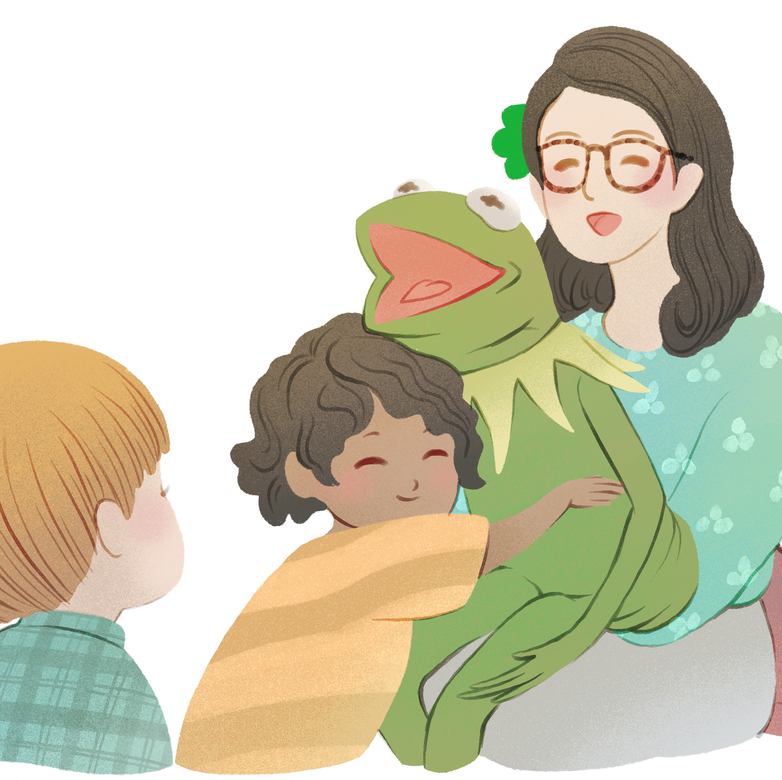
Evaluation methods
The evaluation aimed to gather insights on the project structure and its reported impacts
Flexible, qualitative approaches were used to gather the views of EY practitioners, parents/carers, and children from the five settings
Methods included remote, email and WhatsApp interviews, observations, and focus groups using photos and a hand puppet

Slide 5
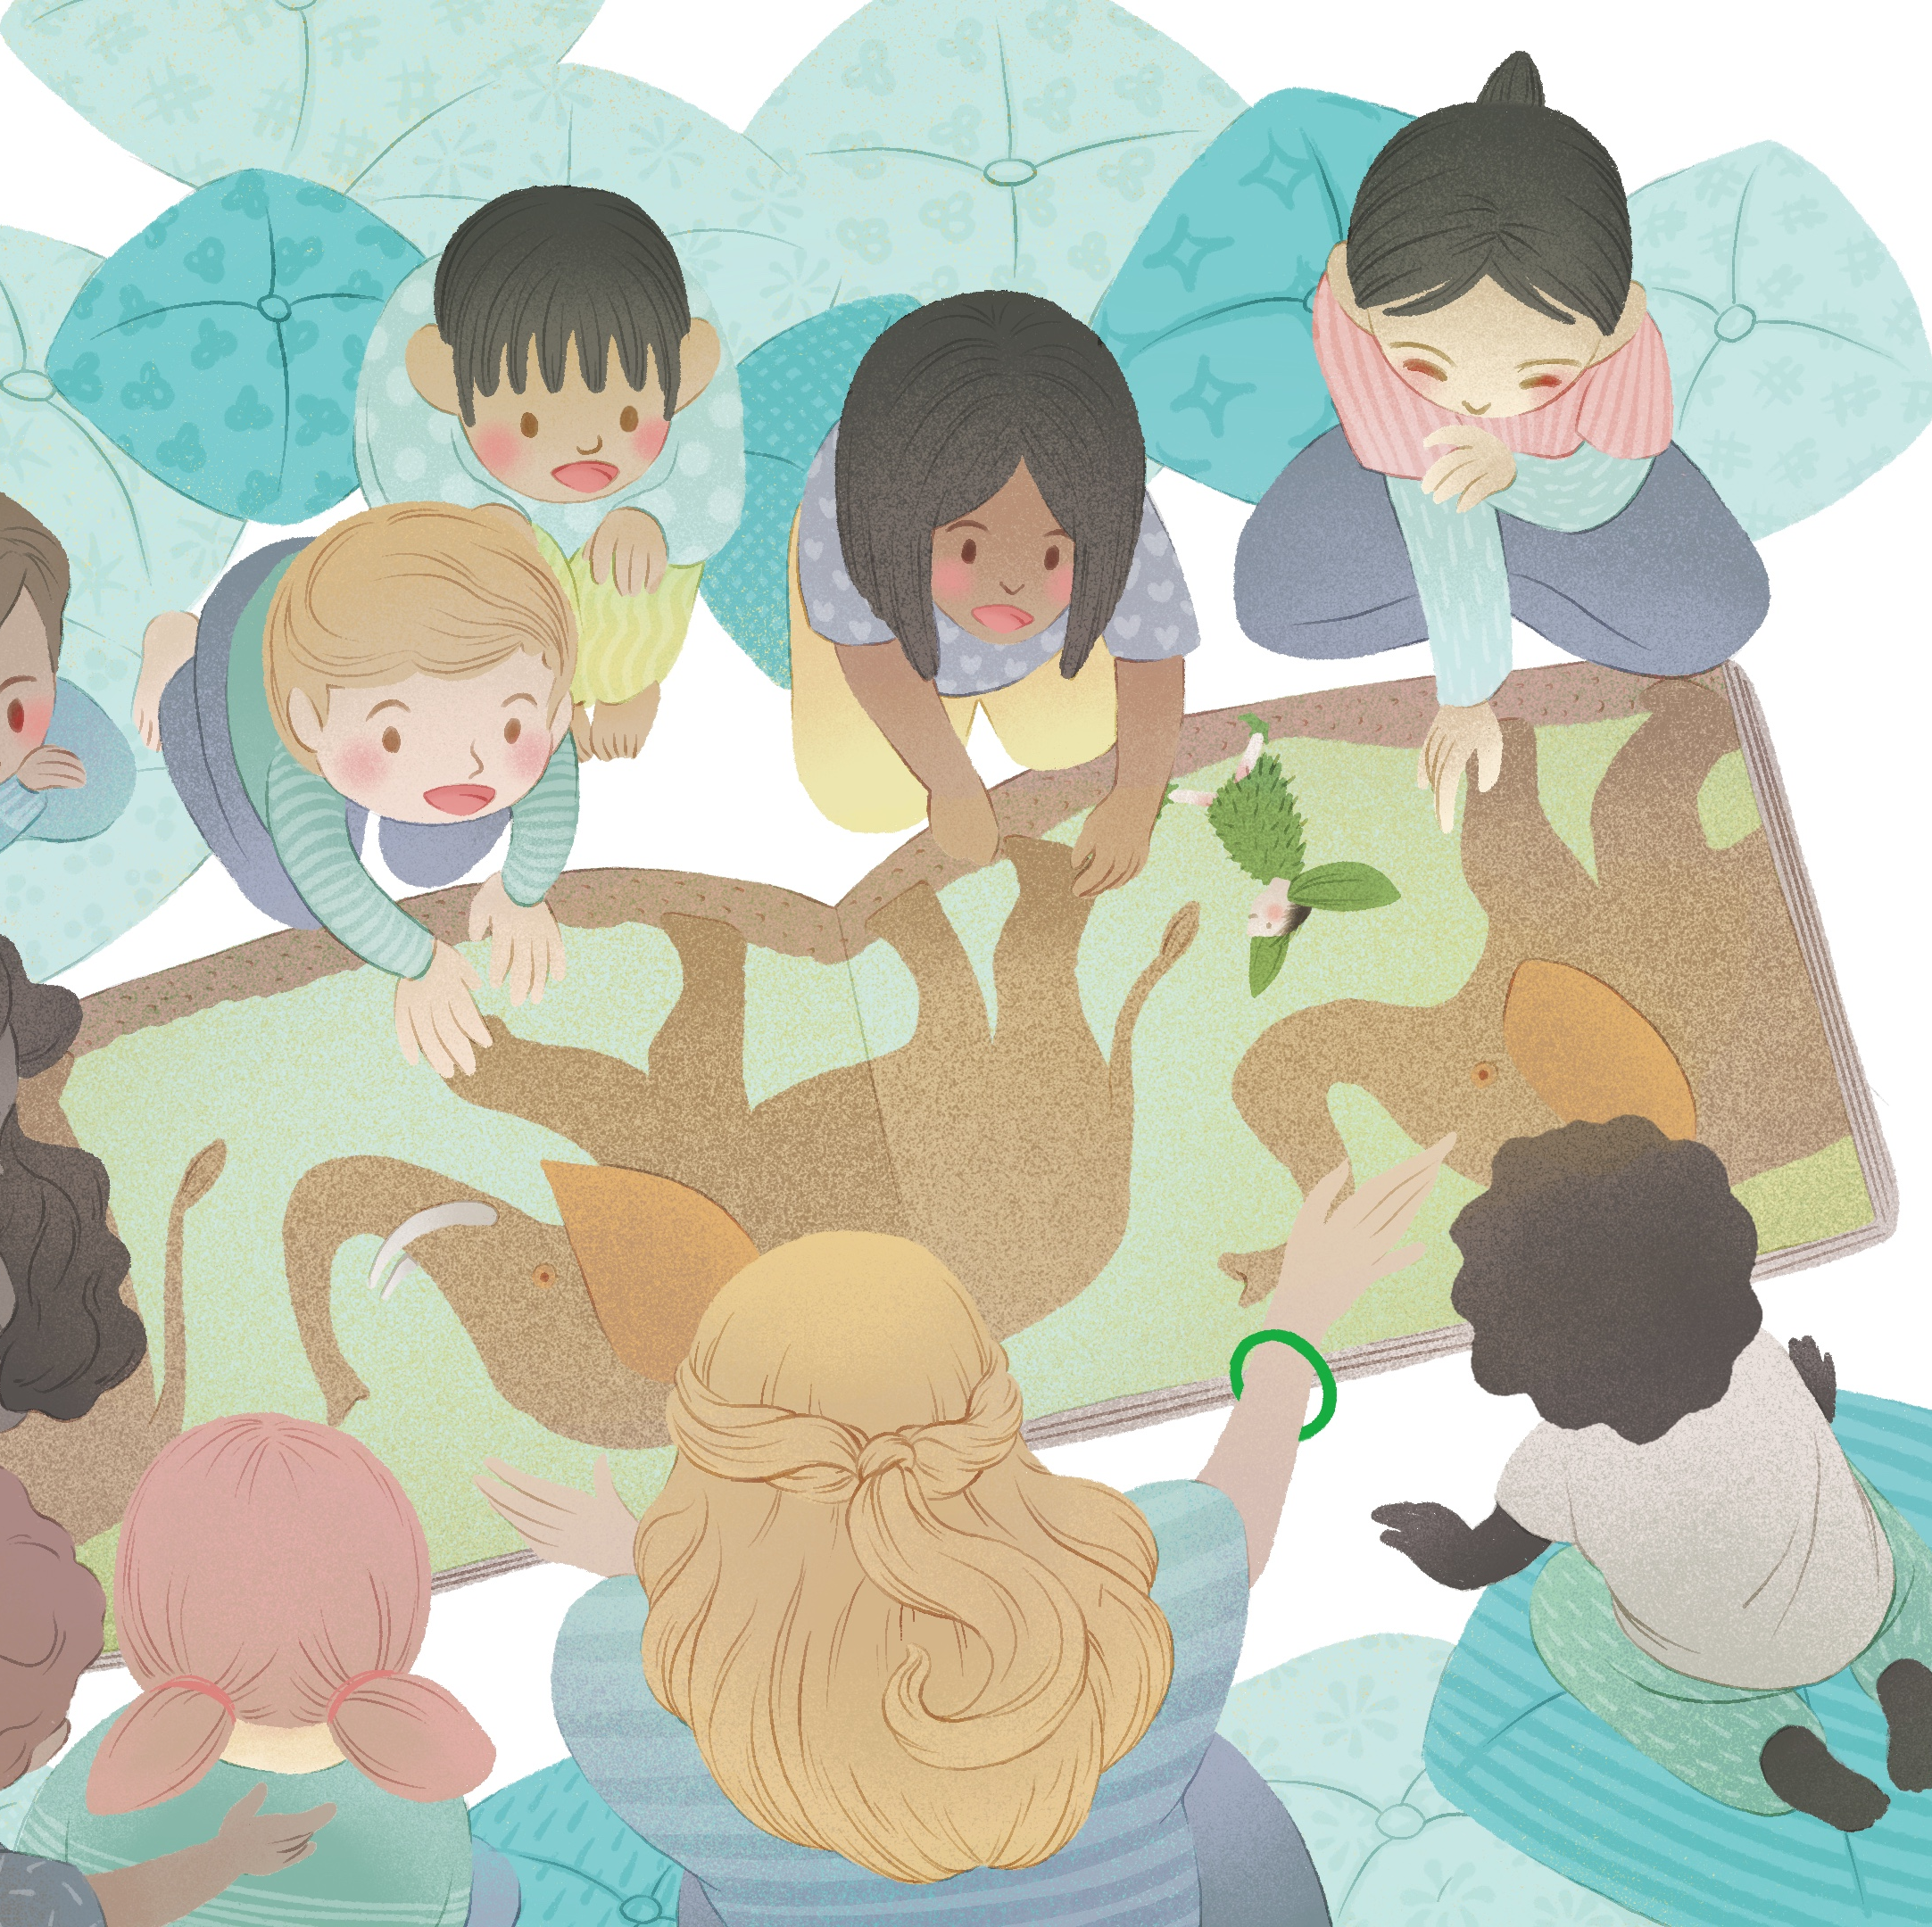
Enjoyment of the sessions
The project was described as fun for both the adults and children involved
It helped practitioners to build confidence and develop their skills
“I really enjoyed it. I think it did bring on my confidence […] But also, it gave me more ideas for when you read the story, not just to read it page-for-page. […] I’ve always tried to make it interactive, but nowhere near as interactive as it's meant to be. So it's given me quite a few good ideas to take back to the setting. (EY practitioner 1)

Slide 6
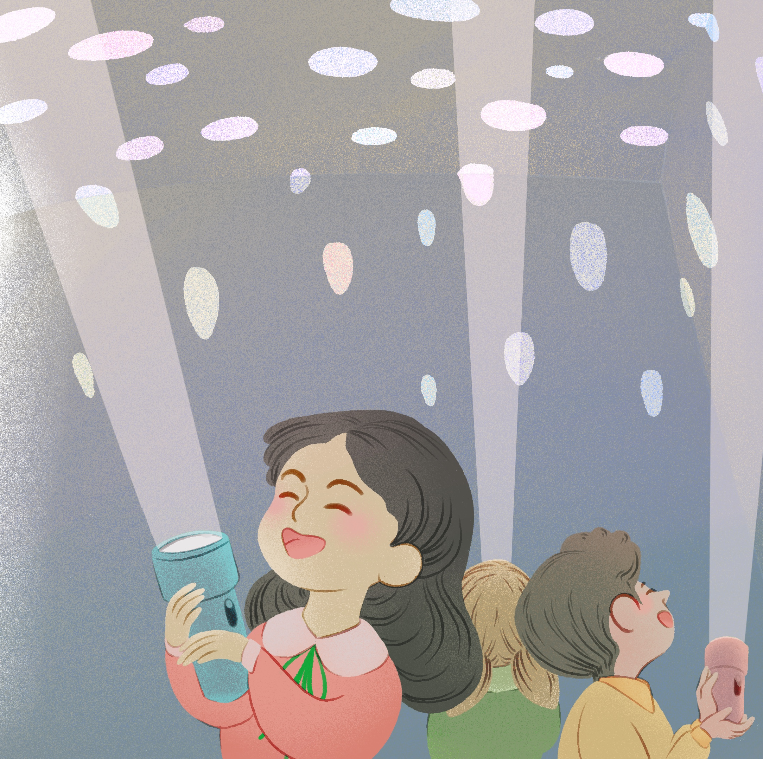
Variety of activities
A key strength of the project was the variety of activities involved, which meant there was generally something that appealed to each child
When asked what they did during the sessions, children listed the following activities: “We jumped”, “Dancing”, “Music”, “Reading stories”, “Followed shells”, and “Built dens with torches”

Slide 7
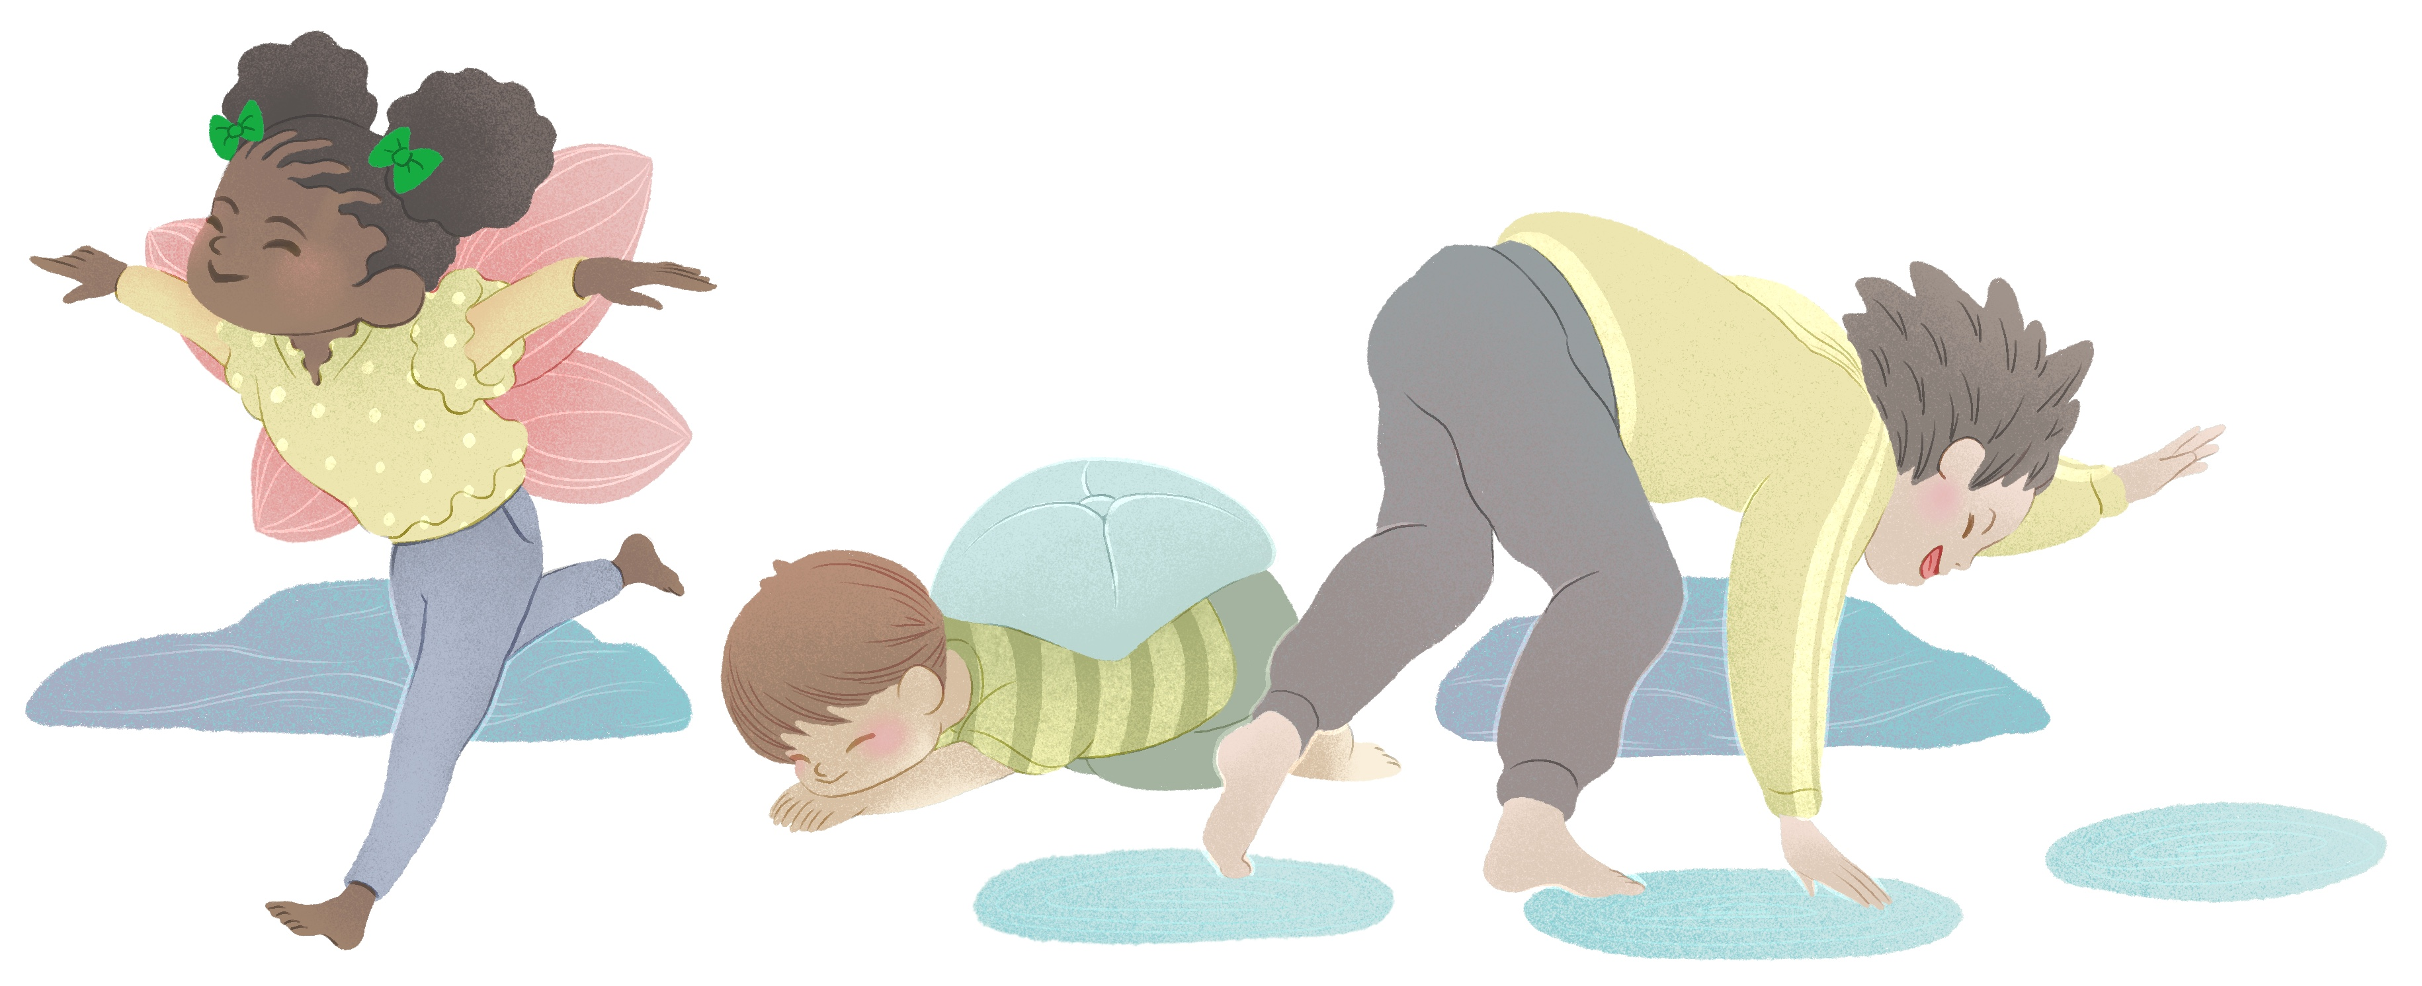
Multisensory experiences
“There was always a sensory activity too. And then we would usually jump back to another physical activity. But through all that as well, we were talking about the story and how it all links in together. Some of them now still talk to me about, “Can we be a turtle in the jungle?” It’s what I keep hearing. So they do love it.” (EY practitioner 1)

Slide 8
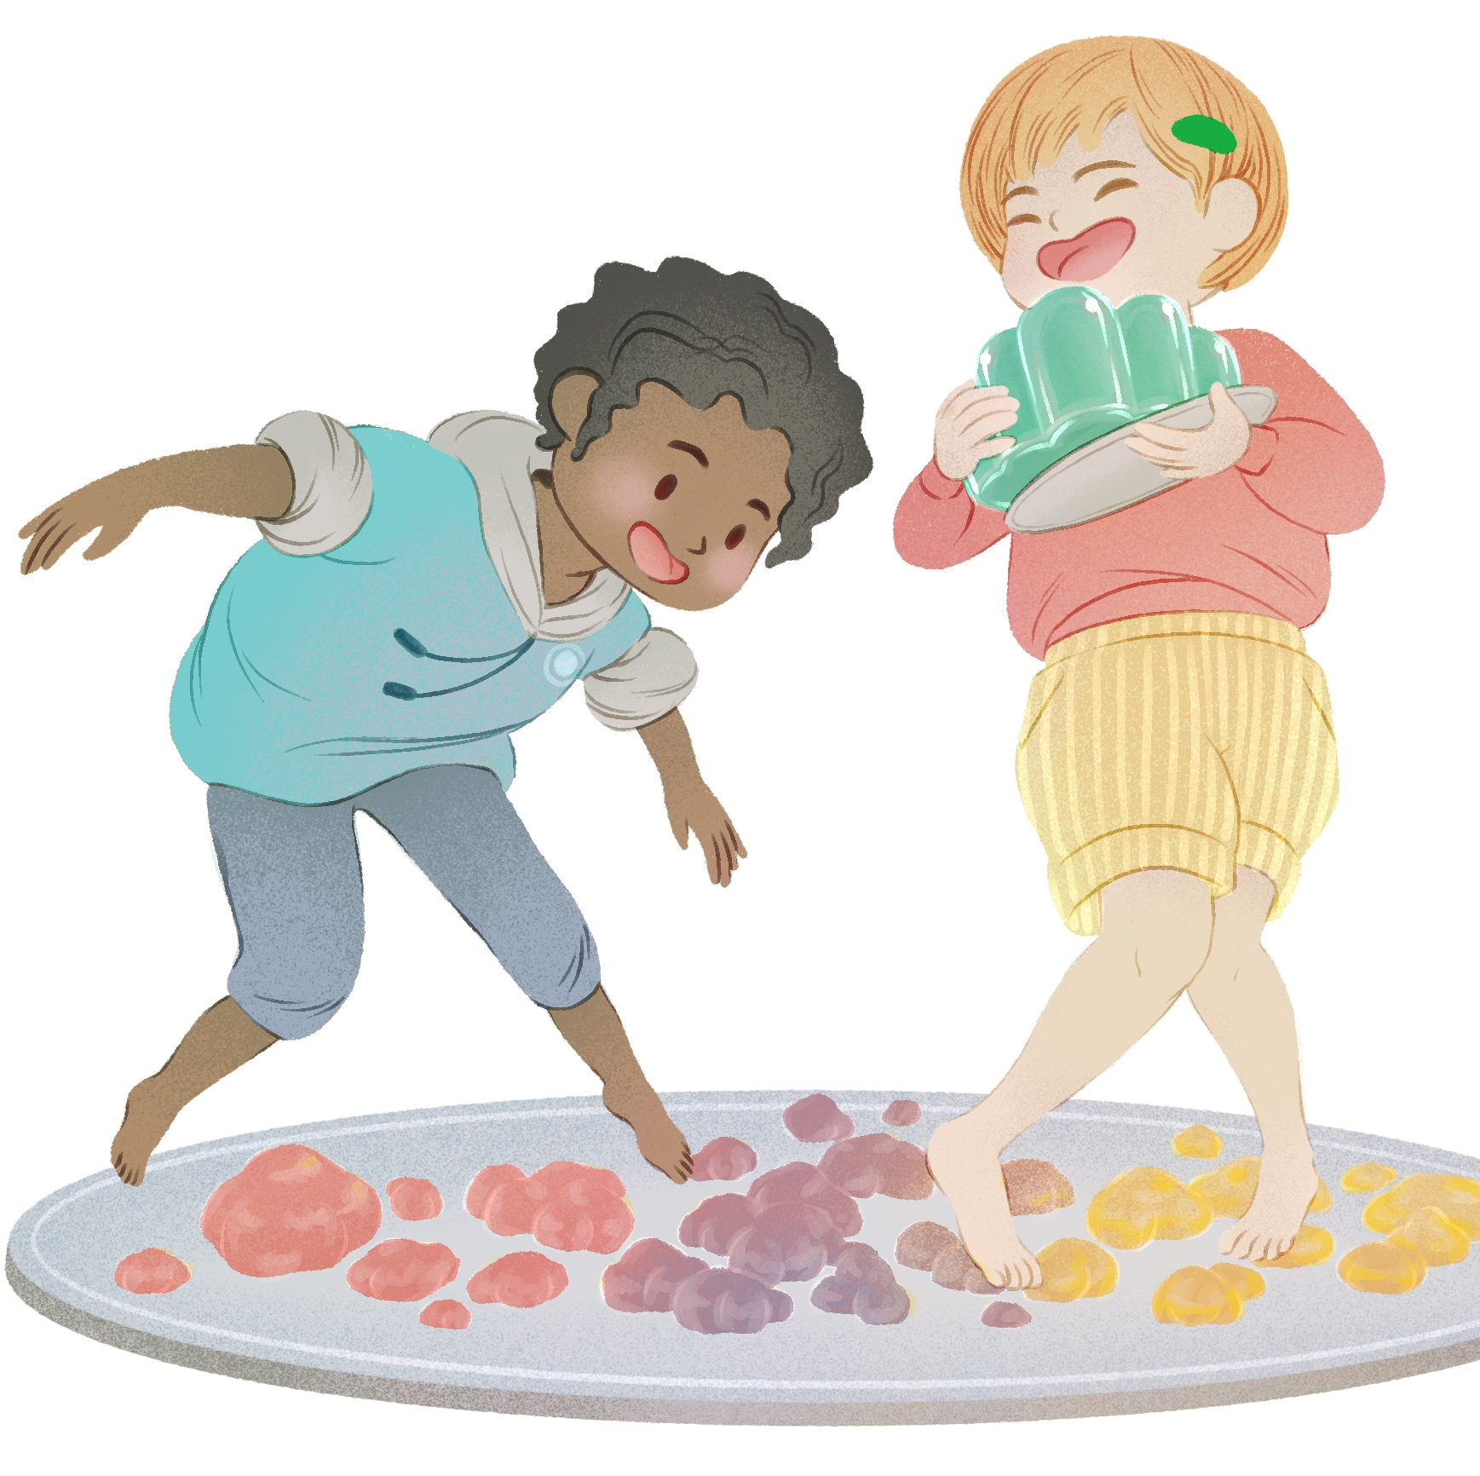
Child-led approach
The children were particularly enthusiastic about the sensory activities and said they would like to do more of these in future
When asked about their favourite parts of the project, some responded with “Playing with ice” and “Eating jelly”
Others recalled that “We were pretending jelly was jellyfish”

Slide 9
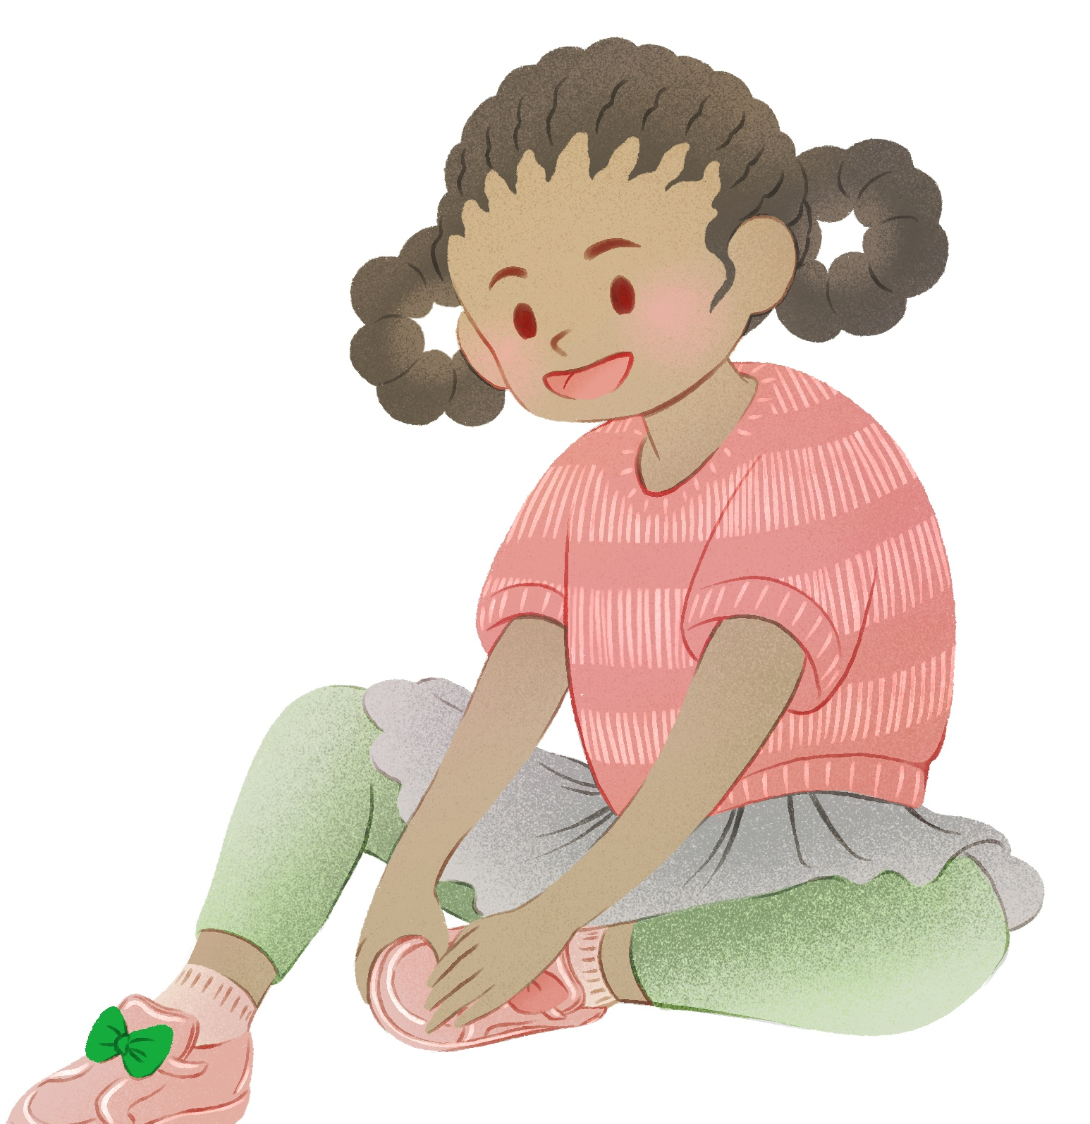
Fostering independence
The project was felt to have built confidence amongst the children
Practitioners were encouraged to incorporate suggestions from the children, which gave them a sense of ownership over the sessions
“Even to the basic level of, you know, starting the session by taking your socks and shoes off – I mean, that's an ideal one for school readiness for sort of like the PE sessions. And say, by the end of five weeks they were really independent at doing that, you know. (EY practitioner 3)

Slide 10
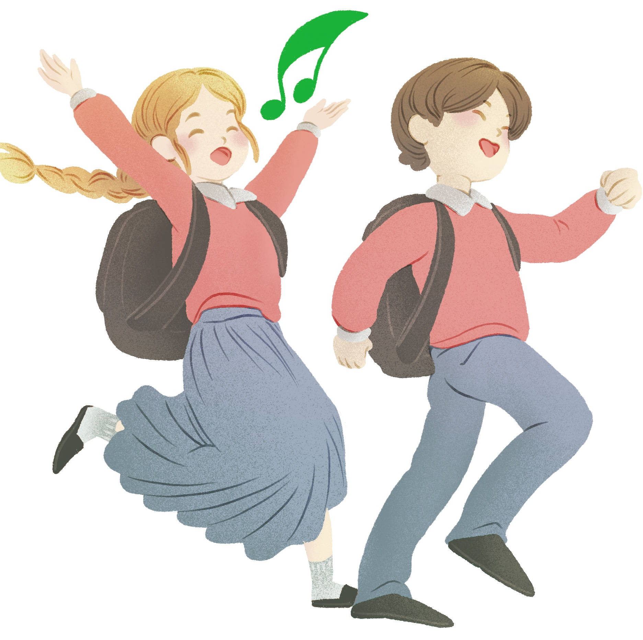
School readiness
The findings indicate that the LEAP project contributed to progress against each goal within the Early Years Foundation Stage Framework
This is particularly important in areas like North East England, as deprivation in a family doubles the risk of a child not being school ready
The movement-based approach particularly encourages the development of motor skills, which are strongly associated with the likelihood of achieving school readiness

Slide 11
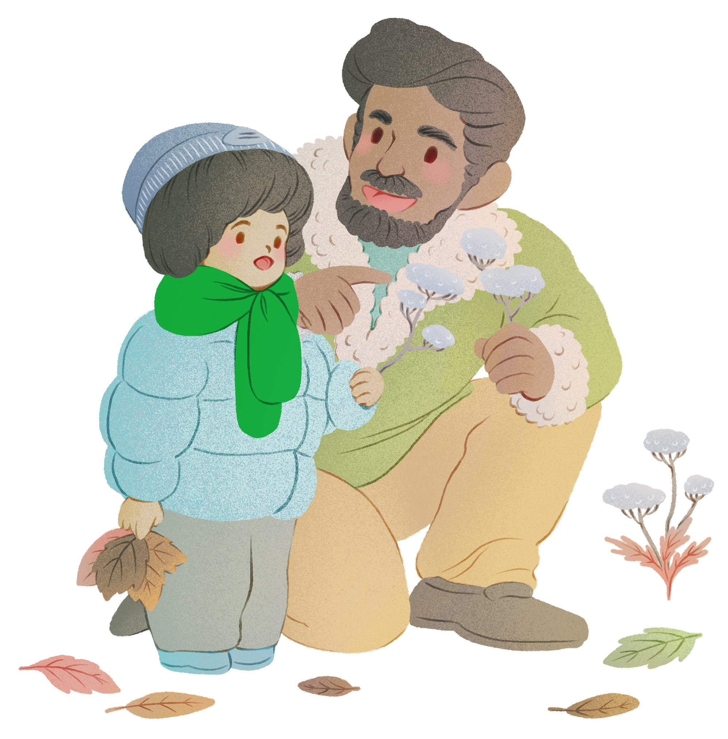
Recommendations
Build on what worked well about the pilot, e.g. adoption of a child-led approach; small group sessions; use of readily available resources
Promote the positive impacts of taking part, in terms of increased school readiness and children’s enjoyment of the sessions
Emphasise the benefits for EY practitioners not only in terms of the skills, knowledge and confidence gained, but also in terms of resources and ideas that can be used to enhance their everyday practice
Explore ways to engage parents/carers and families from all communities, recognising that they may not have the capacity, ability or interest to be actively involved in the way we anticipated

Slide 12
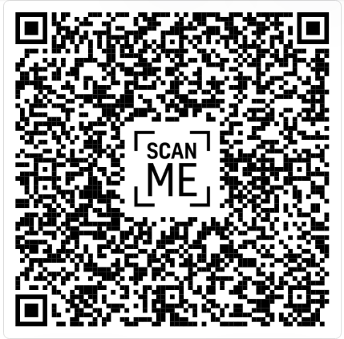

To find out more:
Download the evaluation report by using the QR code opposite or this URL: https://www.nenc-healthiertogether.nhs.uk/resources/child-health-and-wellbeing-network-chwn-shared-resources/arts-and-creativity/evaluation-leap-pilot-project
Contact The North East and North Cumbria Child Health and Wellbeing Network via nencicb.northernchildnetwork@nhs.net
The original artwork used in this presentation was sourced from www.CreativeConnection.co.uk and produced by the artist www.gorgonvelvet.com.

