Slide 1




Healthier Together NENC
Secondary School Age children
Emma Lim
Healthier Together Clinical Lead

Slide 2
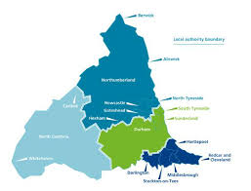

NENC Context
Children are c. 20% of our population (100% future)
Highest levels of child poverty in England
Reduced resource and capacity across healthcare workforce
Highest rates of childhood obesity in England
Highest rates of A&E attendances for 0–4-year-olds in England 22/23
Highest rates of asthma admission
Impact of pandemic
Equality Act - legal duty for programmes and organisations to make explicit consideration to age
  Overcoming Challenges
  Collaborative approaches with VCSE and Education to ensure reach into our most under-served communities
  Effectively using data to target high prevalence areas to maximise resources effectively
  System wide engagement to establish strong mutually beneficial relationships
  Upskilling front line workforce

Slide 3
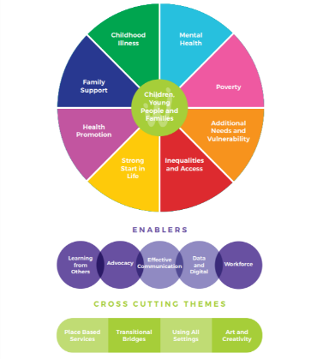
Network foundations and principles
Our shared vision
In the North East and North Cumbria we believe all children and young people should be given the opportunity to flourish and reach their potential, and be advantaged by organisations working together
What did the system want us to do
“Share good practice, drive work forward and connect us into experts and groups”

Slide 4


Network delivery and reach
Delivery Areas
- CYP Transformation programme, Integration and CEW pilots (NHSE)
  - Asthma, Epilepsy, Transition and Diabetes focus & Mental Health Champions and
  Paediatric Early Warning (PEW)
  - 2 Clinics for Excessive Weight pilots established
  - Integration Centre 3-year pilot – supportive environment to test and learn
- Delivered the Tackling Inequalities in Children Programme (NHS Charities Together)
  - Youth MH First Aid, Poverty Proofing, South Tees ARts (STAR), Digital Apprenticeship
- NENC specific CYP Core20PLUS5 Toolkit developed and launched (NHSE & H&F)
  - Work with Healthier and Fairer delivering the national framework oversight
  - Asylum seeking health work focus
- Developed a Sustainability Resource on Child Health
- Delivered an Interactive film on Mental Health and Young Parents
Notes:
Deliver the CYP Transformation & Integration programme (NHSE)
Asthma, Epilepsy, Transition and Diabetes focus
Mental Health Champions and Paediatric Early Warning (PEW)
2 CEW Clinic pilots established
13 schools accredited as Beat Asthma Friendly
Healthier Together - over 7,000 children registered
VCSE partnership model to embed initiatives into our most underserved communities – over 43 organisations involved (and 58 Education settings)
Asthma - Primary Care to Secondary Care and Secondary Care to Tertiary Care pathway downloaded 2918 times & L1 and L2 Elearning for Health Asthma Training accessed by 1261 people
NENC specific CYP Core20 Toolkit developed and launched (NHSE H&F)
Work with Healthier and Fairer delivering the national framework oversight
Asylum seeking health work focus
Delivered the Tackling Inequalities in Children Programme (NHS Charities Together)
Over 500 trained in Youth MH First Aid
Over 1000 children been part of STAR initiative
Supported Poverty Proofing in 8 settings including dental and oral health
Delivered a Sustainability Resource on Child Health
Delivered an Interactive film on MH and Young Parents

Slide 5
Outline
Introduction to Healthier Together
Acute conditions
  Sepsis
  Fits and faints
  Testicular torsion
Injuries
  Head injuries
  Minor injuries#
Teenage conditions
  Puberty
  To early/too late
Useful tip
  Young People’s Pages
  Alcohol
Q&A

Slide 6

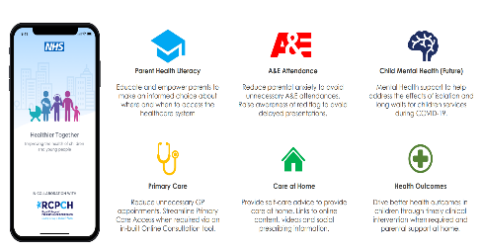
Healthier Together Website and Mobile App
Valued by both professionals and families alike as a platform to share information consistently across the whole healthcare system

Slide 7
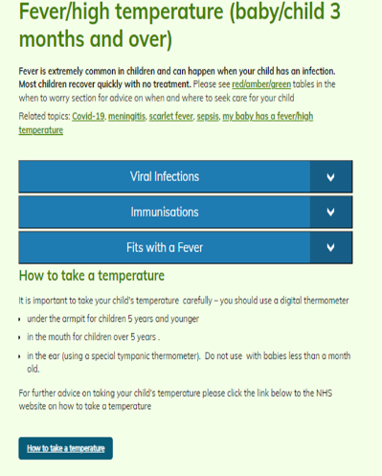
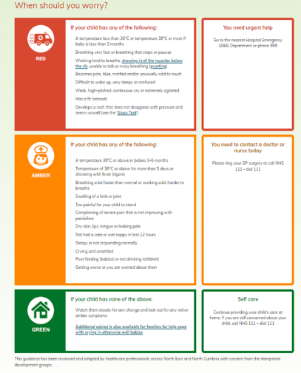
Traffic light system
Notes:
Reassure/empower parents
Reduce unnecessary PED attendance and encourage prompt attendance of sick children

Slide 8
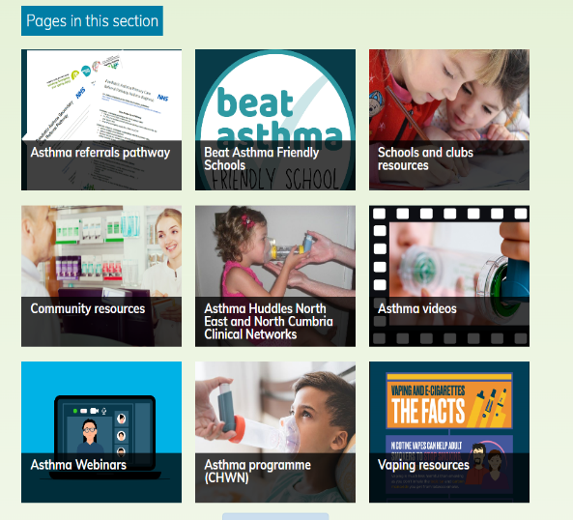
Professional Resources
Professional resources
Community resources
Webinars
Referral Pathways

Slide 9
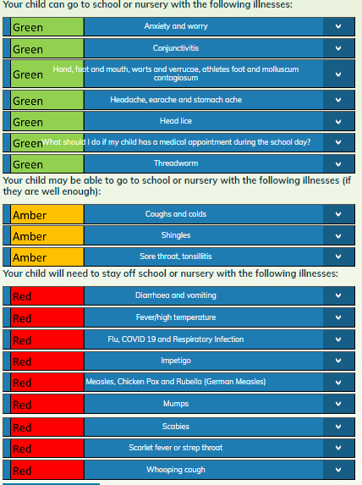

Slide 10

Sepsis in the Community (NHSE e learning module)

Slide 11
Red Flags
Unimmunised
Recent trauma/surgery/invasive procedure
Impaired immunity (from illness or drugs)
Chronic illness (neurodisability, chest disease)
Indwelling lines/catheter
Beware
Fever>5 days
Fever and abdominal pain
Swelling limb/joint
Parent or carer concern

Slide 12
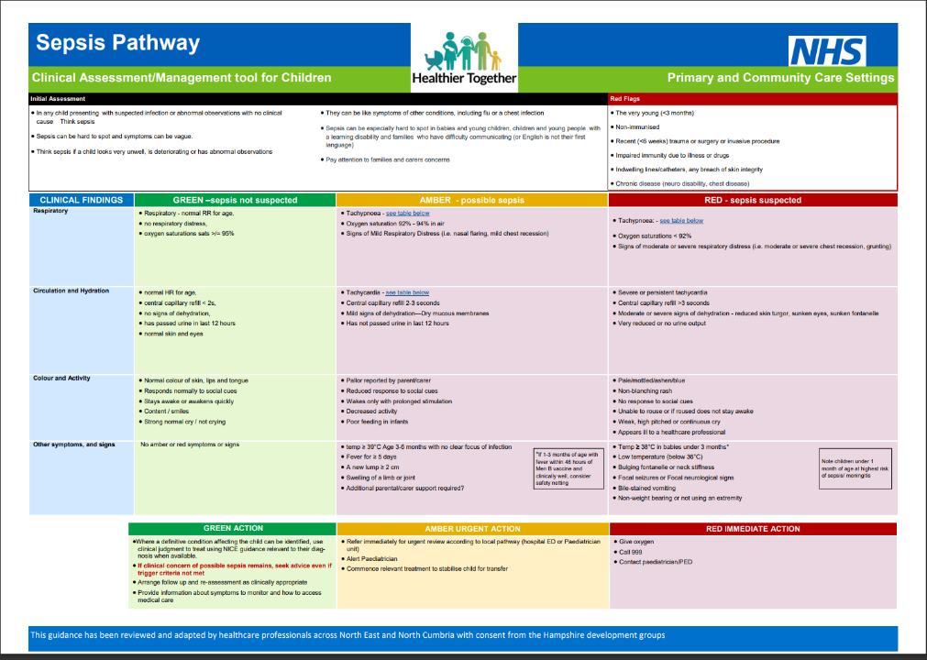

Slide 13

Fits, Faints and Funny turns
History
Examination
ECG

Slide 14
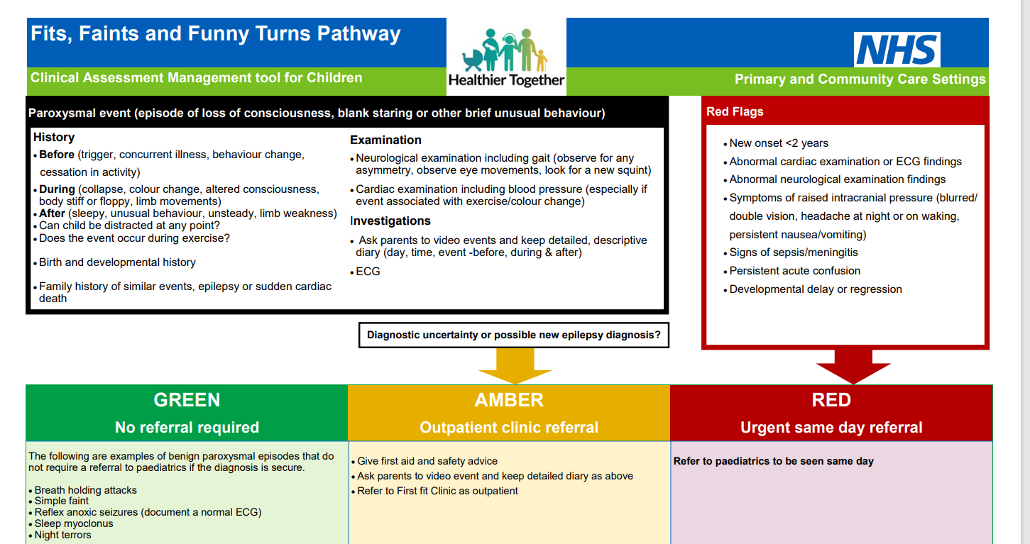

Slide 15

Notes:
Lancashire football podcast

Slide 16
What is testicular torsion?
Testicular torsion occurs when a testicle rotates, twisting the spermatic cord that supplies blood to the scrotum. This can severely reduce blood flow, leading to sudden, intense pain and swelling.
So, what are the findings of the NCEPOD report? Increase public awareness
65.7% of patients and 34.7% of parents/carers didn’t recognise the problem.
only 73% of patients presenting to a healthcare worker within six hours.
One systematic review of 1283 patients showed to have a chance of saving the testicle depended on time to operating
6 hours, you had a 97% success
18 hours dropped to 79.3% saved
>24 hours, salvage rate was just 18.1%.
Directing patients to hospitals where testicular torsion surgery can be undertaken will minimize the need for transfer and reduce the risk of delay to theatre.
Notes:
Ensure pathways to minimise the need for transfers
Not every hospital has the facilities, in terms of trained staff, to manage a child with testicular torsion. 63.6% of hospitals reported that they had to transfer patients, leading to delays in definitive care.

Slide 17
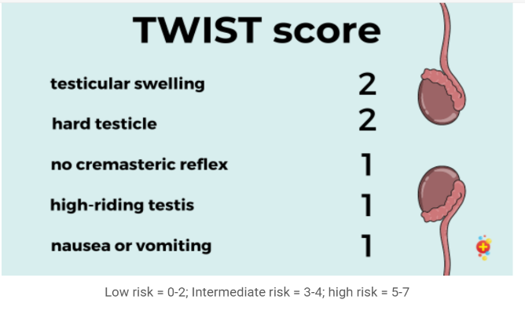
Testicular Torsion
11-18 year olds 1 in 800
6 hours to save the testicle
Presentations
Sudden onset of unilateral testicular pain
aching even on rest
Abdominal pain
Nausea and vomiting
Increased risk
Undescended testes
Child with neurodiversity
Low risk=home, intermediate=ultrasound, high risk=theatre

Slide 18
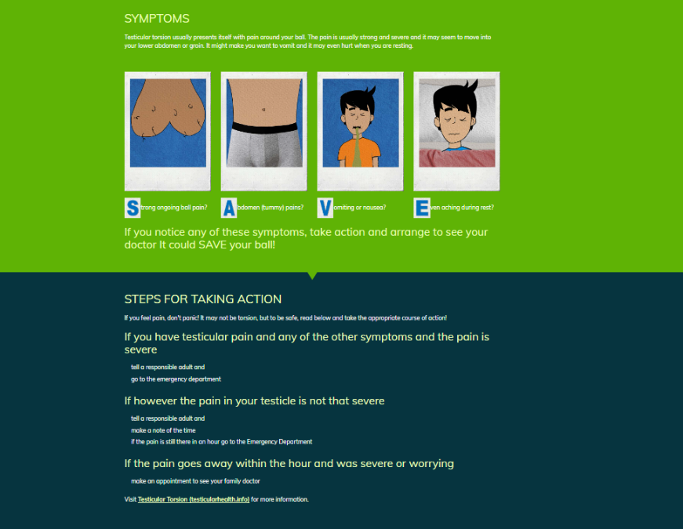

Slide 19
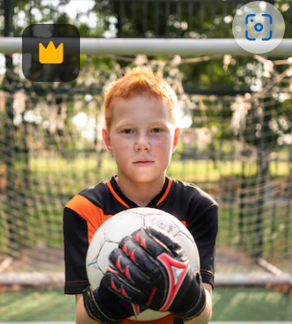
Head Injury and Concussion
Notes:
Continuing on the ball theme

Slide 20
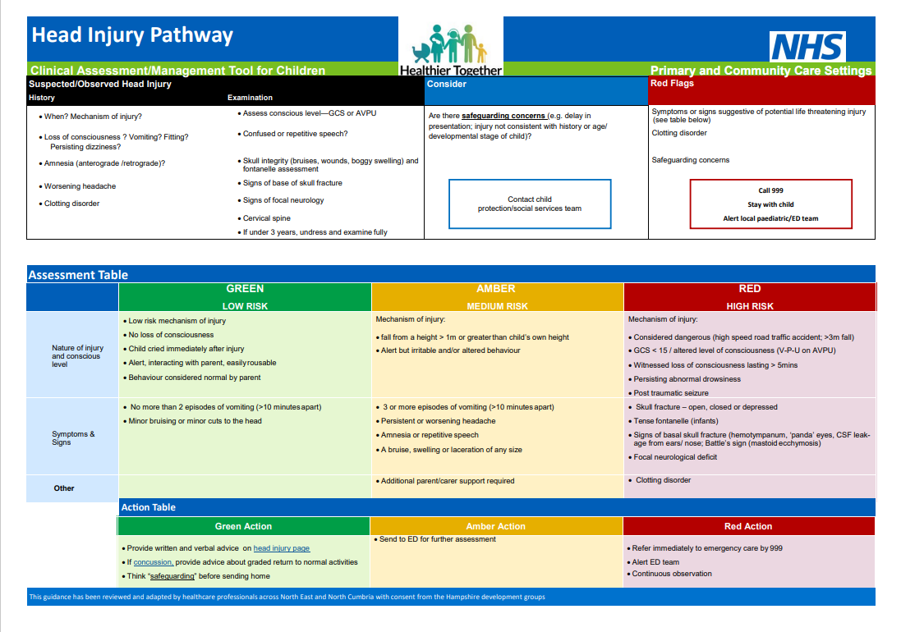

Slide 21
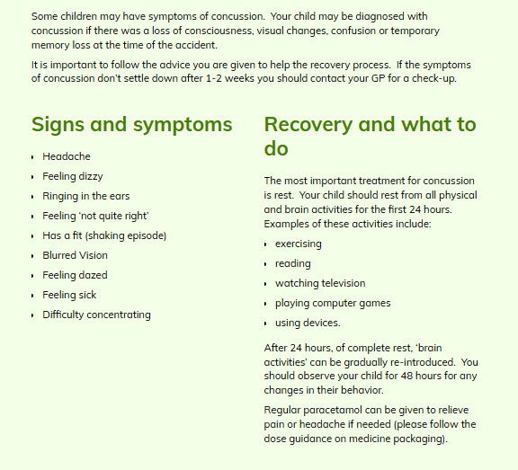

Slide 22
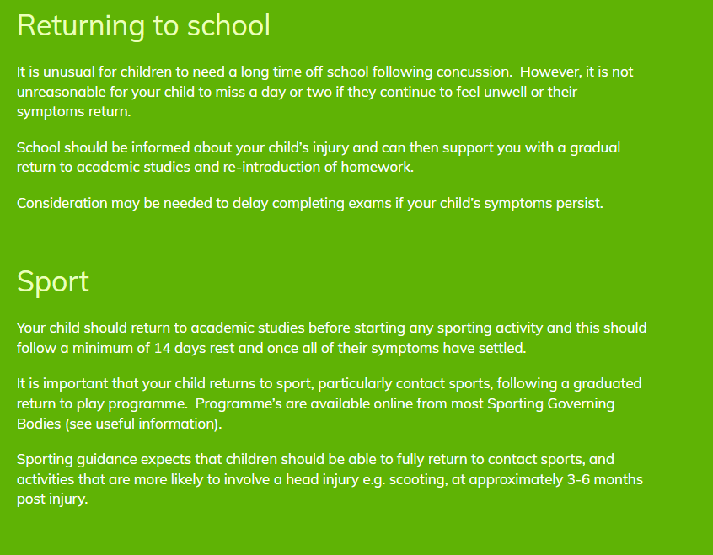

Slide 23
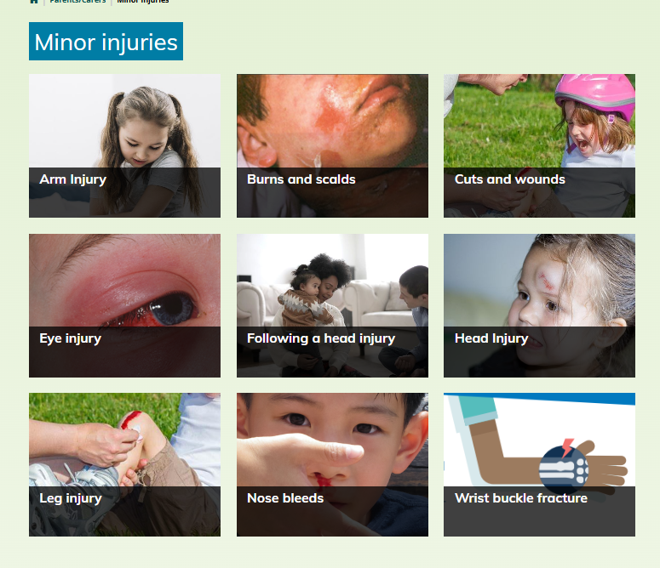

Slide 24
Eye injuries
How can you care for eye injuries at home?
Wash out the affected eye If the eye has been exposed to chemicals or fine particles
(Avoid if injury involved significant force or you can see any cuts to the eye itself)
Use clean water (not hot) – this can be from a tap, shower, or bottled water
Hold the eye open
Run lots of water over the eyeball for at least 20 minutes
Pain relief
Lightly cover the eye to prevent your child from rubbing it
Think prevention
Children who play sports should wear protective goggles or unbreakable glasses as needed.
Keep chemicals and other hazardous objects/products out of reach of children.
Supervise your child when they are playing with toys or Nerf guns.
Make sure your child has age-appropriate toys.
Make sure all safety equipment meets national standards.
Be wary of dogs that are not known to you.
Notes:
Eye balls!
Make sure the flow of water is not too strong.

Slide 25

Puberty

Slide 26
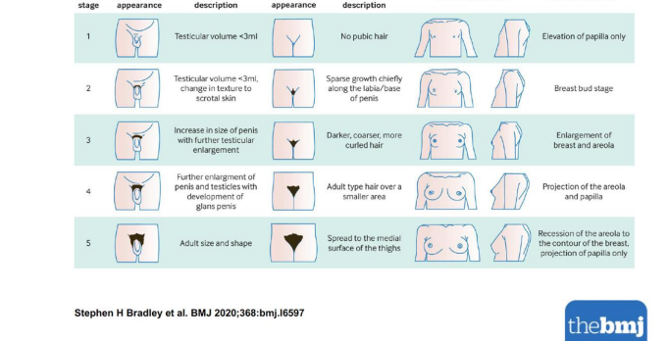
Notes:
Ball size (mls)

Slide 27

Size Matters
Notes:
Ball size

Slide 28
The first sign of puberty
In boys,
is an increase in the size of the testes to ≥4mls.
This is followed by an increase in penile size and pubic hair development.
The growth spurt associated with male puberty is later than in females and usually starts about 1 year after puberty begins
In girls,
breast bud development,
with pubic hair development beginning at around the same time.
The growth spurt in girls occurs early in puberty.
The average onset of menarche is 13 years,
Pubic hair can develop before the onset of puberty in boys and girls
because of adrenal androgen generation which typically starts prior to pubertal onset.

Slide 29
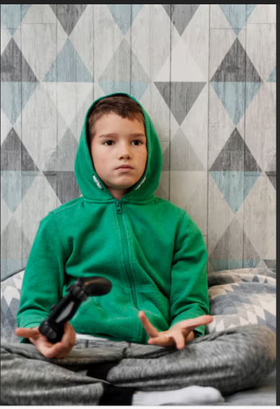
Puberty – it’s too late!

Slide 30
Delayed Puberty
History of presenting complaint:
• Assess stage of puberty using Tanner staging criteria
• has young person had a ‘growth spurt’ •
Clinical features of puberty
• Recent change or excessive exercise patterns, any recent weight loss
• Recent excessive tiredness / constipation/ cold intolerance / weight gain– could be suggestive of disorders such as hypothyroidism
• Symptoms that could be suggestive of tumours adjacent to the H-P axis – visual problems, headaches, confusion or personality change, polydipsia / polyuria

Slide 31
Constitutional delay of growth and puberty is common.
It accounts for approximately 90% of cases, particularly in boys.
It is likely to run in families, is transient, and puberty will start spontaneously.
Delayed puberty can also be caused by
external factors, such as chronic disease, excessive exercise, malnutrition and stress.
Other causes of delayed puberty can be grouped into central and peripheral causes:

Slide 32
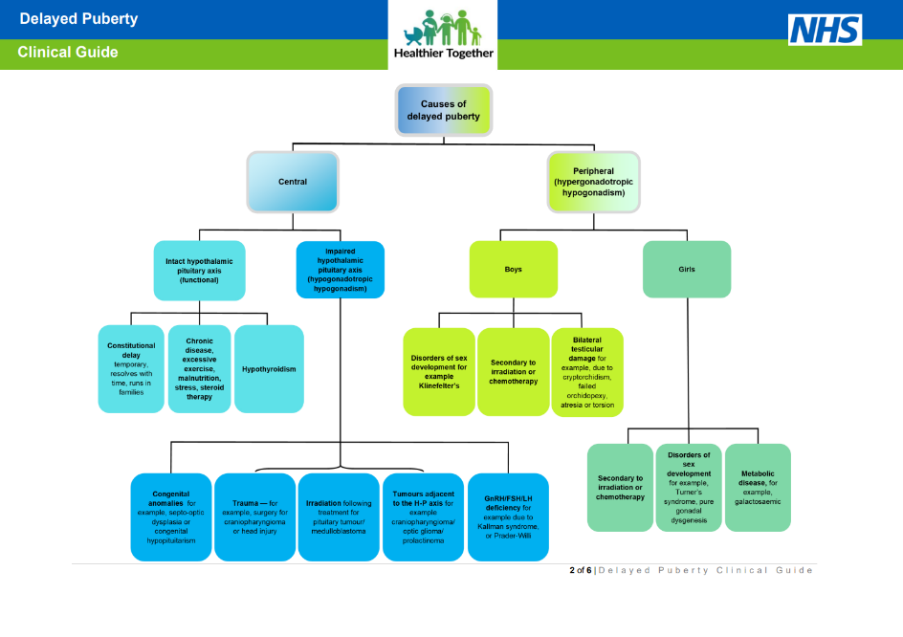

Slide 33

Puberty - it’s too early!
Notes:
Hair/body odour

Slide 34
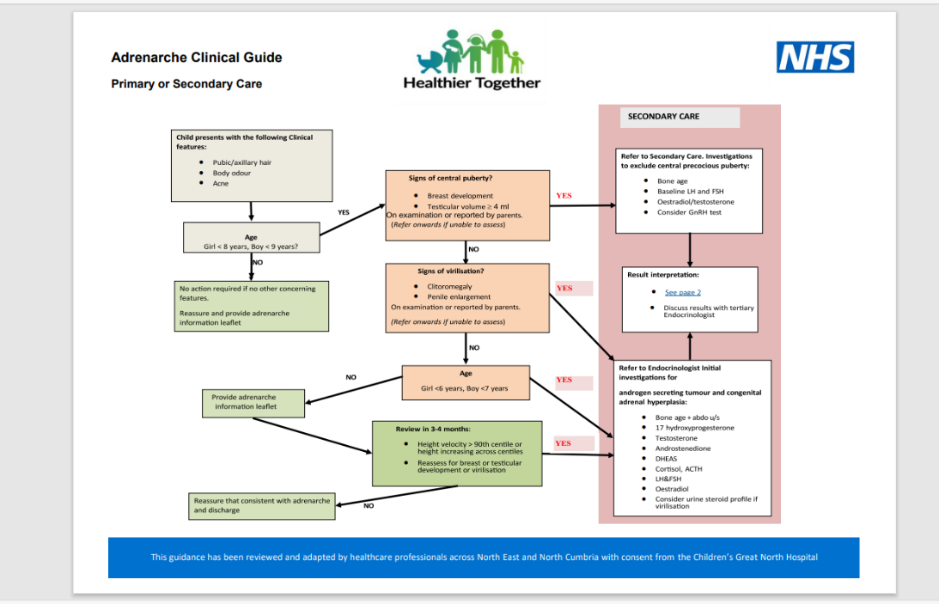

Slide 35


Slide 36

Notes:
What I worry about

Slide 37
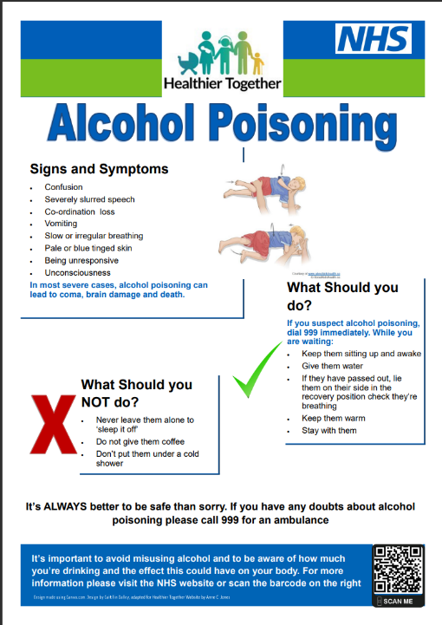

Slide 38

Notes:
What they worry about – low level problems bullying/skin

Slide 39

Notes:
Leave website quickly
Accessing reliable information

Slide 40
Summary
Healthier Together
Acute conditions
Sepsis look for red flags/parental concern
6 hours to save balls!
Fits and faints History, exam, ECG
Injuries
  Head injuries/concussion back to school/sport advice
  Eye injuries – when to wash
Puberty
when to refer/reassure
Young persons section
please use and promote

Slide 41
Any questions?
Thanks to
Laura Cassidy
Anne Jones
Alex Battersby images by freepik

Slide 42
Our Ask for support as a champion to
Embed Healthier Together into your day to day practice
Ensure Healthier Together website and app is promoted to parents and carers this winter and beyond as go to trusted resources.
Ensure parents and carers are supported to download the app
Share the Healthier Together resource with wider colleagues.

Slide 43
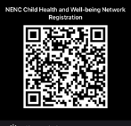
Stay in touch…
Please follow, share and retweet relevant work so that we can continue to share good practice across the region via the Child Health and Wellbeing Network Twitter @EveryChildNENC
Visit our website: https://northeastnorthcumbria.nhs.uk/our-work/workstreams/optimising-services/child-health-and-wellbeing-network/
Please encourage colleagues from all areas of Child Health and Wellbeing to register via forms.gle/gG11zhr2Z8VLU2db9 so they are included in our communications and feed into the workplan projects that they are interested in.
Please fill in this short form to let us know how you facilitate engagement, participation and 'CYP voice' activity, and connect with us
Complete this short form to register your professional network/group and create more connections
Join our Network
Contact us: nencicb.northernchildnetwork@nhs.net

Slide 44


